Slide 1

SHAREMED
Sharing and enhancing capabilities to address environmental threats in the Mediterranean sea
Coordinator: Cosimo Solidoro - OGS
Programme co-financed by the
European Regional Development Fund
Programme cofinancé par le Fonds
européen de développement régional

Slide 2
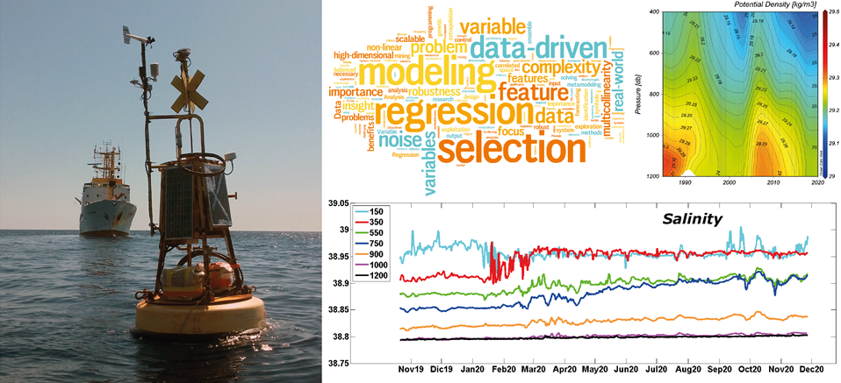
SHAREMED strat project
GOAL:
increase the capability of regional, subregional, and local authorities and of research community to
assess and address hazards related to pollution and environmental threats in Mediterranean transnational waters
HOW:
- enhancing, observing & assessing capabilities
- sharing knowledge, observation and technologies
- building common frameworks, tools and services
- roadmap and action plans

Slide 3
3 types of target groups and stakeholders by 3 spatial scales (med, study site, local)
A Stakeholders needing observing & assessing capabilities
B Institutions already managing observing infrastructured and willing to share and exchange (includes local and regional authorities and organizations in charge of environmental threats, i.e. those offering the services)
C Experts able to provide suggestion/ knowledge /practice on how to enhance obs & assess capabilities (includes scientific community, i.e. advicing)

Slide 4
SHAREMED challenge
- to design a transnational system of systems for observing and assessing
- to test its implementation in several test area
not really new:
but how come it is still to be done ???
technological challenge (scientific community)
governance challenge (?who should be in charge? )

Slide 5
ENHANCE OBSERVING CAPABILITIES
NETWORK of transnational systems of HF radar for surface current; harmonization; data assimilation
Biological dimension : visual observation & molecular methods (eDNA & metabarcoding)
New high resolutions satellite products
Relocatable high res phy & biogeochemical short term forecast systems
Notes:
This will enhance the capability to produce and deliver coherent and jointly produced assessments on important issues like pollution (marine litter), changes in trophic regimes (eutrophication/oligotrophication), weather/climate change (marine heat waves, warming, acidification), as well as, increasing the possibility to find access and use existing data and information on those issues, serving the needs of national responsible entities, stakeholders and a range of users

Slide 6
Can one really integrate systems managed by different authorities?
(harmonize agenda & aling objective; share ownerships)
multi-scale
multi-goal
m-purpouse

Slide 7
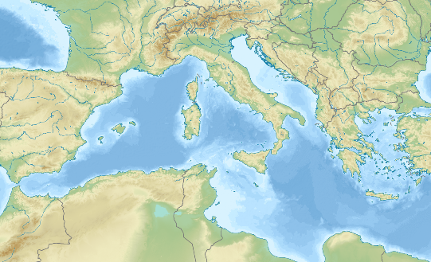
SHAREMED Action sites
three transnational sites:
NorthAdriatic , NorthWestMeD,
Sicily Channel
plus Mediterranean scale
NAdr
NWMed
SCh
FRAMEWORKS for sharing, consolidation, integration, harmonization of existing information, data, technology, infrastructure and expertise
DESIGN transnational systems of observing systems and marine modelling frameworks, build and implemented for each site
> Shared monitoring capabilities
> Shared operational models
> Shared webportals > Shared Atlas

Slide 8
SHAREMED
Enhance and expand monitoring capabilities (WP 3.3)
Development of a strategy to acquire time series of organic and inorganic contaminants
The objective is to test the strategy of measuring time series of contaminants and develop a specific and adapted protocol as part of improvement of new observation technologies and make them ready for operational use
Rhône mouth and Gulf of Fos

Slide 9
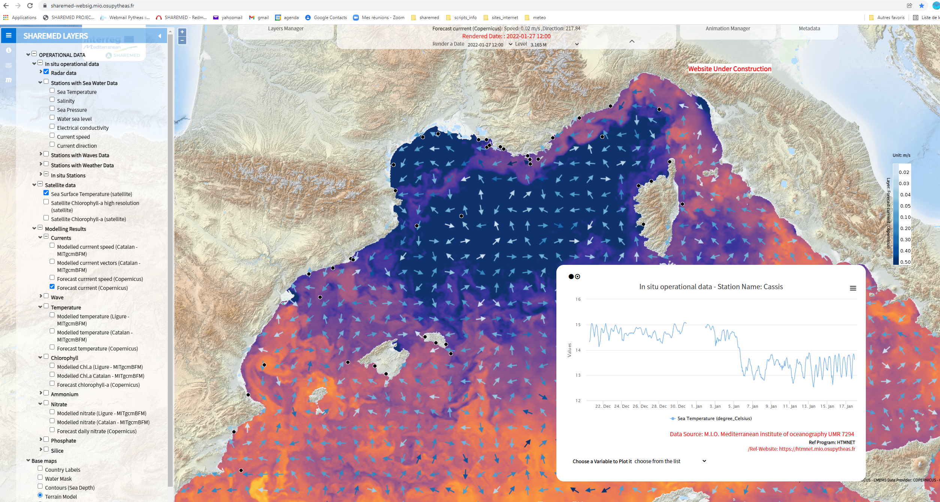
SHAREMED: North-west Med, Adratic, Sicily channels
https://sharemed-websig.mio.osupytheas.fr/
To develop a webGIS in order to visualize marine operational data (with simple and intuitive interface)
To add results from SHAREMED modelling activities on NWMED
To add maps from the SHAREMED Atlas activities
Near-real time data from in situ marine buoys
Currents from coastal radar-HF
Near-real time satellite products
Simulations outputs from forecast models, including SHAREMED models

Slide 10
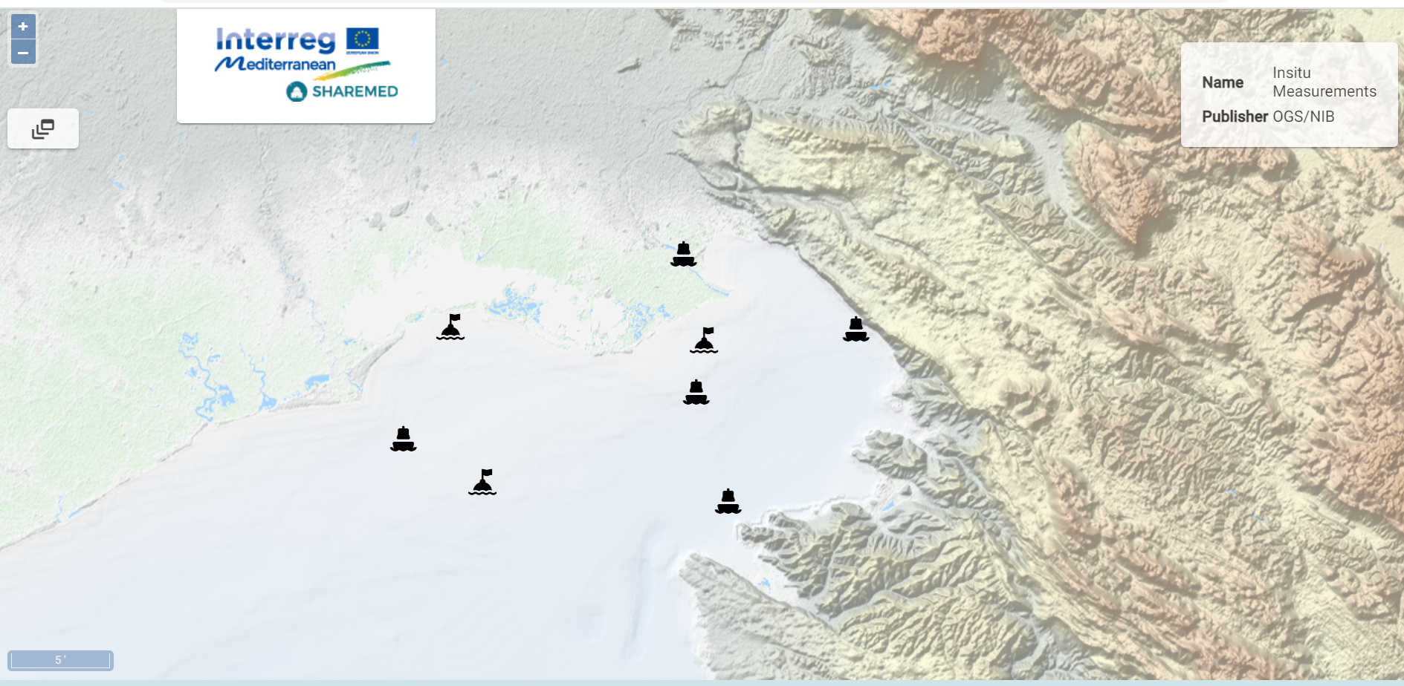
SHAREMED Northern Adriatic – Study Site
https://sharemed-northadriatic-geoportal.ogs.it/
Layer available:
Insitu reat time data
Model
HF Radar maps
Satellite product maps

Slide 11

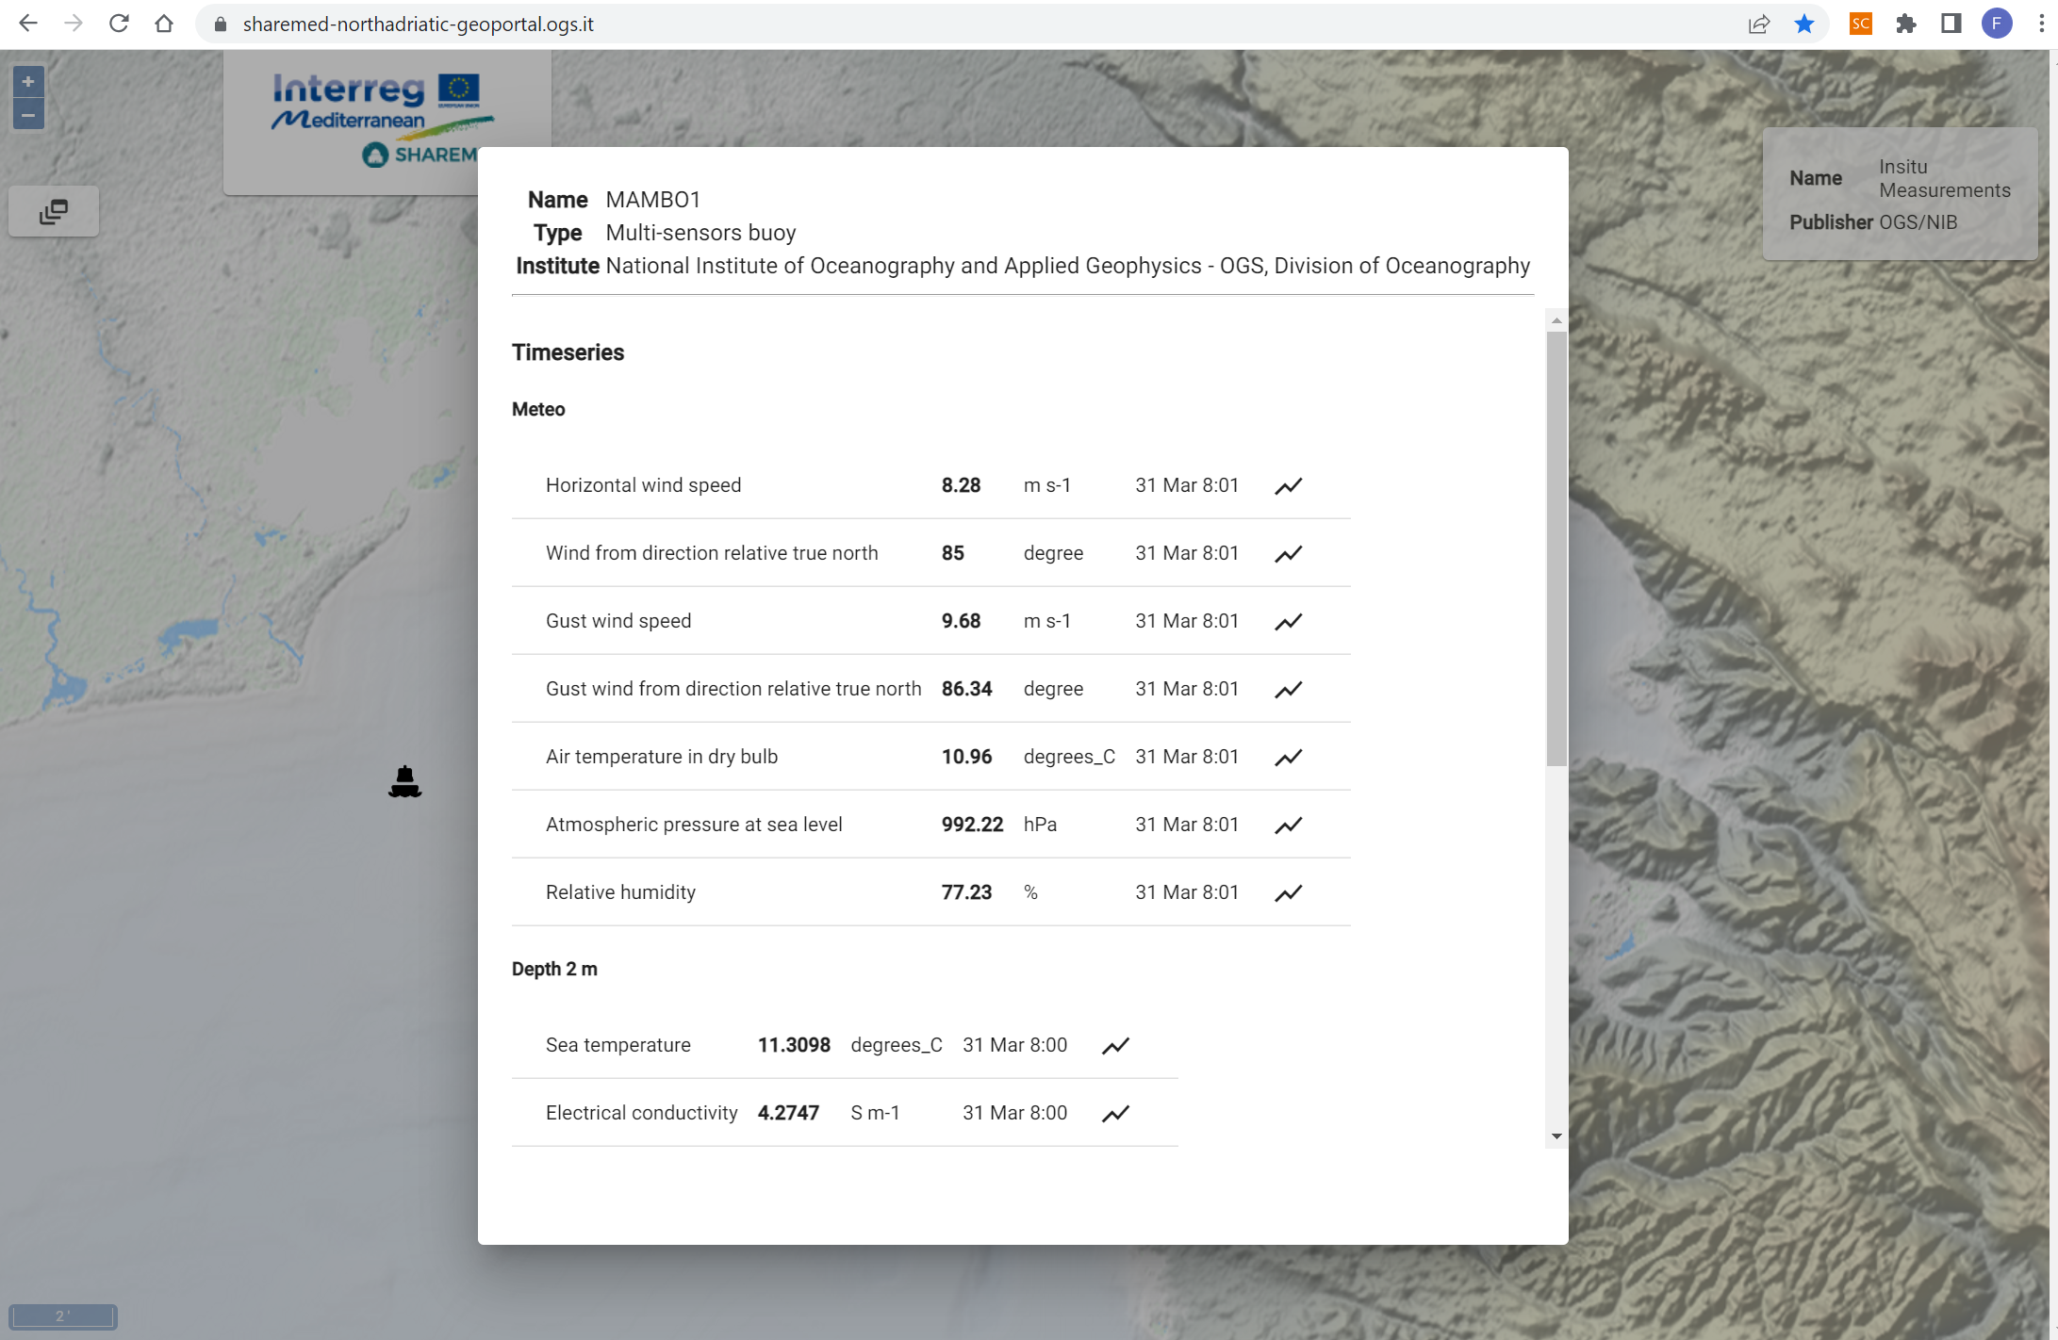
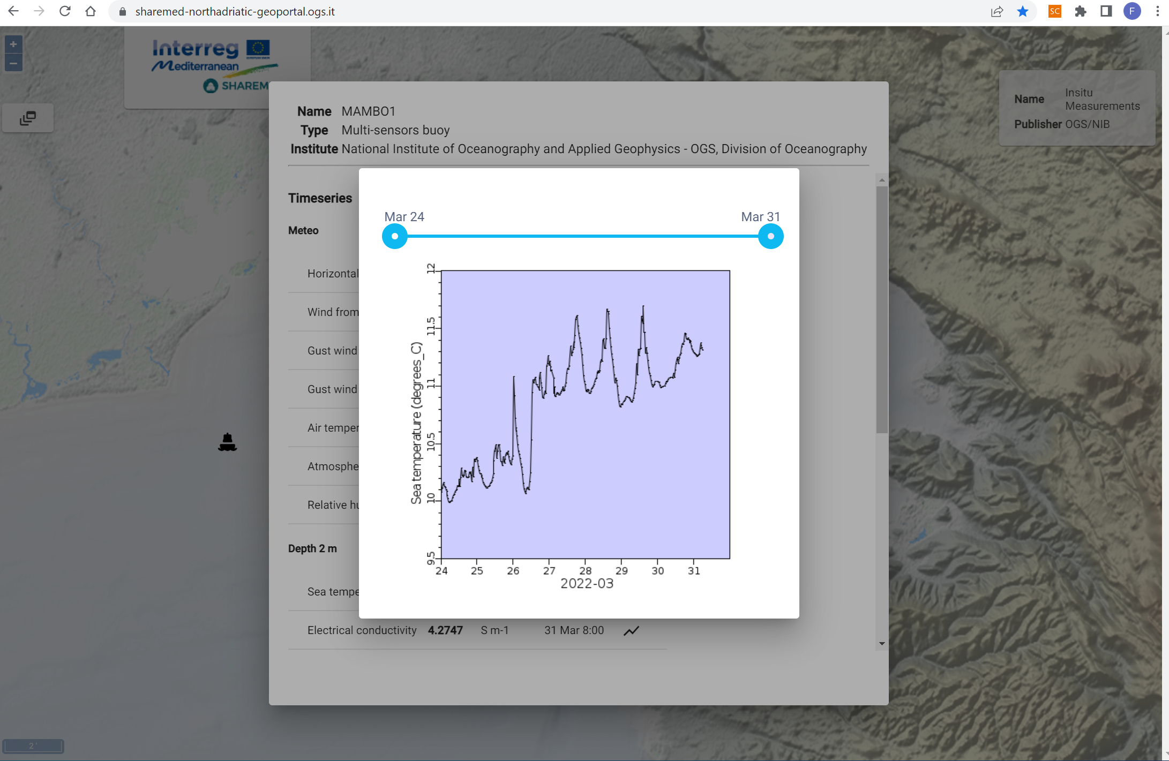
SHAREMED Northern Adriatic – Study Site
The Northern Adriatic – Geoportal
In situ measurements
Time series sea temperature (last week) from MAMBO1 - Miramare
Latest data acquired from MAMBO1 - Miramare

Slide 12
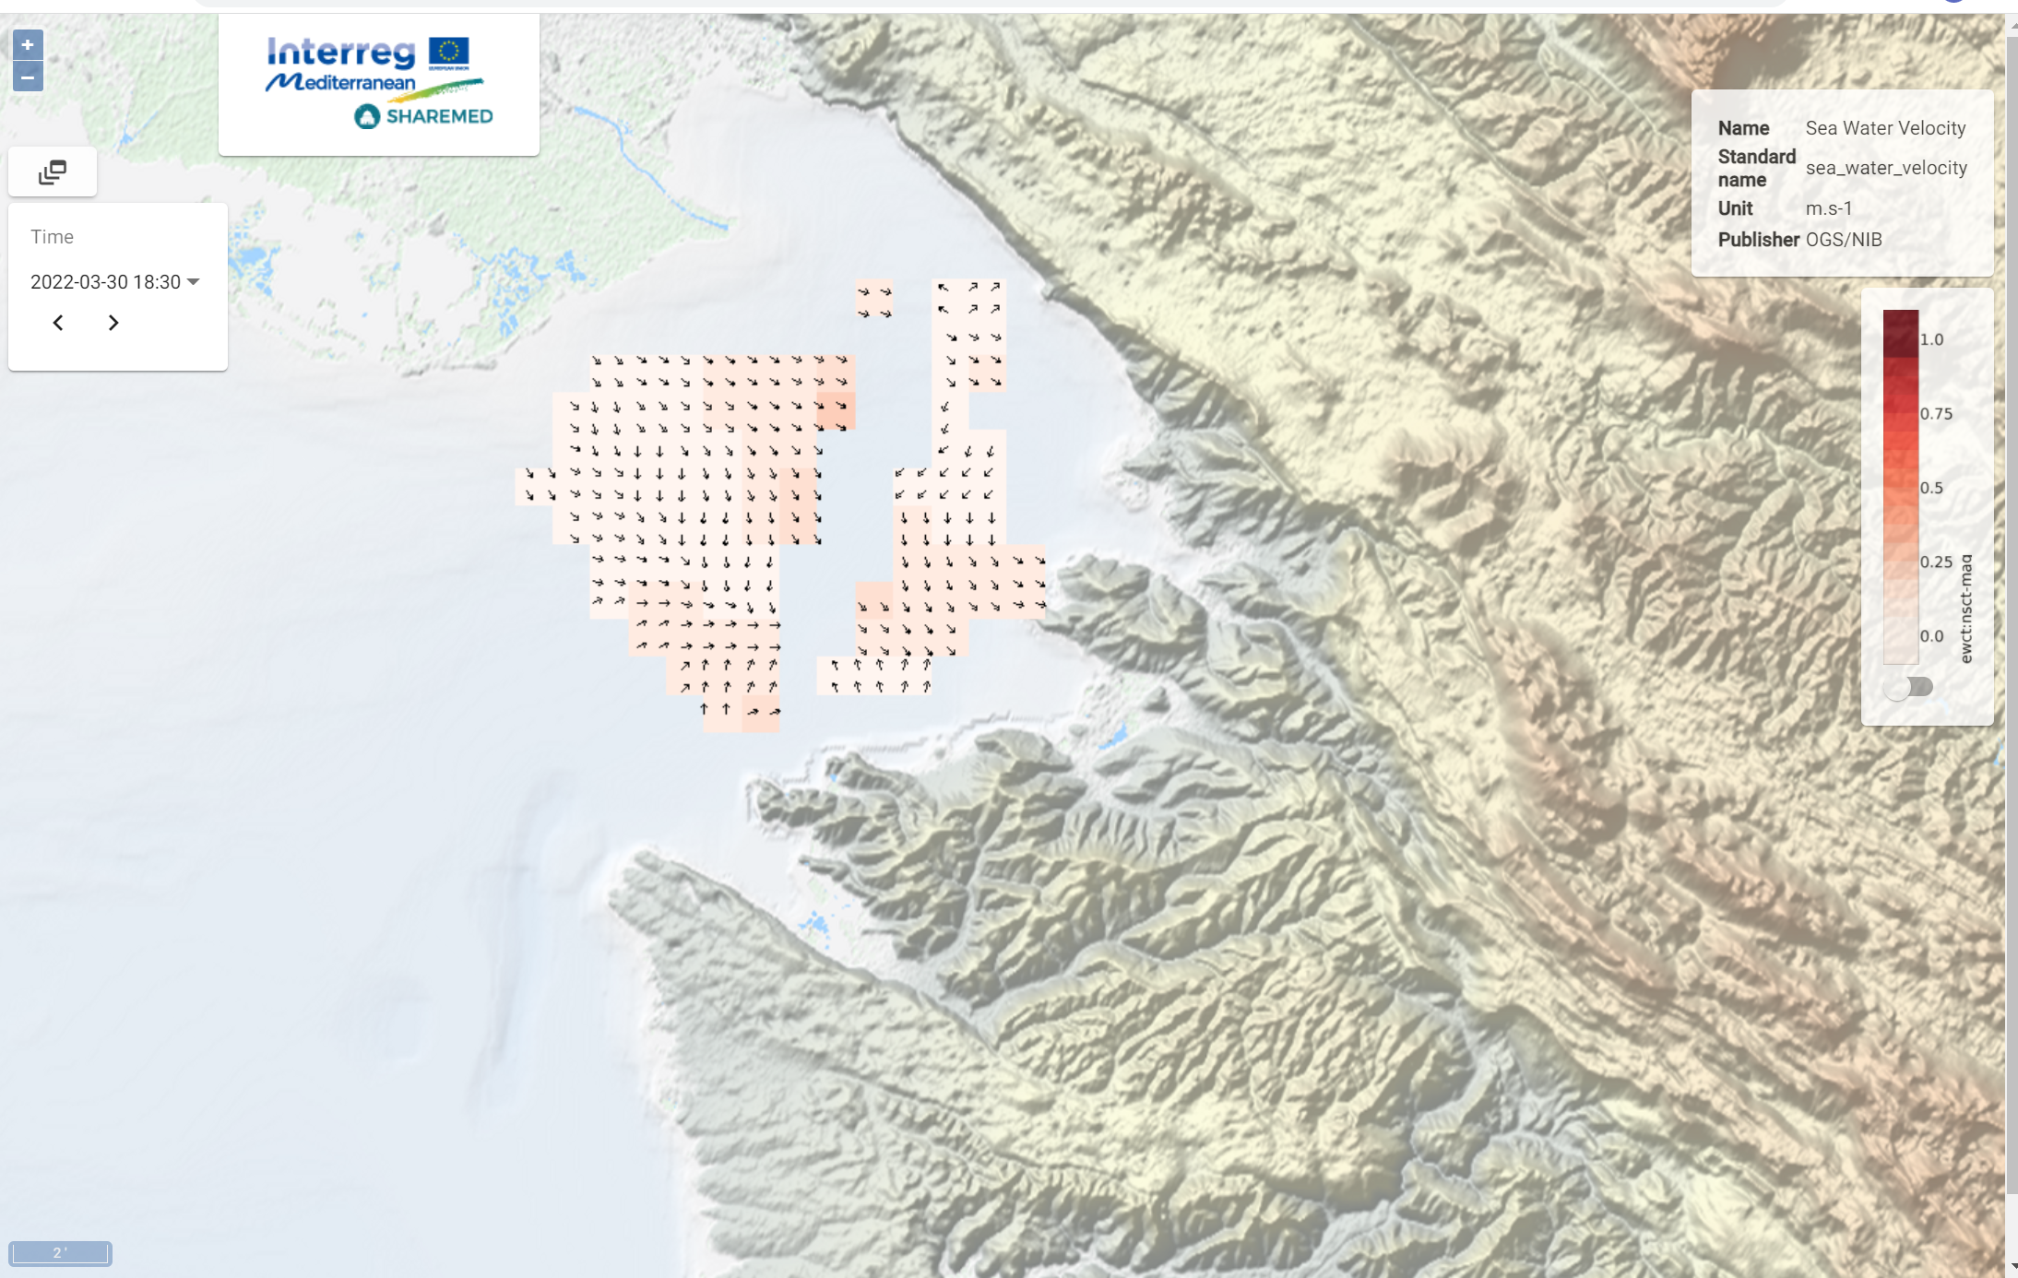

SHAREMED Northern Adriatic – Study Site
The Northern Adriatic – Geoportal
Surface Current Maps
Real time - Surface Current Map from HF - Radar

Slide 13
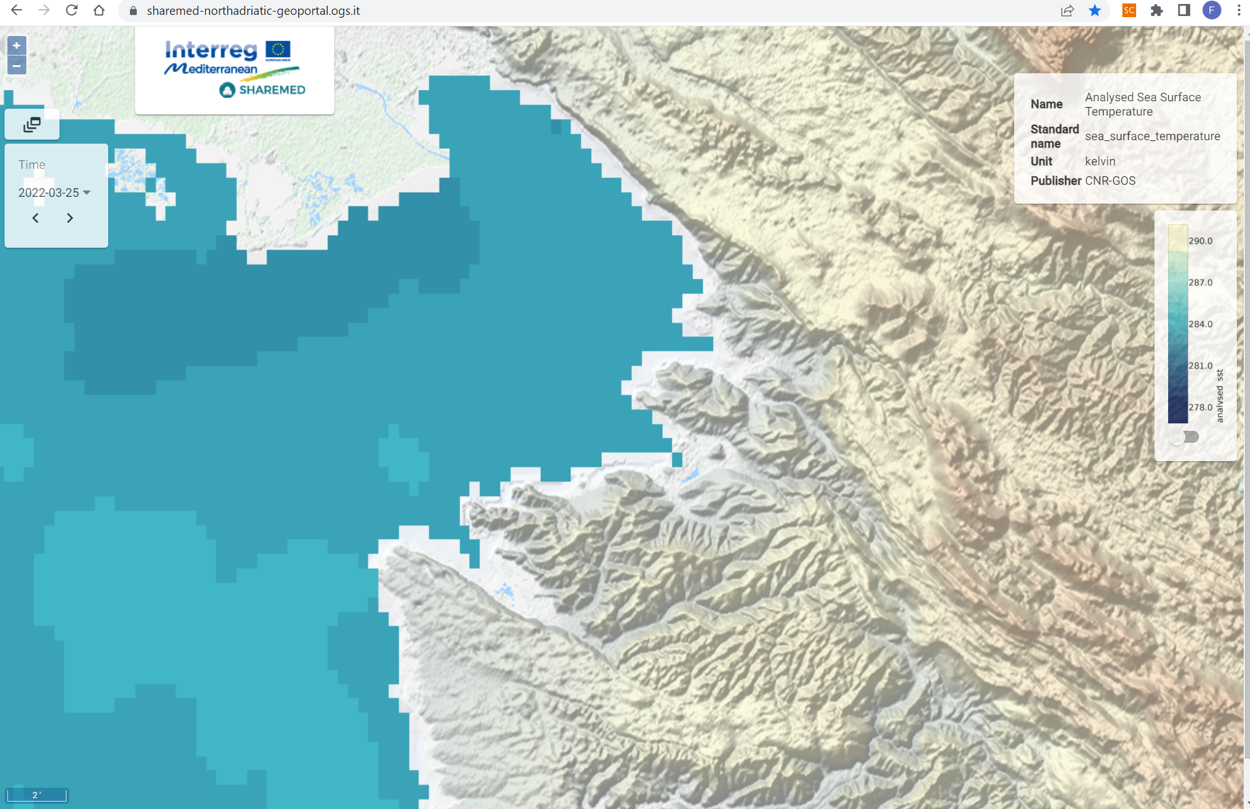
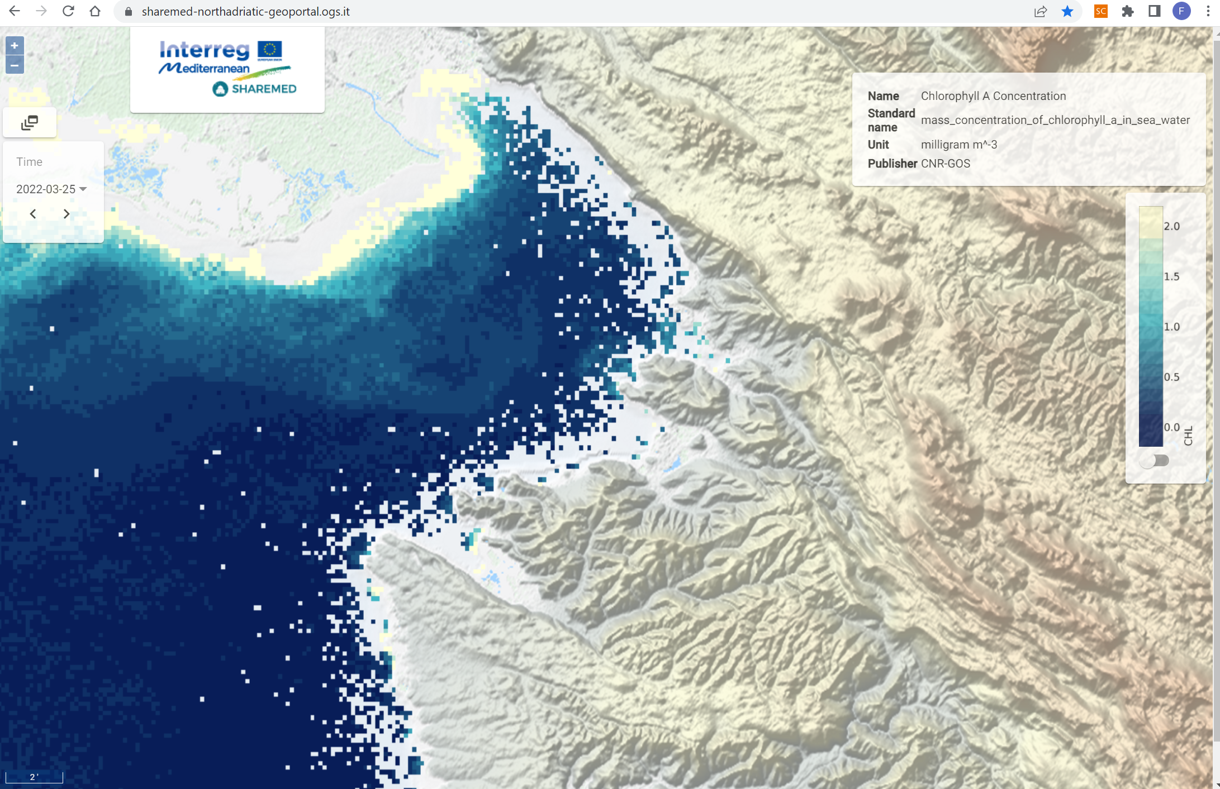
SHAREMED Northern Adriatic – Study Site
Satellite products
Chlorophyll A Concentration
from
Satellite Images
Sea Surface Temperature
from
Satellite Images

Slide 14
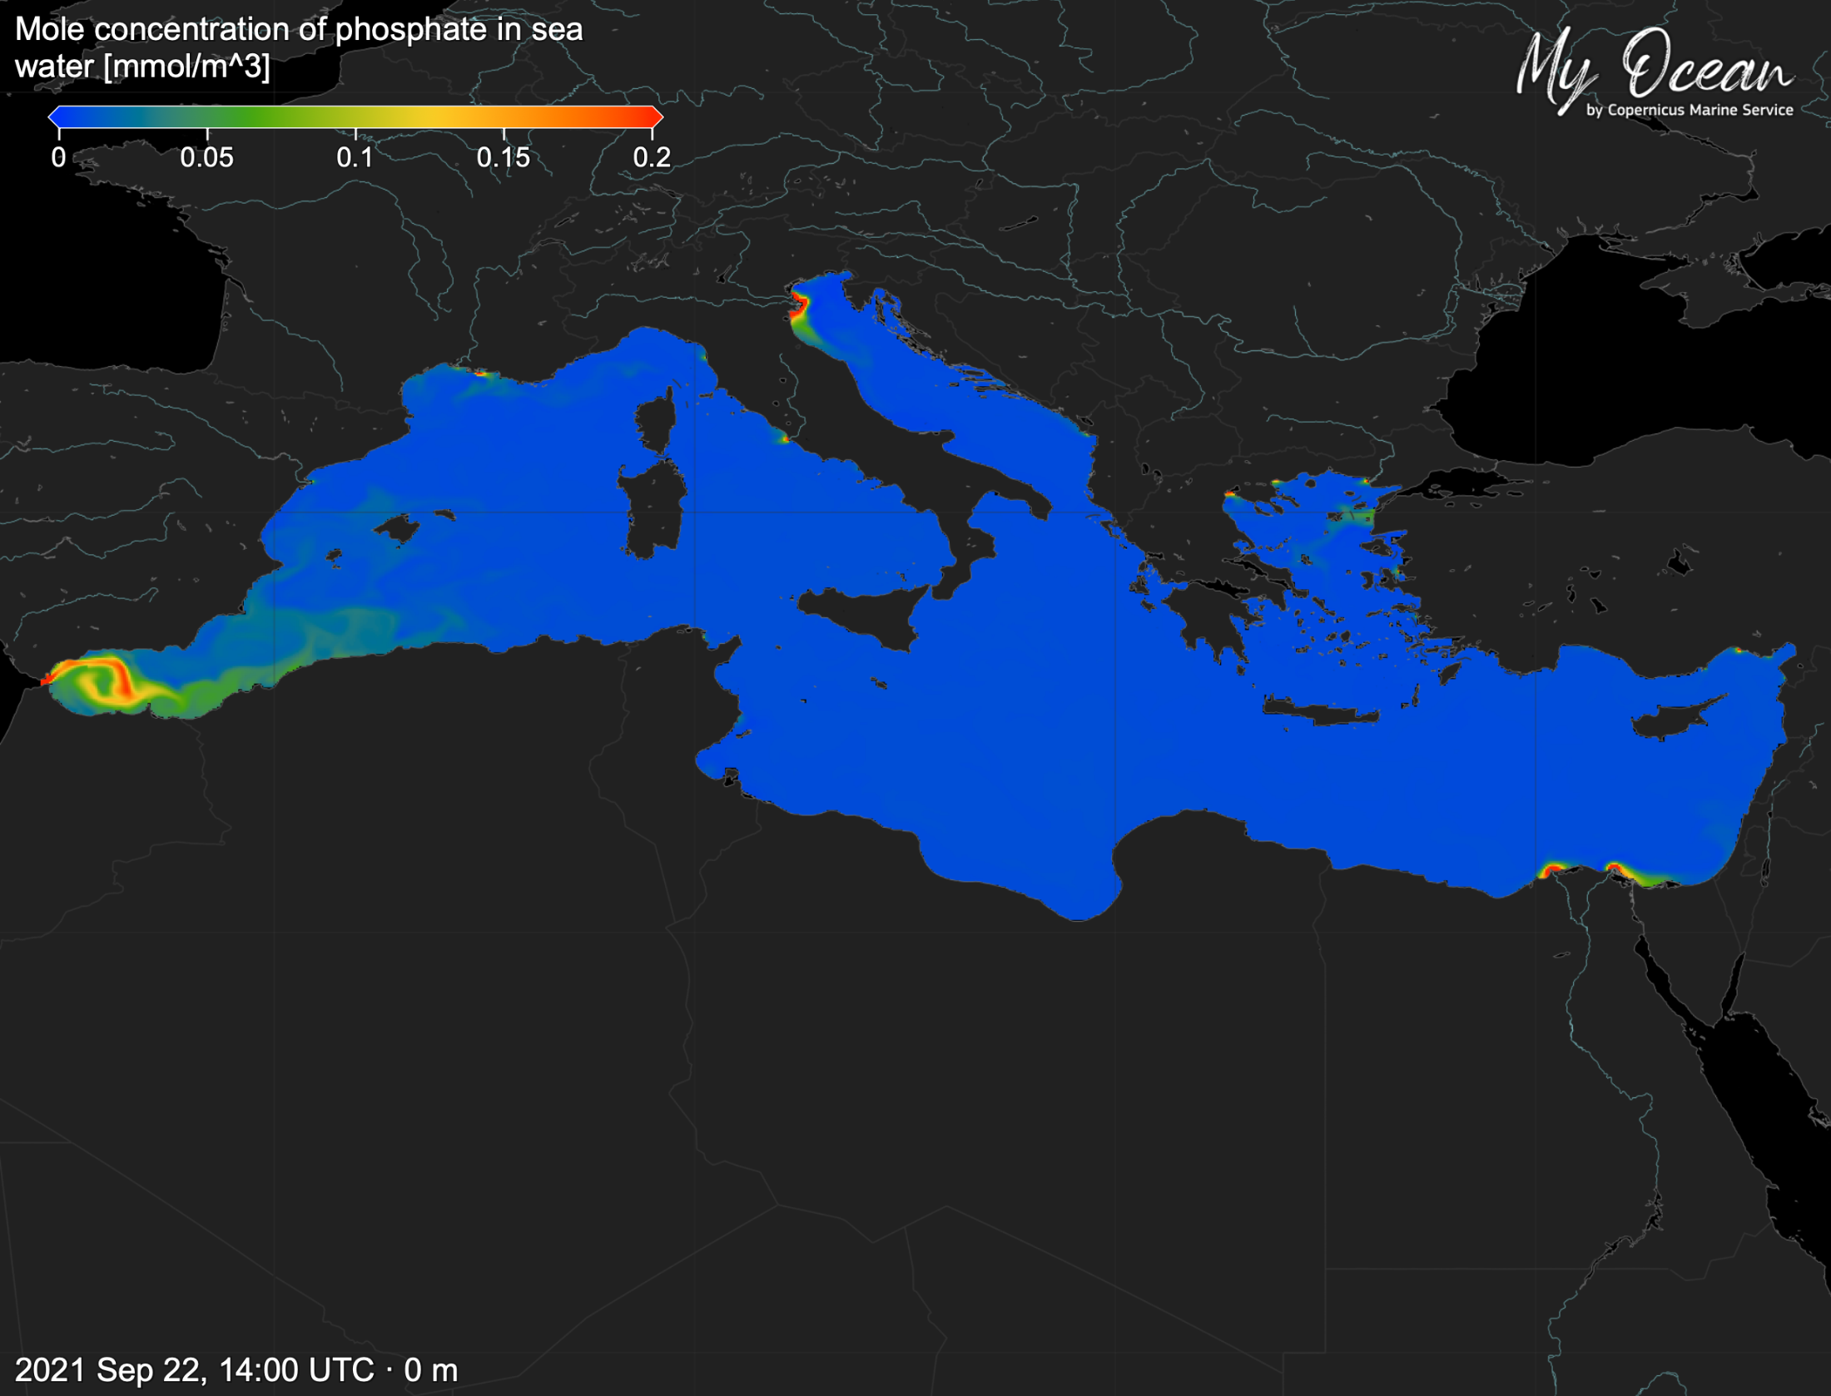


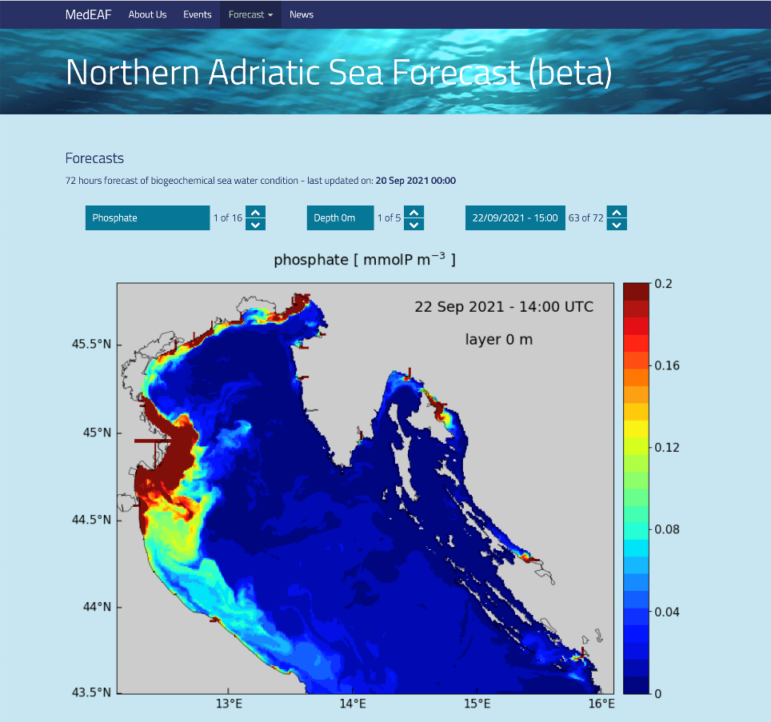




background image credit:
2021 Sep 22, 14:00 UTC - 0 m
1/128°
1/128°
1/128°
1/128°
1/64°
Development of a
relocatable short-term
forecasting system
for coastal areas
http://medeaf.ogs.it/adriatic

Slide 15
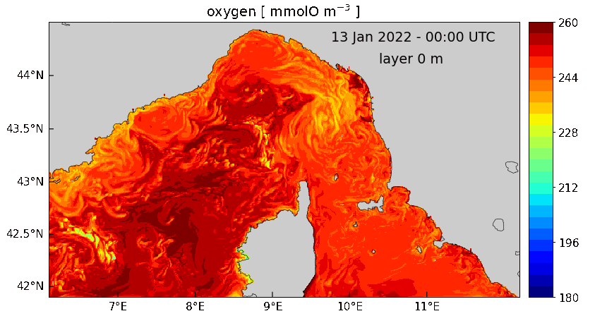
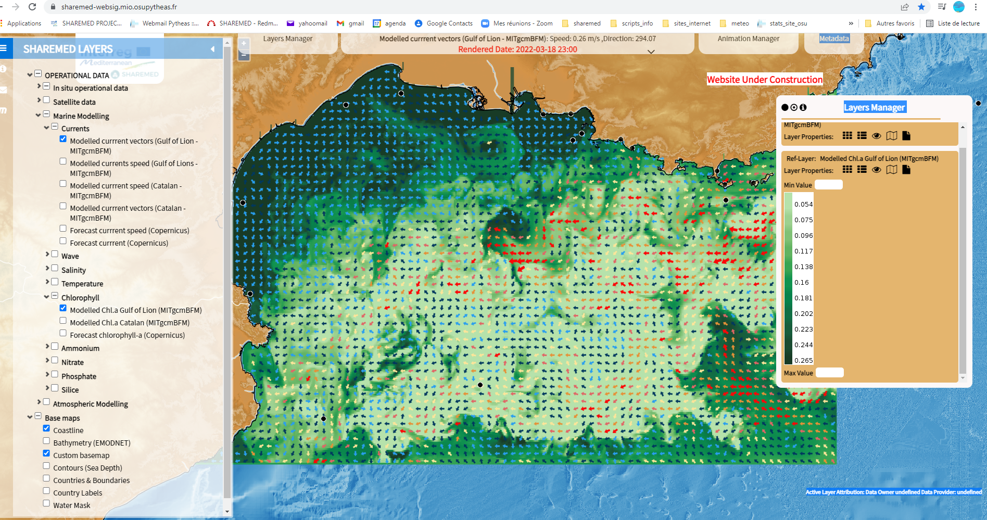
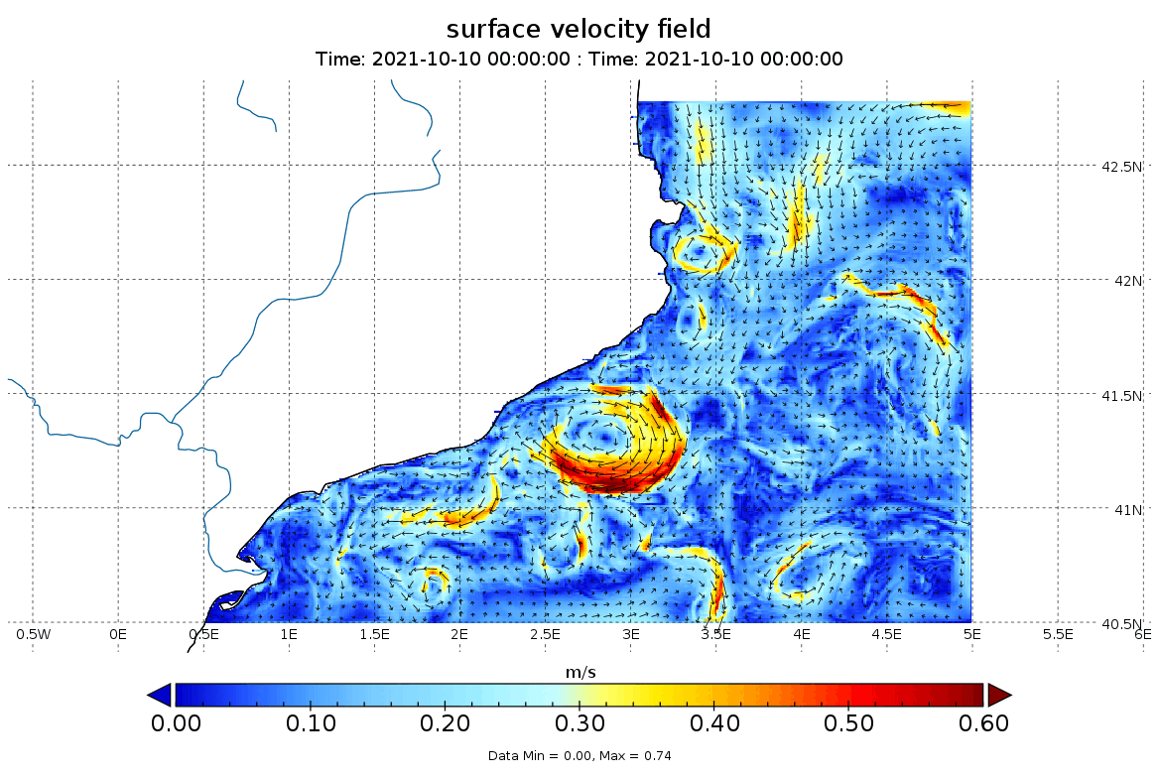
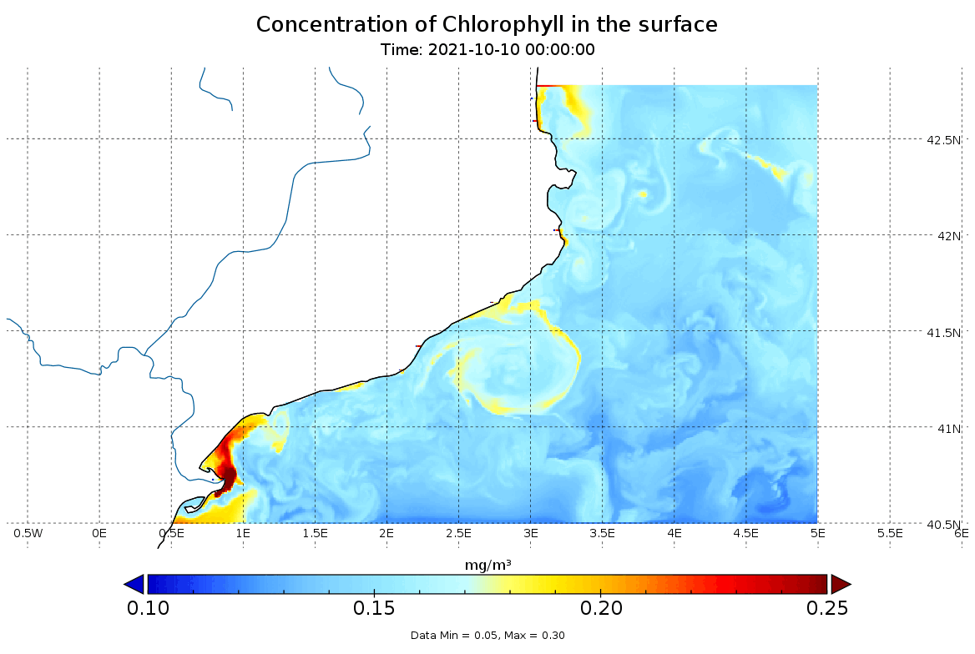
SHAREMED: Forecast system in North-west Mediterranean Pilot site (WP 5.1)
Operational physical-biogeochemical modelling on Gulf of Lion

Slide 16
Atlas of ecosystem status, pressures and hazard index
PRESSURES
HAZARD
EXPOSURE
VULNERABILITY
RISK
Oil spill hazard from main shipping routes
Potential hazard from major rivers discharge
Thermal shocks and occurrence of marine heatwaves
Distrophic events
Chemical contamination
risk map based on layers including location of ghostnets,
MPA, habitats

Slide 17
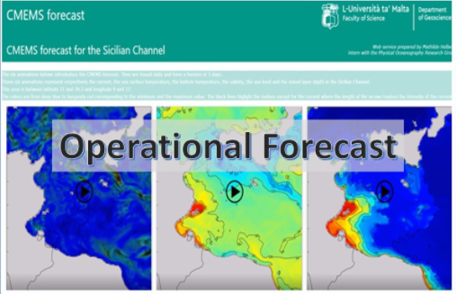
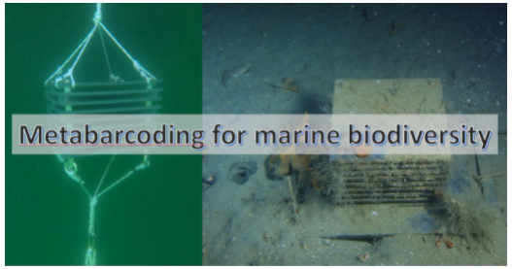
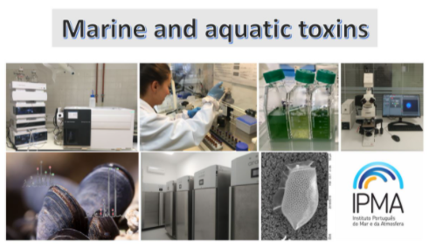
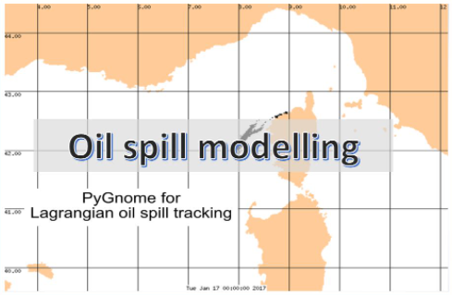
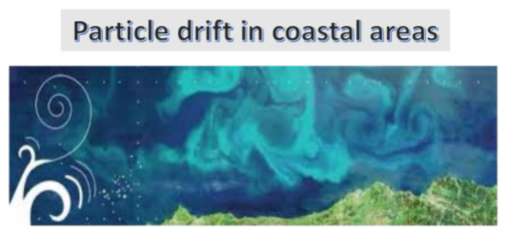
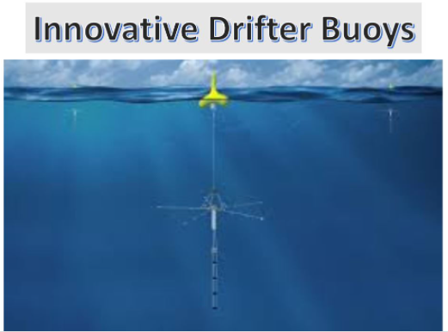
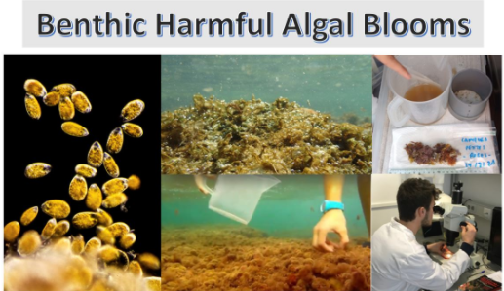
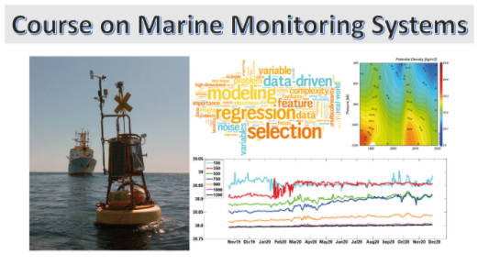
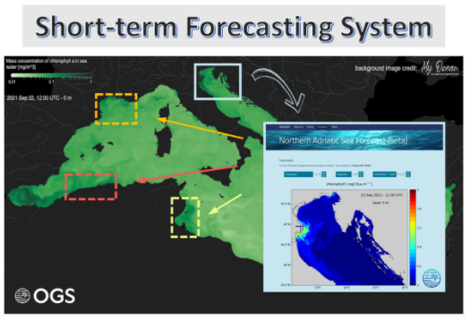
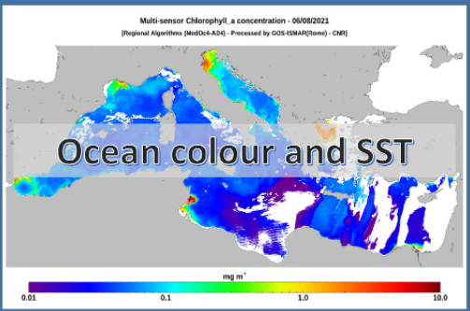
Transnational on demand actions
IMPLEMENT A SHAREMED RESULT IN YOUR SITE: on demand trans national access
fund and support to try it at your own site!
First call end of December and a second end of March 2022

Slide 18
ALL GOODS?.....
…… LESSON FROM FAILURES
NO (signed) PROTOCOL/MOU FOR:
JOINT ASSESSMENT
JOINT DELIVERY
JOINT MANAGEMENT
«easy» to harmonize agenda
difficult to aling objective
impossible to share ownerships
need to EMPOWER the table
separate funding channels
(need to have a single agency?)
need to sustain the activity for a LONGER period, so to showcase results

Slide 19
SHAREMED
Sharing and enhancing capabilities to address environmental threats in the Mediterranean sea
Coordinator: cosimo solidoro - OGS
csolidoro@ogs.it
Programme co-financed by the
European Regional Development Fund
Programme cofinancé par le Fonds
européen de développement régional

