Slide 1
The course is organised in three phases (2022/2023 edition)
First part: lectures
10 lectures spread over two months
second part: intensive course
8 practical sessions:
BIP in Cadiz (Nov 2022) or
Online (Jan-Feb 2023)
third part: project mode
students engaged on group work to accomplish remotely with mentoring by assigned lecturers ~ 2 months
Image by Glynn Gorick (glynn@gorick.co.uk)
Notes:
1

Slide 2
Project mode
70h, remotely
the form of a practical assignment
the emphasis is on the learning experience
the students have the opportunity to show their skill to put into practice some of the knowledge and know-how that they will have gained during the preceding components of the course
Notes:
2

Slide 3
Assignments: sea-related challenges which students will be expected to address by proposing, planning and developing a prototype solution to tackle, resolve or understand better a given problem or situation
The nature of the exercise will focus on the use and merging of data to provide a solution or assessment to resolve the challenge
Students are expected to engineer solutions to a specific pre-defined problem that requires data to be transformed into useable information
A set of challenges (3 topics) will be proposed to the students, and each topic will be supported by a group of at least two mentors
Notes:
3

Slide 4
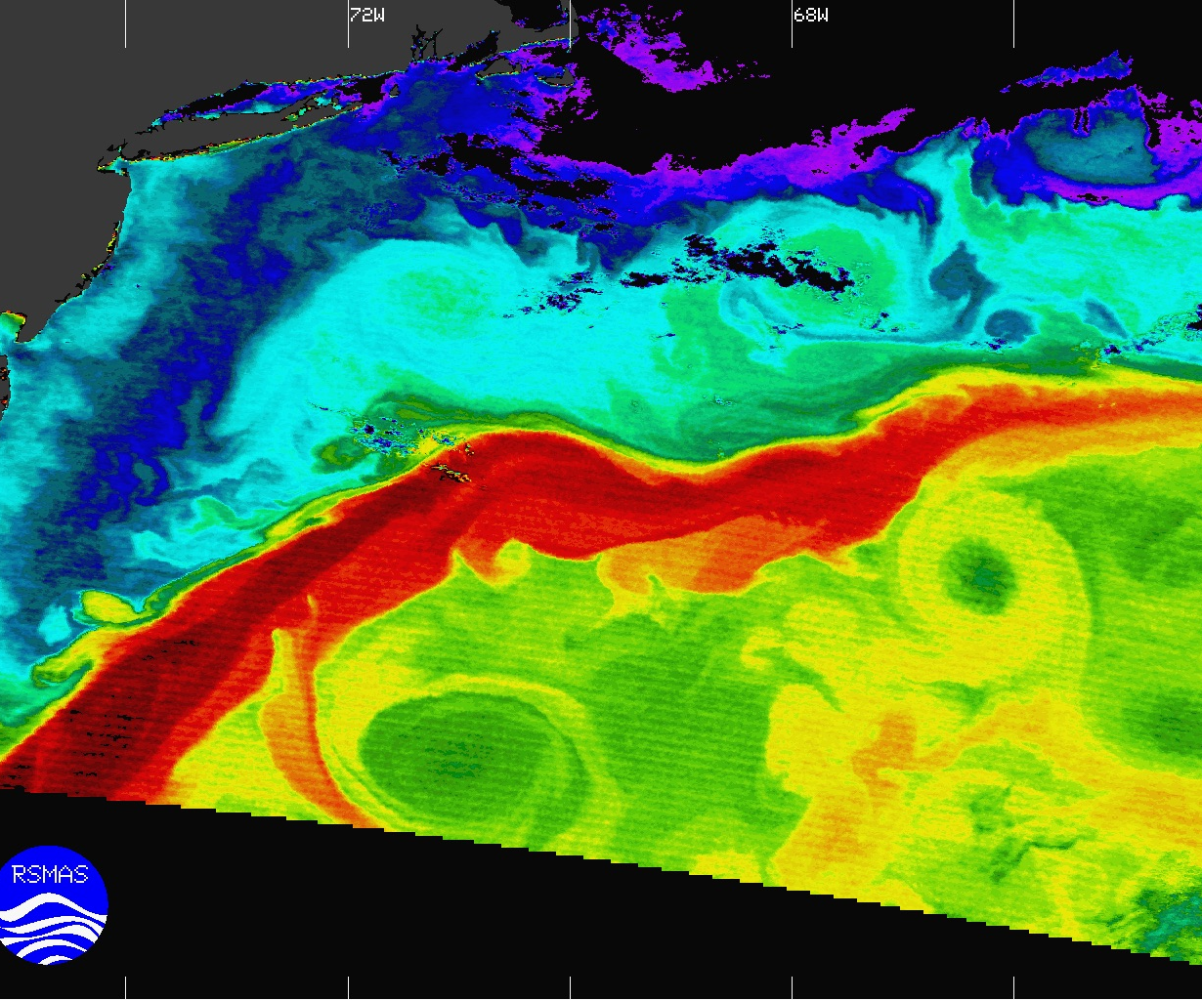
Topic 1: ANALYSIS OF SPATIAL AND TEMPORAL WAVE ENERGY FLUX VARIABILITY ALONG THE SOUTHERN COAST OF EUROPE AND NORTHERN AFRICA OR AT BALTIC SEA
Topic 2: EXTRACTING CHARACTERISTIC PATTERNS OF MARINE VARIABLES USING MACHINE LEARNING
Topic 3: CHARACTERIZING THE MEDITERRANEAN SEA CLIMATE: FROM DAILY TO INTERANNUAL TIME-SCALES
Notes:
4

Slide 5
The assignment of students to each of three challenges will be done by the BoS.
Favouring a mix of students from different universities, and with different academic backgrounds to nourish a multi-disciplinary approach.
Notes:
5

Slide 6
The performance of the students in the course is assessed through all the three course components
The team project is expected to carry an elaborated delivery in which each student will need to have a specific and unique well identified delivery
Notes:
6

Slide 7
The assessment of the projects will be done in two steps
by the mentors on the basis of a report prepared by the students, and using common agreed criteria for evaluation
through a short online presentation and assessed by an expert panel composed of members from the course BoS
Each member of the team will have a separate and distinct role/aspect to tackle in the challenge, and will be expected to report and present on that aspect.
Each member of the team will be assessed individually.
Notes:
7

Slide 8
Assessment rules
Report, prepared by the group: 7500-10,000 words.
A short online presentation - each member of the team will be expected to present on her/his separate aspect of project.
questions of the jury/BoS
Final grade:
50%: report
25%: presentation
25%: defense
Notes:
8

Slide 9
Deadlines and rules
The 3 topics are published on the website link and the mentors will talk about their projects
The student determines her/his preferences by ranking the topics Choose the topic
deadline 31.03.2023 (Friday)
The BoS will assigned students to groups – 3-5.04.2023
The beginning of the project mode 12.04.2023
Contact hours with mentors: will be announced by mentors 12.04.2023
The end of project mode: 29.05.2023 (final session, students presentations; 5 minutes for each student)
certificates 16.06.2023
Notes:
9

