Slide 1
Alfredo Izquierdo González (UCA)
Aleksandra Dudkowska (UG)
Flavio Martins (Ualg)
Characterizing the Mediterranean Sea climate: From daily to interannual time-scales

Slide 2
OUTLINE
Main Objective
Data source
Study Area
Software
Some theoretical background (little reminder!)

Slide 3
Main Objective
Understanding of the Mediterranean Sea functioning through a climate analysis
Focus on different physical variables (S, T, V, SSH, MLD)
Analysing different scales of variability may provide insight on processes/characteristics relevant in different regions (vertical structure, deep-water formation, mesoscale variability, ocean-atmosphere interaction, circulation, seasonal cycle, long-term trends)
Use of high resolution reanalysis products

Slide 4
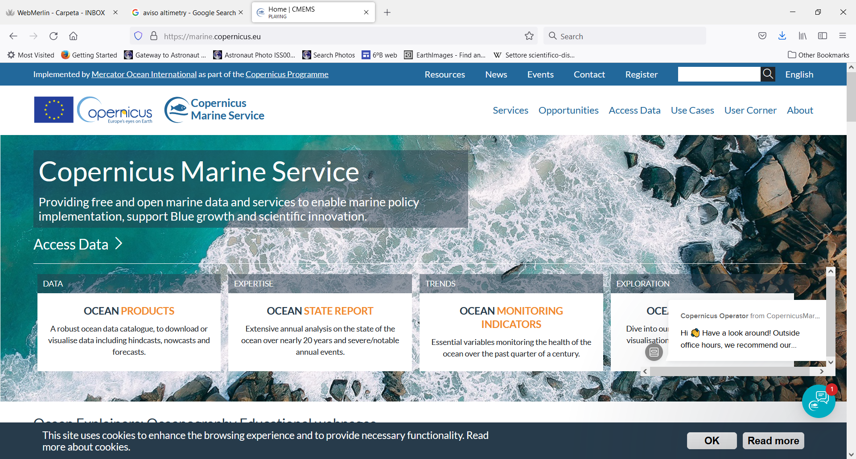
Data Source
https://marine.copernicus.eu/

Slide 5
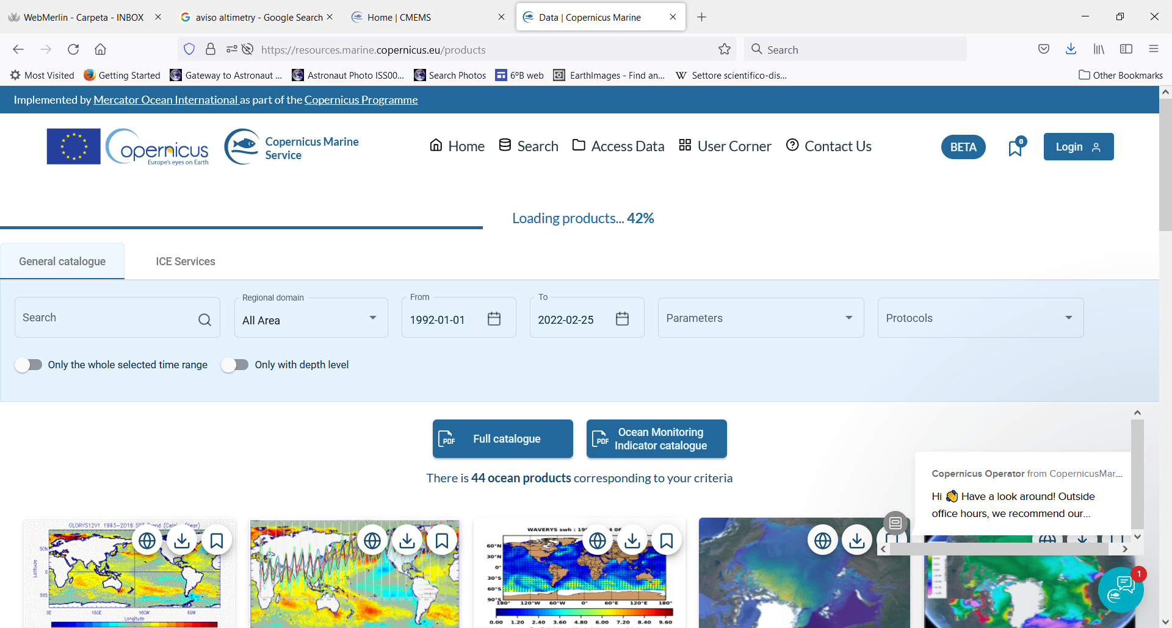
Data Source
Mediterranean Sea Physics Reanalysis
MEDSEA_MULTIYEAR_PHY_006_004
Spatial resolution: 0.042º x 0.042º
Temporal resolution: Hourly, daily, monthly, yearly, multi-yearly
Temporal extent: Since 1 Jan 1987
You need to be registered

Slide 6
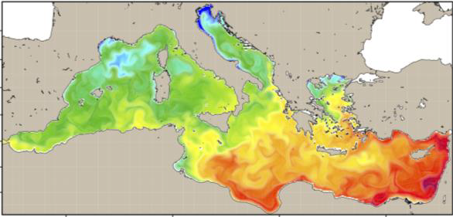
Mediterranean sea Physics Reanalysis
CMEMS MEDSEA_MULTIYEAR_PHY_006_004 product
Level 2
Level 3

Slide 7
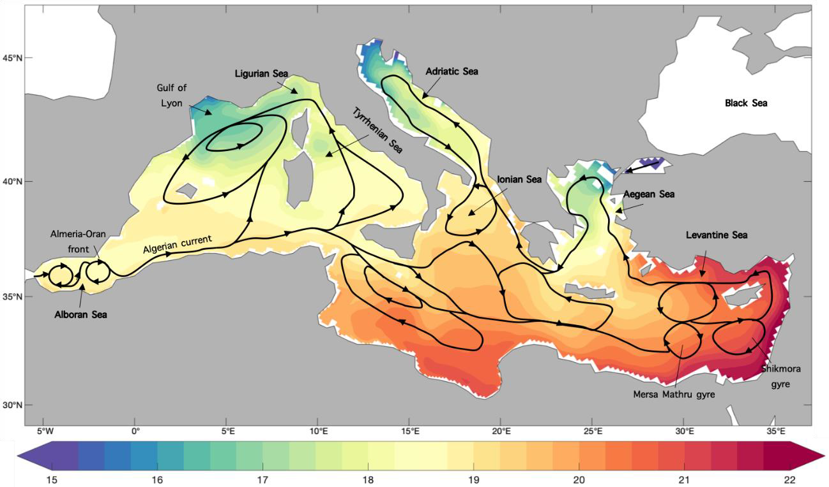
Study Area
Mediterranean Sea
Lat_Max : 48ºN
Lat_Min: 29ºN
Lon_Max: 42º E
Lon_Min: -6º W
Mediterranean basin: 1980–2012 mean SST (C) and upper ocean currents (Parras-Berrocal et al. 2020)

Slide 8
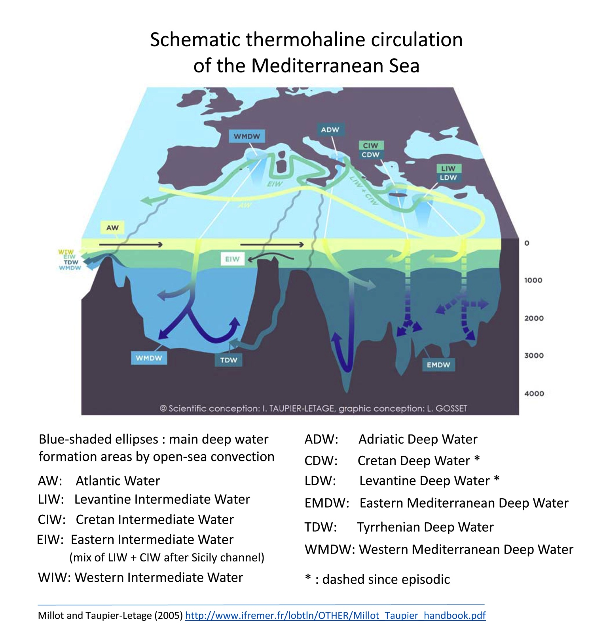
Mediterranean Sea
Mediterranean sea:
A miniature ocean
https://miolaseyne.ifremer.fr/sciences/COURANTS/SCHEMA_3D_MED_LABELS_EN.jpg

Slide 9
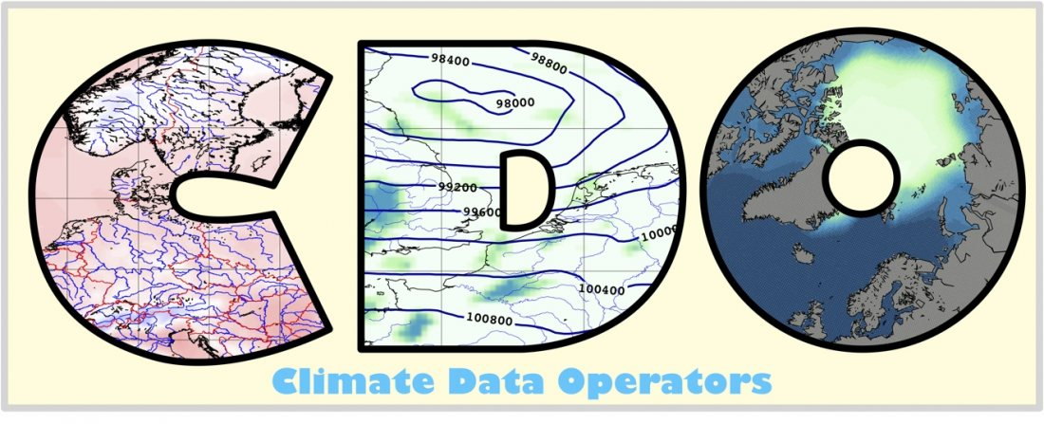
Software
Basic statistical analysis of the data: estimation of monthly and seasonal means and standard deviations, long-term trends. Spatial mean and stds
More advanced analysis is possible if your work is encouraging.
Plotting tools in ODV. Also MatLab, Pyferret could be used.
For analysis tools such as CDO (Climate Data Operators) or Matlab.
https://www.uomustansiriyah.edu.iq/web_article.php?post_id=516:157&lang=ar
Become familiar with the data: READ the DESCRITIVE DOCUMENTS!!
Find and download data from data providers.
Make a review about the Mediterranean Sea oceanography and climate.
Installation and tutorial of CDO.
Climate characterization through a targetted basic statistical spatial/temporal analysis of the reanalysis product.
Use plotting tools for a better comprehensive view of your results.
Interpret your results.

Slide 10
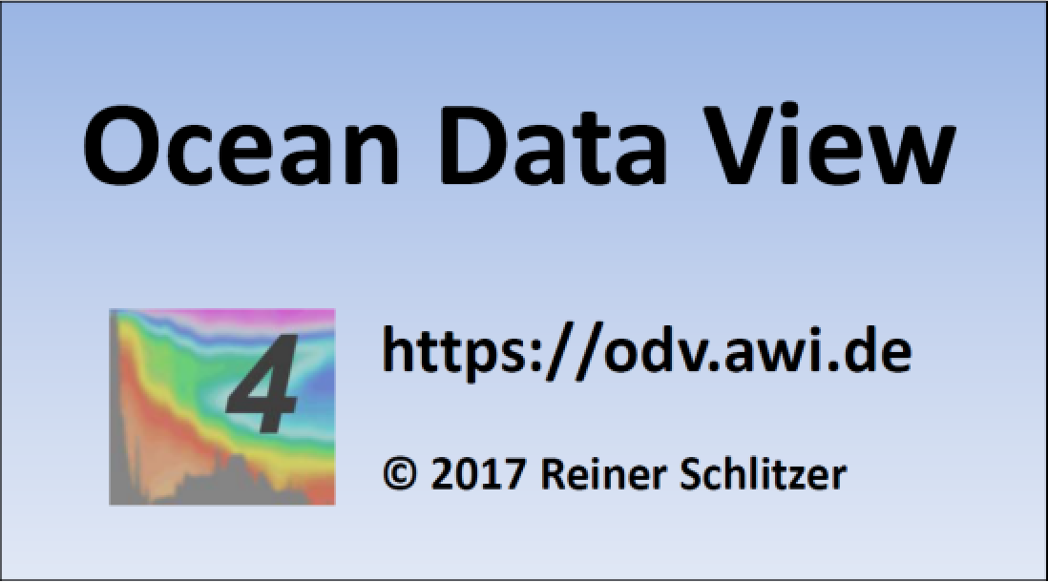
Software
Surface maps of mean, std, trends (caution with their interpretation)
Mean T, S, density profiles (sub-basin averaging)
T-S analysis. Water masses identification.
Seasonality. Determination of the ocean active layer (MLD seasonality)
Mean (multiyear) seasonal cycle. Interannual variability. Trends. (All this using sub-basin averages).
2D Maps of amplitude of seasonal cycle and interannual variability, anomaly maps, cross-sections.
Tme-correlations between variables (possible with atm variables), or with teleconnection indexes (NAO, etc).

Slide 11
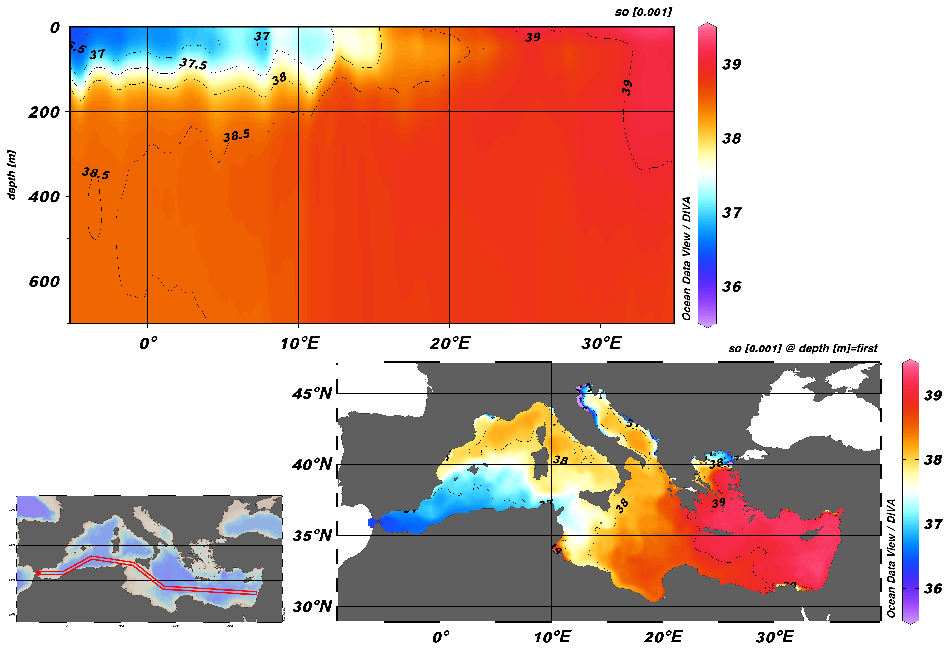
Software
Mediterranean Sea Physics Reanalysis
MEDSEA_MULTIYEAR_PHY_006_004
multiyear mean salinity field

Slide 12
Review of Introductory lectures and practical sessions will be more than useful…necessary!!!!
Some slides from Lecture 2…

Slide 13
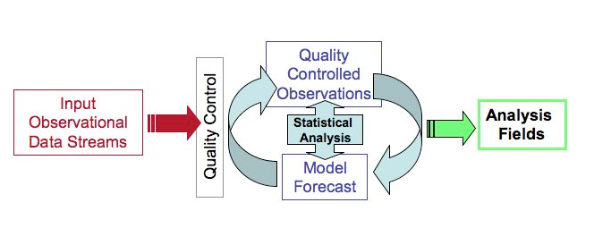
Re/analysis products
An analysis is a snapshot of the state of the ocean at any given time. It is done using a model, data and observations to provide a best fit produced on the fly.
An oceanographic reanalysis consists in modelling the state of the ocean over a long period of time (several years) while correcting it with the best available past observations.
From the Blue Book Copernicus for a Sustainable Ocean
From E. Kalnay, www2.atmos.umd.edu

Slide 14
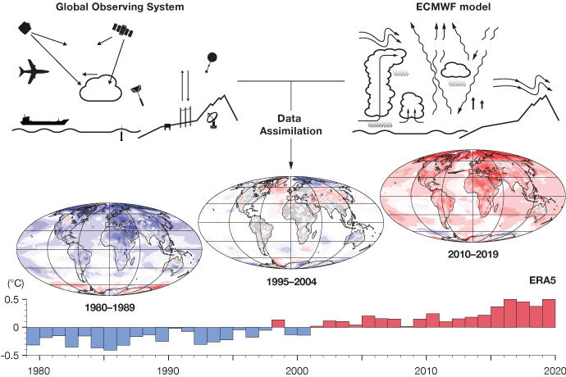
Re/analysis data
Reanalysis data provide the most complete picture currently possible of past weather and climate.
‘Maps without gaps’.
https://www.ecmwf.int/en/about/media-centre/focus/2020/fact-sheet-reanalysis
Notes:
Provide the most complete picture currently possible of past weather and climate. They are a blend of observations with past short-range weather forecasts rerun with modern weather forecasting models. They are globally complete and consistent in time and are sometimes referred to as ‘Maps without gaps’.
Why is reanalysis important?
To understand climate change and current weather extremes, it is important to have observations of the Earth system going back as far as possible in time. However, observations have always been unevenly distributed, and they come with errors. Even in the satellite era, observations alone cannot provide a complete and accurate picture of the state of the Earth system across the globe at a given point in time. Reanalyses fill the gaps in the observational record, and they do so in a way that is consistent in time, thus minimising any spurious signals of change.
How are reanalyses produced?
Reanalysis combines past short-range weather forecasts with observations through data assimilation. The process mimics the production of day-to-day weather forecasts, which use an analysis of the current state of the Earth system as their starting point. The analysis is a physically consistent blend of observations with a short-range forecast based on the previous analysis. Reanalyses are usually produced at lower resolution than current weather forecasts, and they use the same modern data assimilation system and forecasting model throughout the reanalysis period. Prior to the production of a new reanalysis, work is carried out to improve the quality and availability of past observational data, for example by digitising old paper-based records and reprocessing existing satellite records. Careful quality control is carried out as reanalyses are produced, and their reliability is assessed by comparison with reanalyses produced at other institutes.

Slide 15
Climatology data
Climate is the statistical ensemble of states occurring in the system Atmosphere-Ocean-Solid Earth in a period of several decades (Monin, 1979)
Climate may be defined as the multivariate, multiple-time probability distribution of status of the ocean-ice-atmosphere system (North et al. 1982)
Climate normals: Period averages computed for a uniform and relatively long period comprising at least three consecutive ten-year periods (WMO No-1203).
Climate includes arithmetic mean, but it can also include values such as the standard deviation, percentile points, number of exceedances of a threshold or extreme values
Notes:
daily and seasonal variabilities, for example std of the monthly multiyear series.
Gridded climatology are made from multiple source observation analysis, but also can be done from reanalysis.

Slide 16
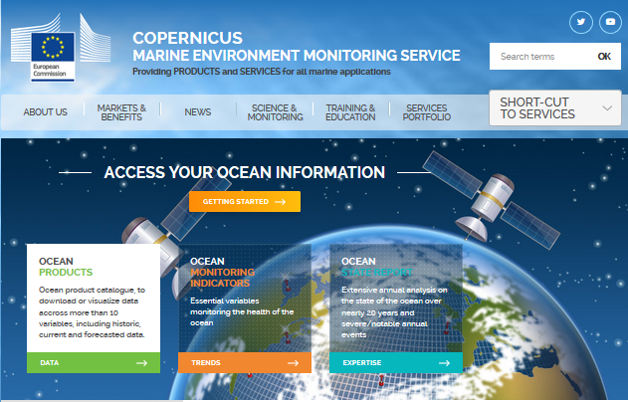
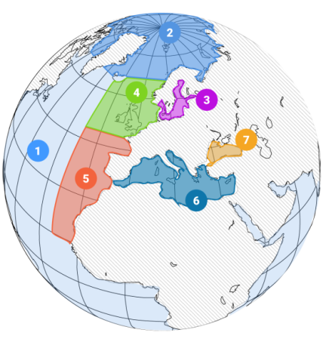
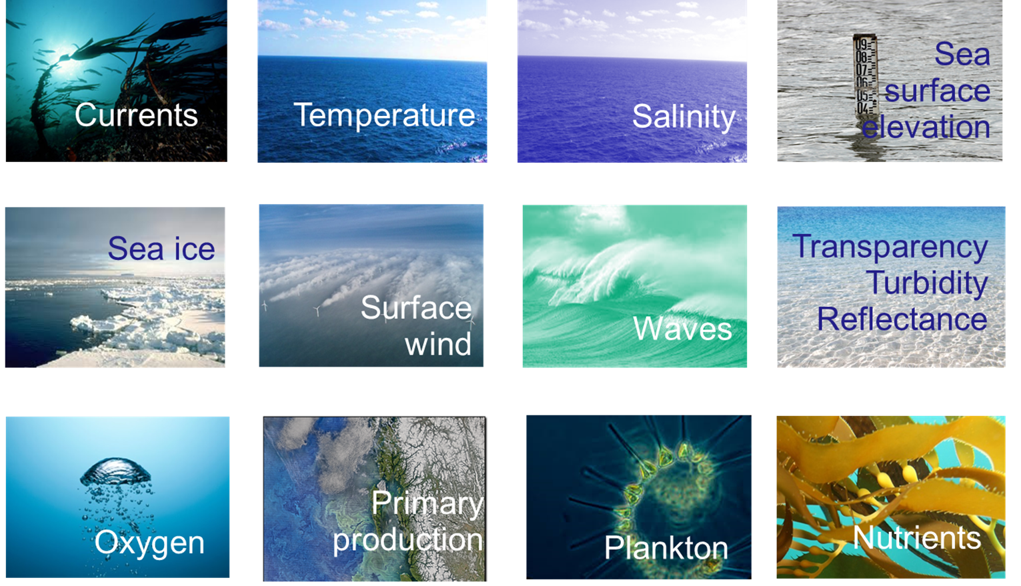
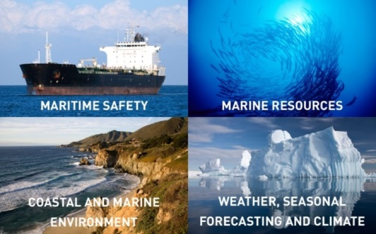
Copernicus Marine Environment Monitoring Service
CMEMS -An operational European service by European experts to offer the best worldwide information on Marine Environment based on observations and models
Domains: Global and 6 regional domains

Slide 17
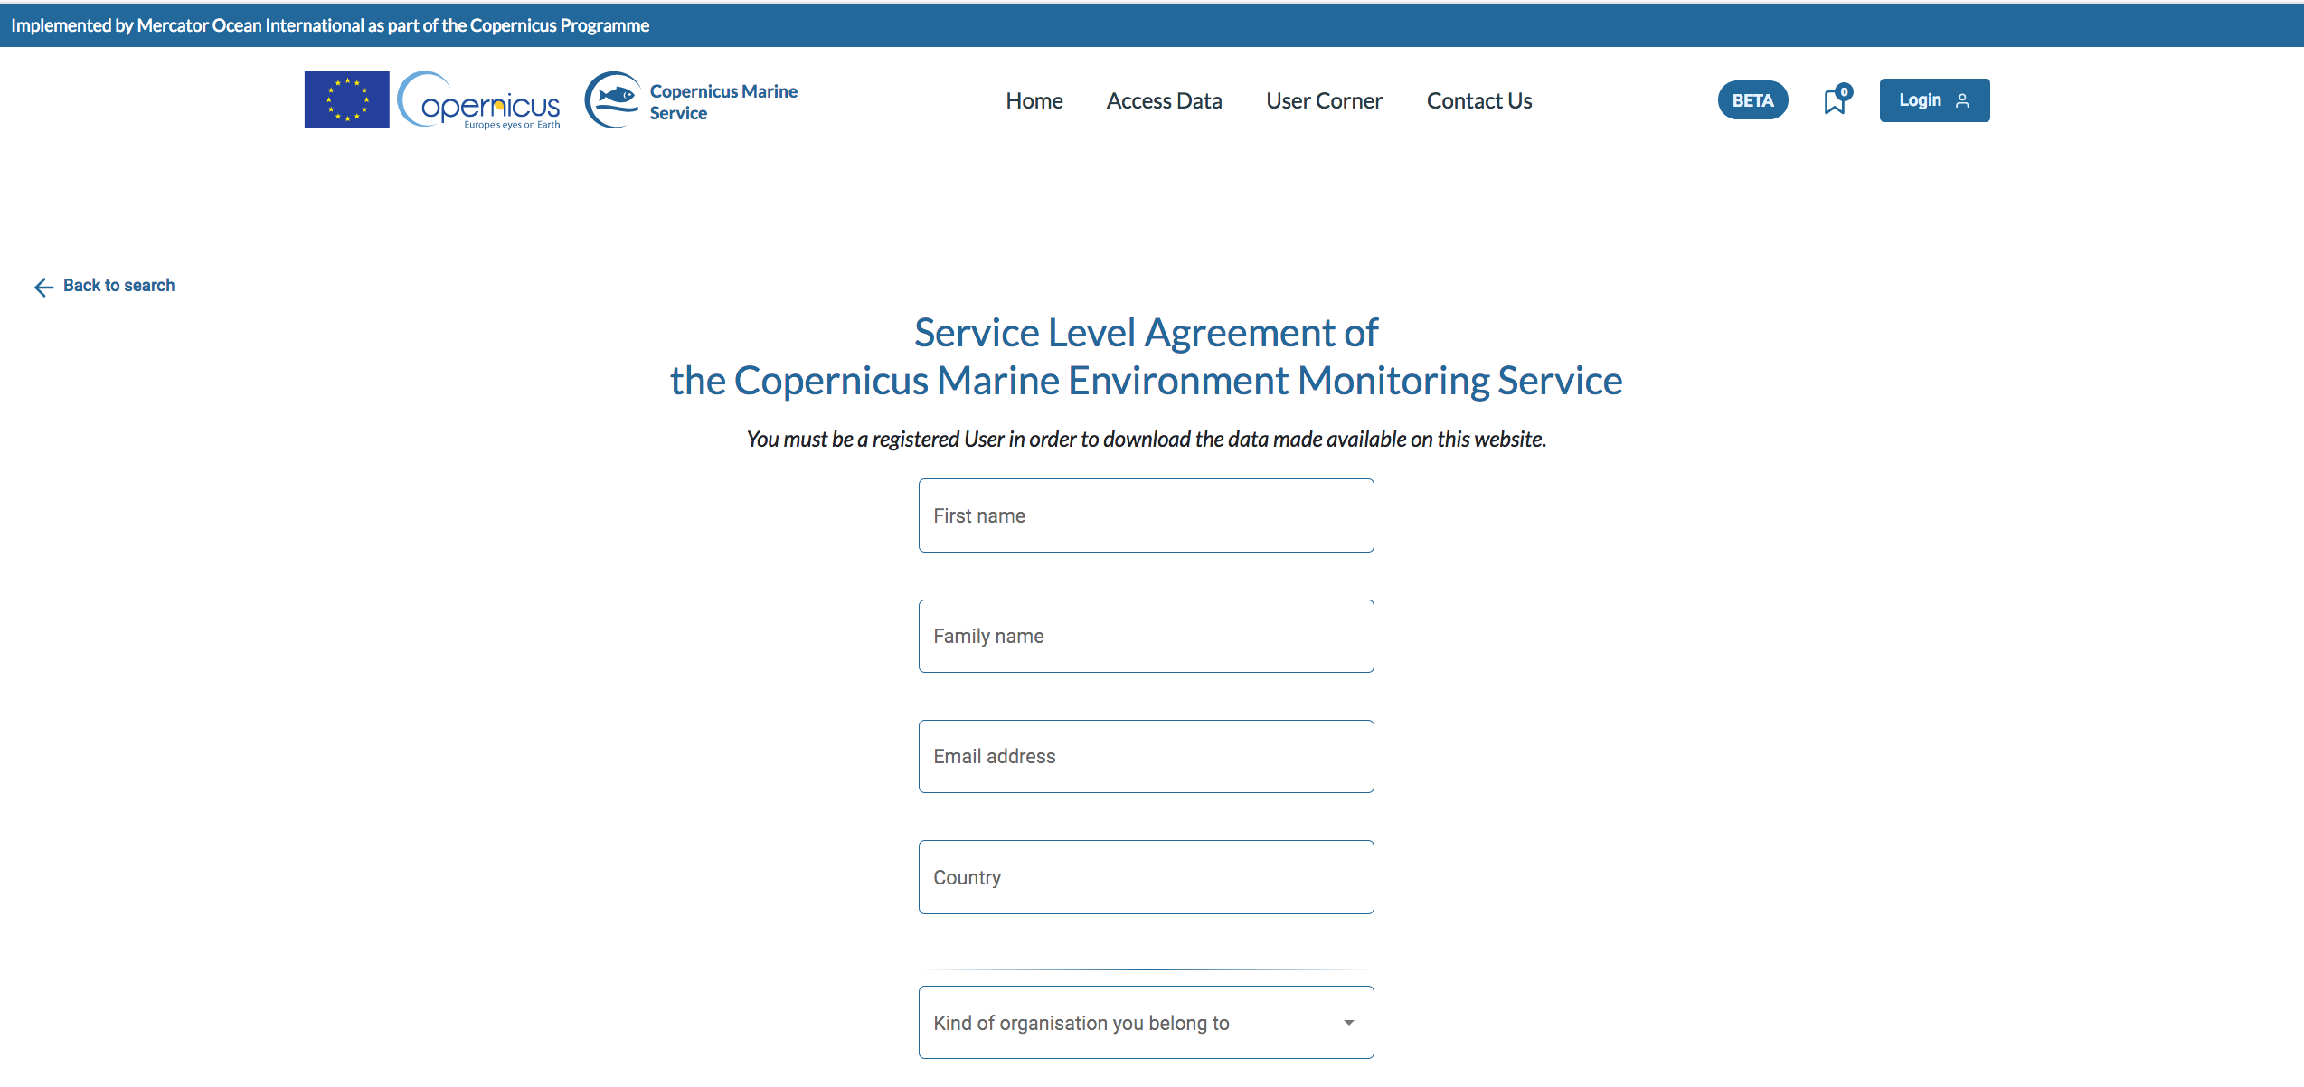
User registration
https://resources.marine.copernicus.eu/registration-form

Slide 18
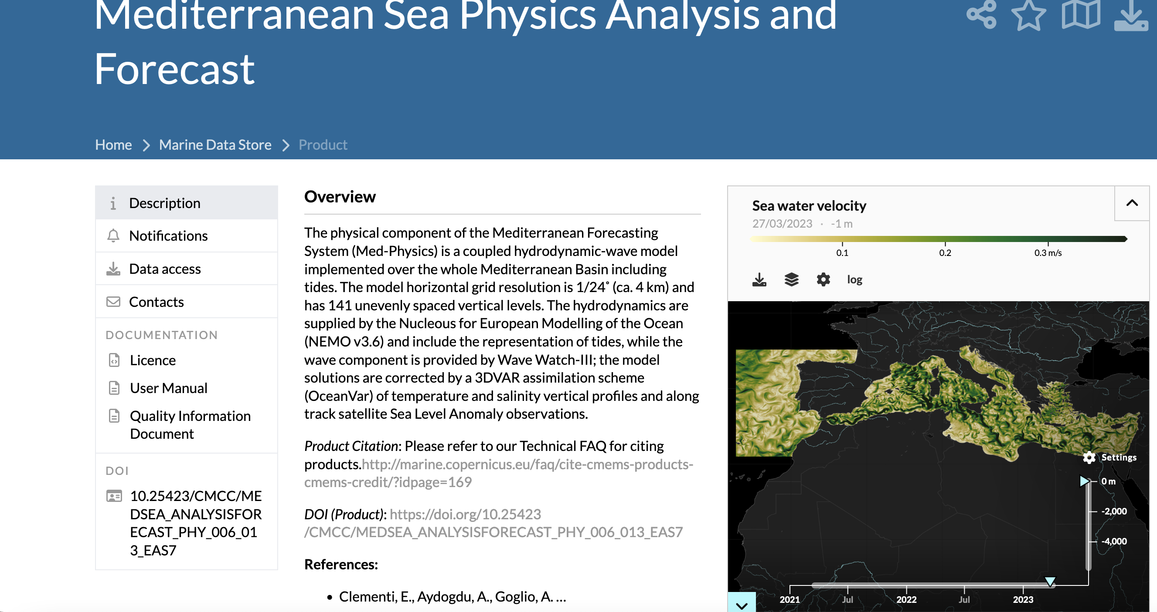
Data description: user manual and quality information documents
https://marine.copernicus.eu/tutorials/getting-started/

