Slide 1
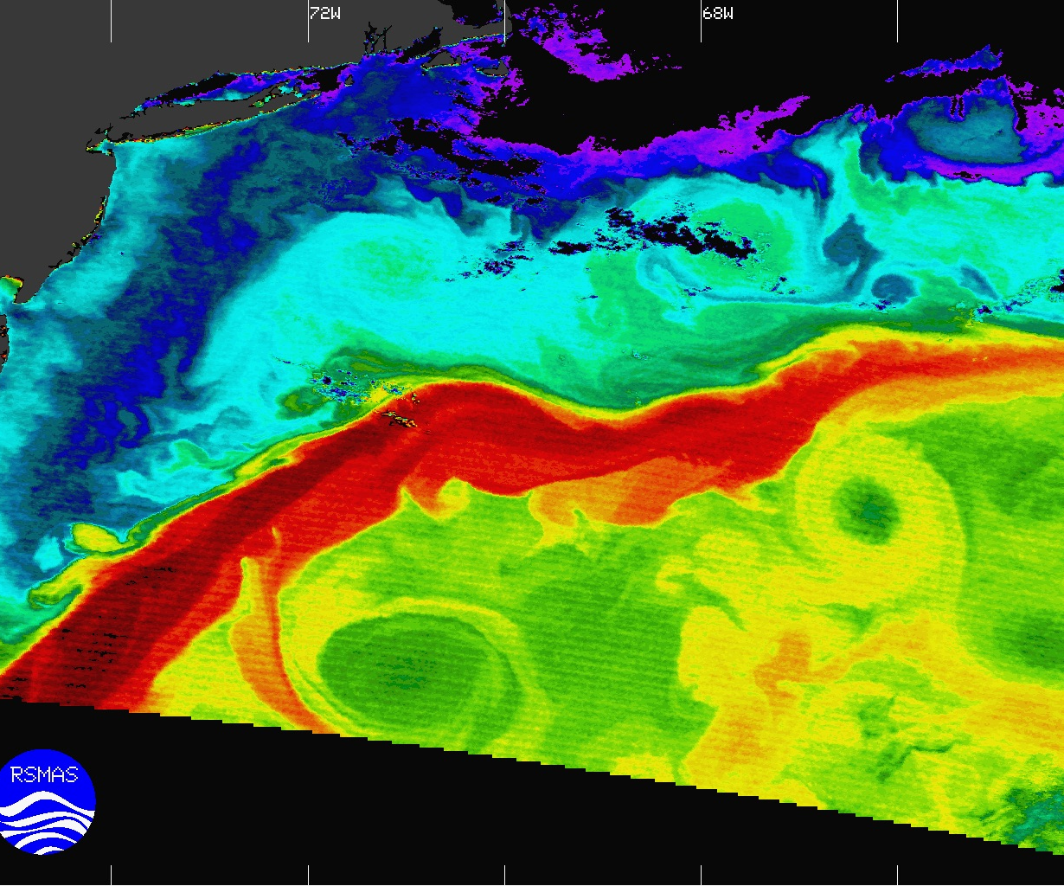
Extracting characteristic patterns of marine variables using machine learning
Frano Matić¹ & Carlos Roman Cascon²
¹University of Split, University Department of Marine Studies, Split, Croatia
²University of Cadiz, Spain
Contact: frano.matic@unist.hr
carlos.roman@uca.es

Slide 2
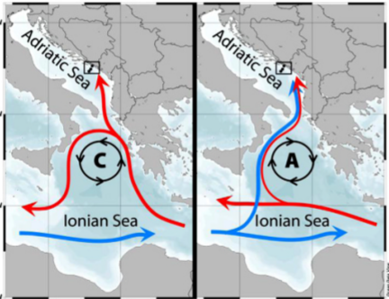
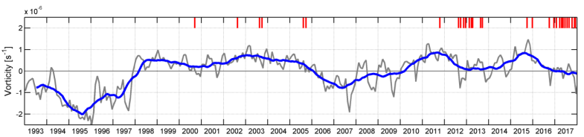
Motivation
An interesting phenomenon
Circulation of the Ionian Sea is either cyclonic or anticyclonic.
During cyclonic phase:
Warmer and saltier Levantine water enters the Adriatic Sea along the eastern Adriatic coastline
During anticyclonic phase:
Colder and less salty western Mediterranean water enters the Adriatic Sea
Cyclonic and anticyclonic phase interchange with a quasi-decadal periodicity
(Batistić et al., CSR, 2019)
(Mihanović et al., FMARS, 2021)

Slide 3
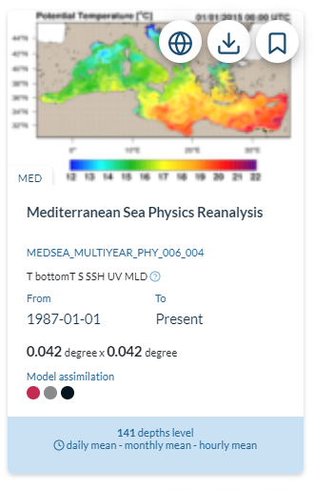
Mediterranean Sea Physics Reanalysis dataset
Credits: E.U. Copernicus Marine Service Information
INFO: The Med MFC physical reanalysis product is generated by a numerical system composed of an hydrodynamic model, supplied by the Nucleous for European Modelling of the Ocean (NEMO) and a variational data assimilation scheme (OceanVAR) for temperature and salinity vertical profiles and satellite Sea Level Anomaly along track data. The model horizontal grid resolution is 1/24˚ (ca. 4-5 km) and the unevenly spaced vertical levels are 141.

Slide 4
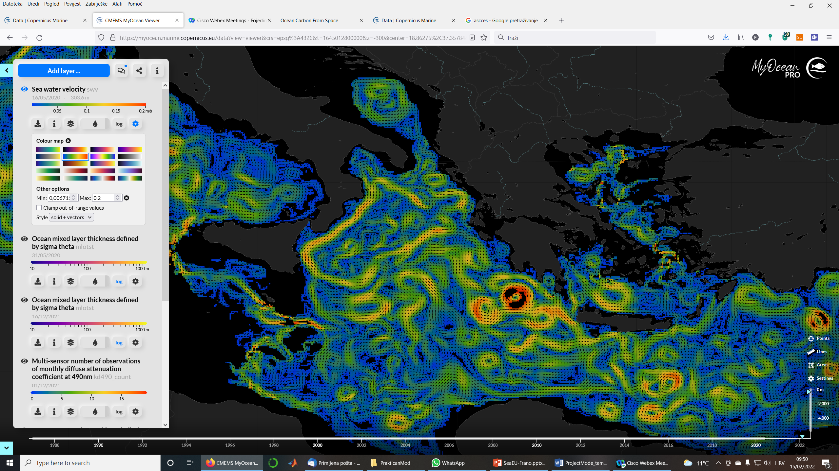
Mediterranean Sea Physics Reanalysis dataset
An easy to understand and easy to use interface for visualization and downloading of necessary data

Slide 5
Neural Gas
Neural gas is an artificial neural network inspired by the self-organizing map, introduced in 1991 by Thomas Martinetz and Klaus Schulten. The neural gas is a simple algorithm for finding optimal data representations and can be considered as a one-dimensional reduction/classification method. The main feature is the weak connection (similarity) between the modelled neurons/classes, because during the learning process the algorithm distributes the neurons like a gas in the data space, which makes the method suitable for modelling extreme events.
Thomas Martinetz and Klaus Schulten (1991). "A "neural gas" network learns topologies". Artificial Neural Networks. Elsevier. pp. 397–402.

Slide 6
An example of neural gas application
Wind over the Mediterranean Sea, January

Slide 7
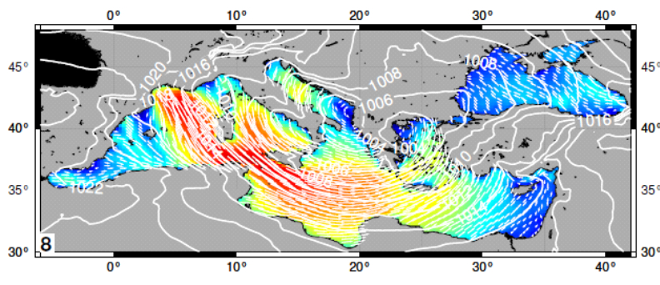
An example of neural gas application
Zoom-in to BMU3

Slide 8
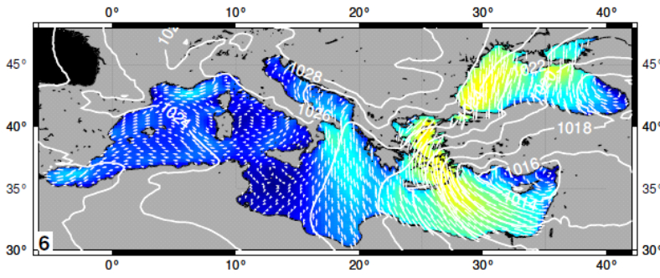
An example of neural gas application
Zoom-in to BMU9

Slide 9
Hypothesis
The Med MFC physical reanalysis product can reproduce BiOS circulation
BiOS circulation influences temperature and salinity distribution in the northern Ionian and the Adriatic Sea

Slide 10
Research steps
Downloading the selected monthly data from Copernicus Marine Service
Basic statistical analysis of the data: monthly and annual means and variability
Transformation of the data to fit the Neural Gas method
Applying the Neural Gas method to the selected data and extracting the characteristic patterns
Testing Hypothesis 1 – is BiOS reproduced
Testing Hypothesis 2 – does BiOS influence temperature and salinity distributions in the Adriatic

Slide 11
Requirements
Access to MATLAB

Slide 12
Project mode dynamics
Meeting with mentors | Work in group | Suggested timeline
Introduction to the Mediterranean Sea Physics Reanalysis dataset | Data download | 1 week
Statistical analysis | Basic statistical analysis of relevant variables | 2 weeks
Neural Gas method | Transforming data to fit the Neural Gas method | 1 week
 | Applying the neural Gas Method | 1 week
 | Extracting characteristic patterns | 1 week
Presenting characteristic patterns to mentors – discussion on approach to confirm/reject hypothesis | Research; confirming or rejecting hypothesis | 1 week
Writing and presenting the final report |  | 2 weeks

