Slide 1



SHORT COURSE ON MARINE DATA LITERACY
PROJECT MODE
Analysis of spatial and temporal wave energy flux variability
along the southern coast of Europe and northern Africa or at the Baltic Sea
Tomás Fernández Montblanc
Earth Science Department
Faculty of Marine Science
University of Cádiz
Aleksandra Cupiał & Marta Misiewicz
Faculty of Oceanography and Geography
University of Gdańsk
27th Mar 2023

Slide 2
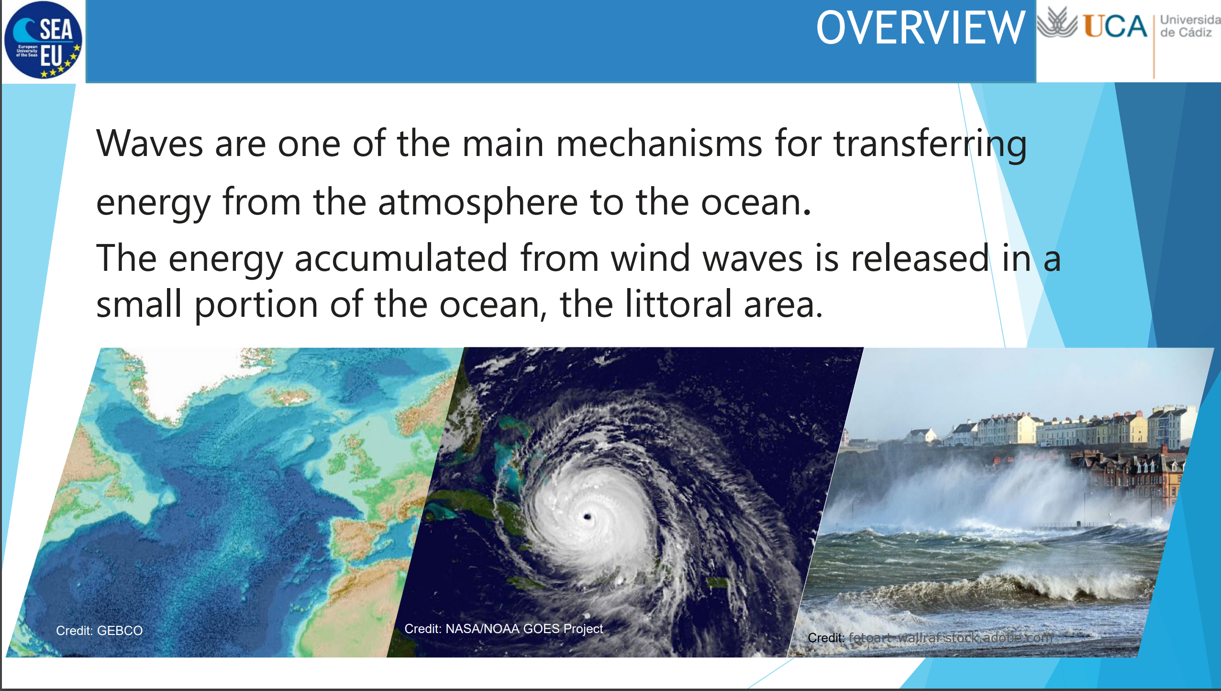


Slide 3
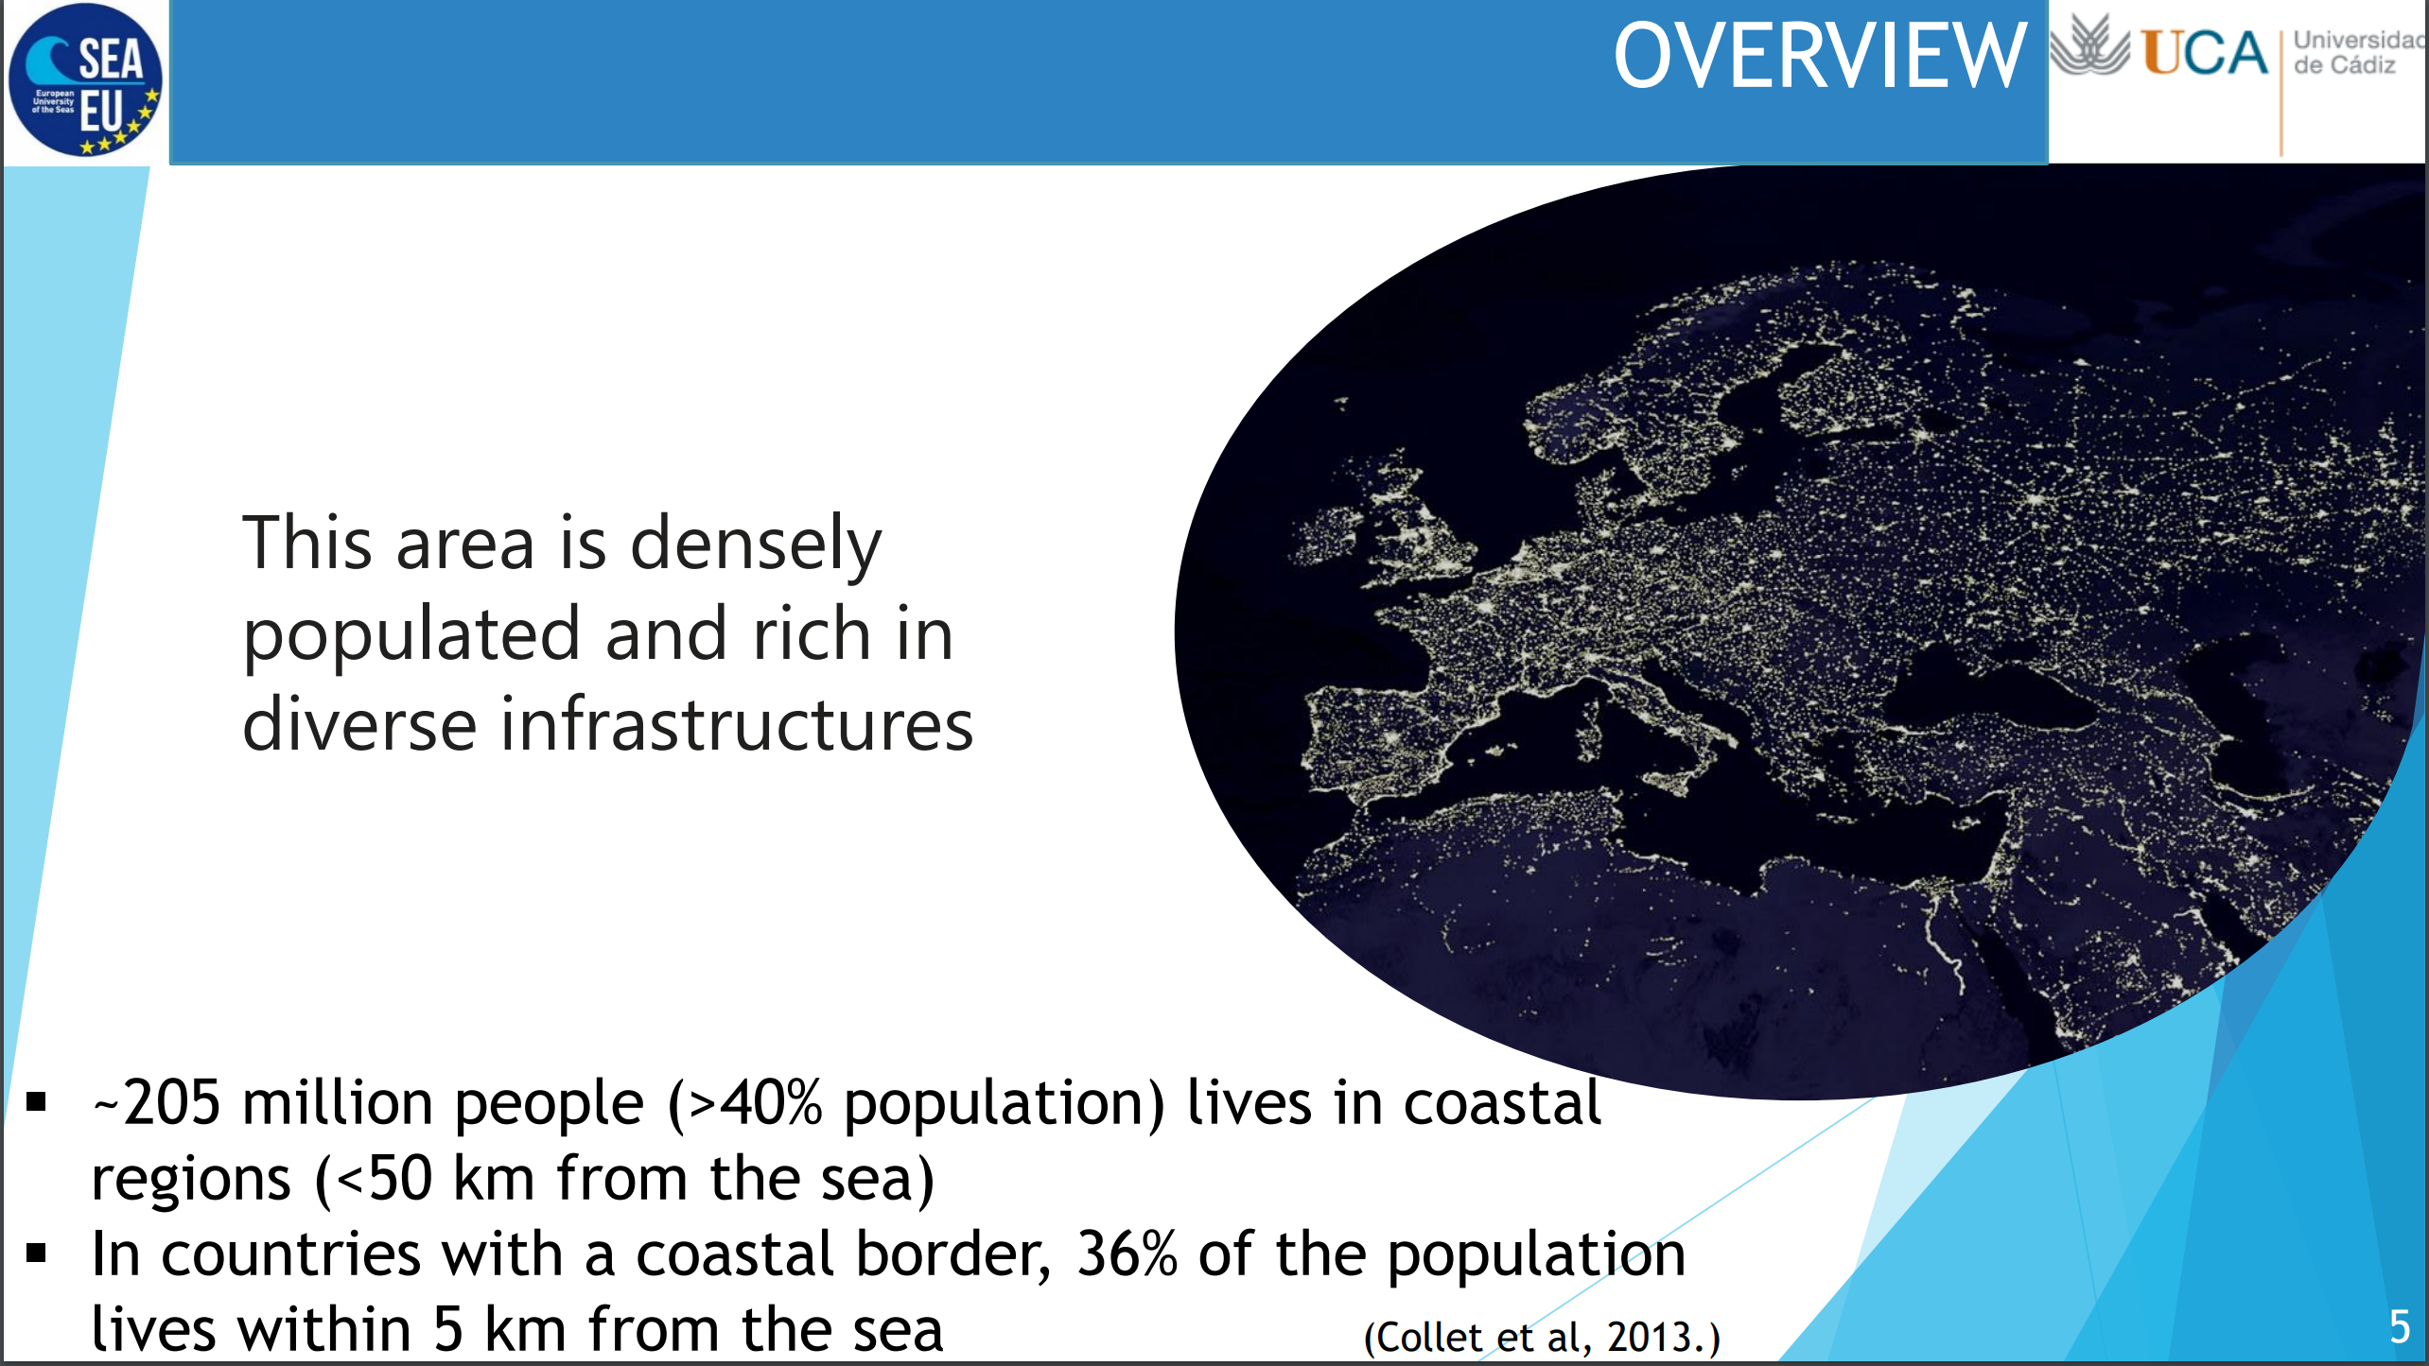

Slide 4
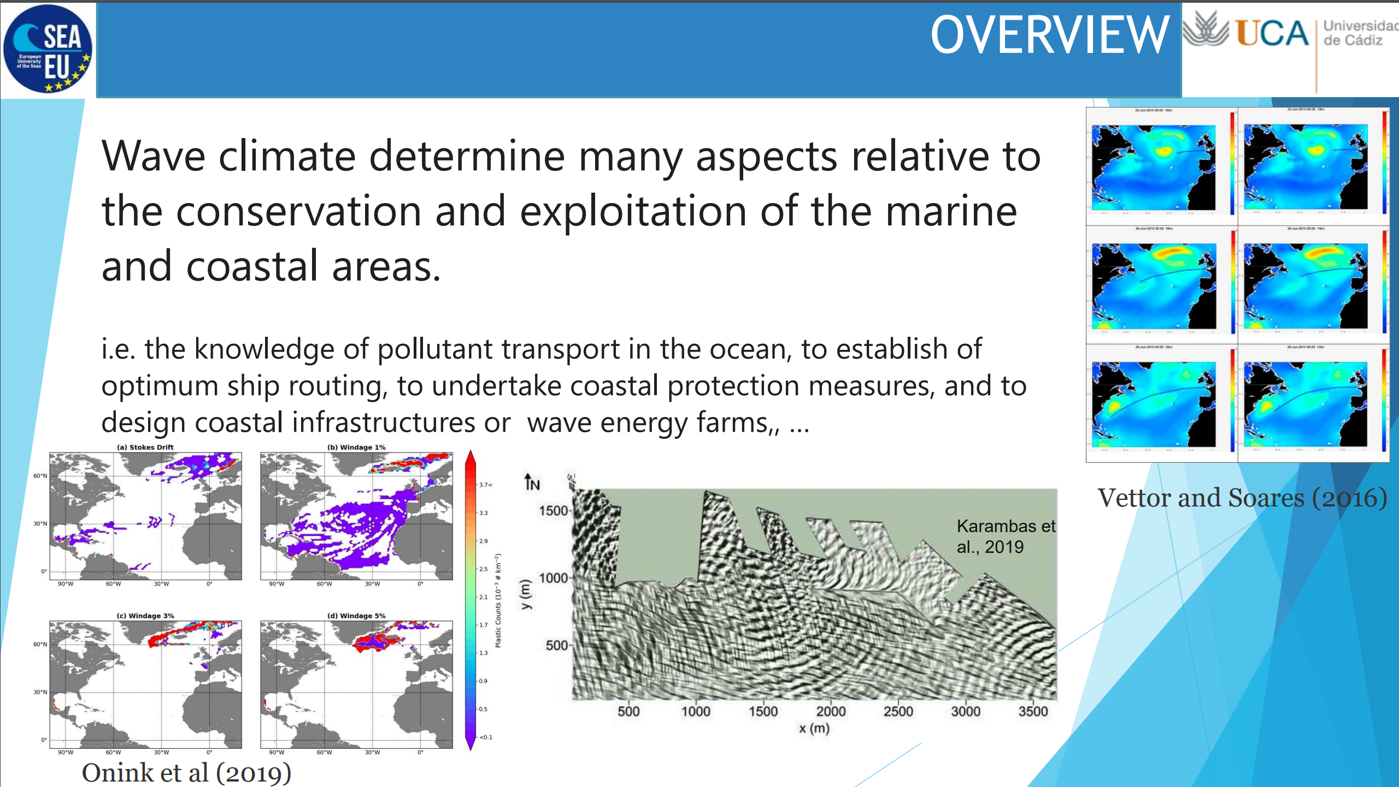

Slide 5
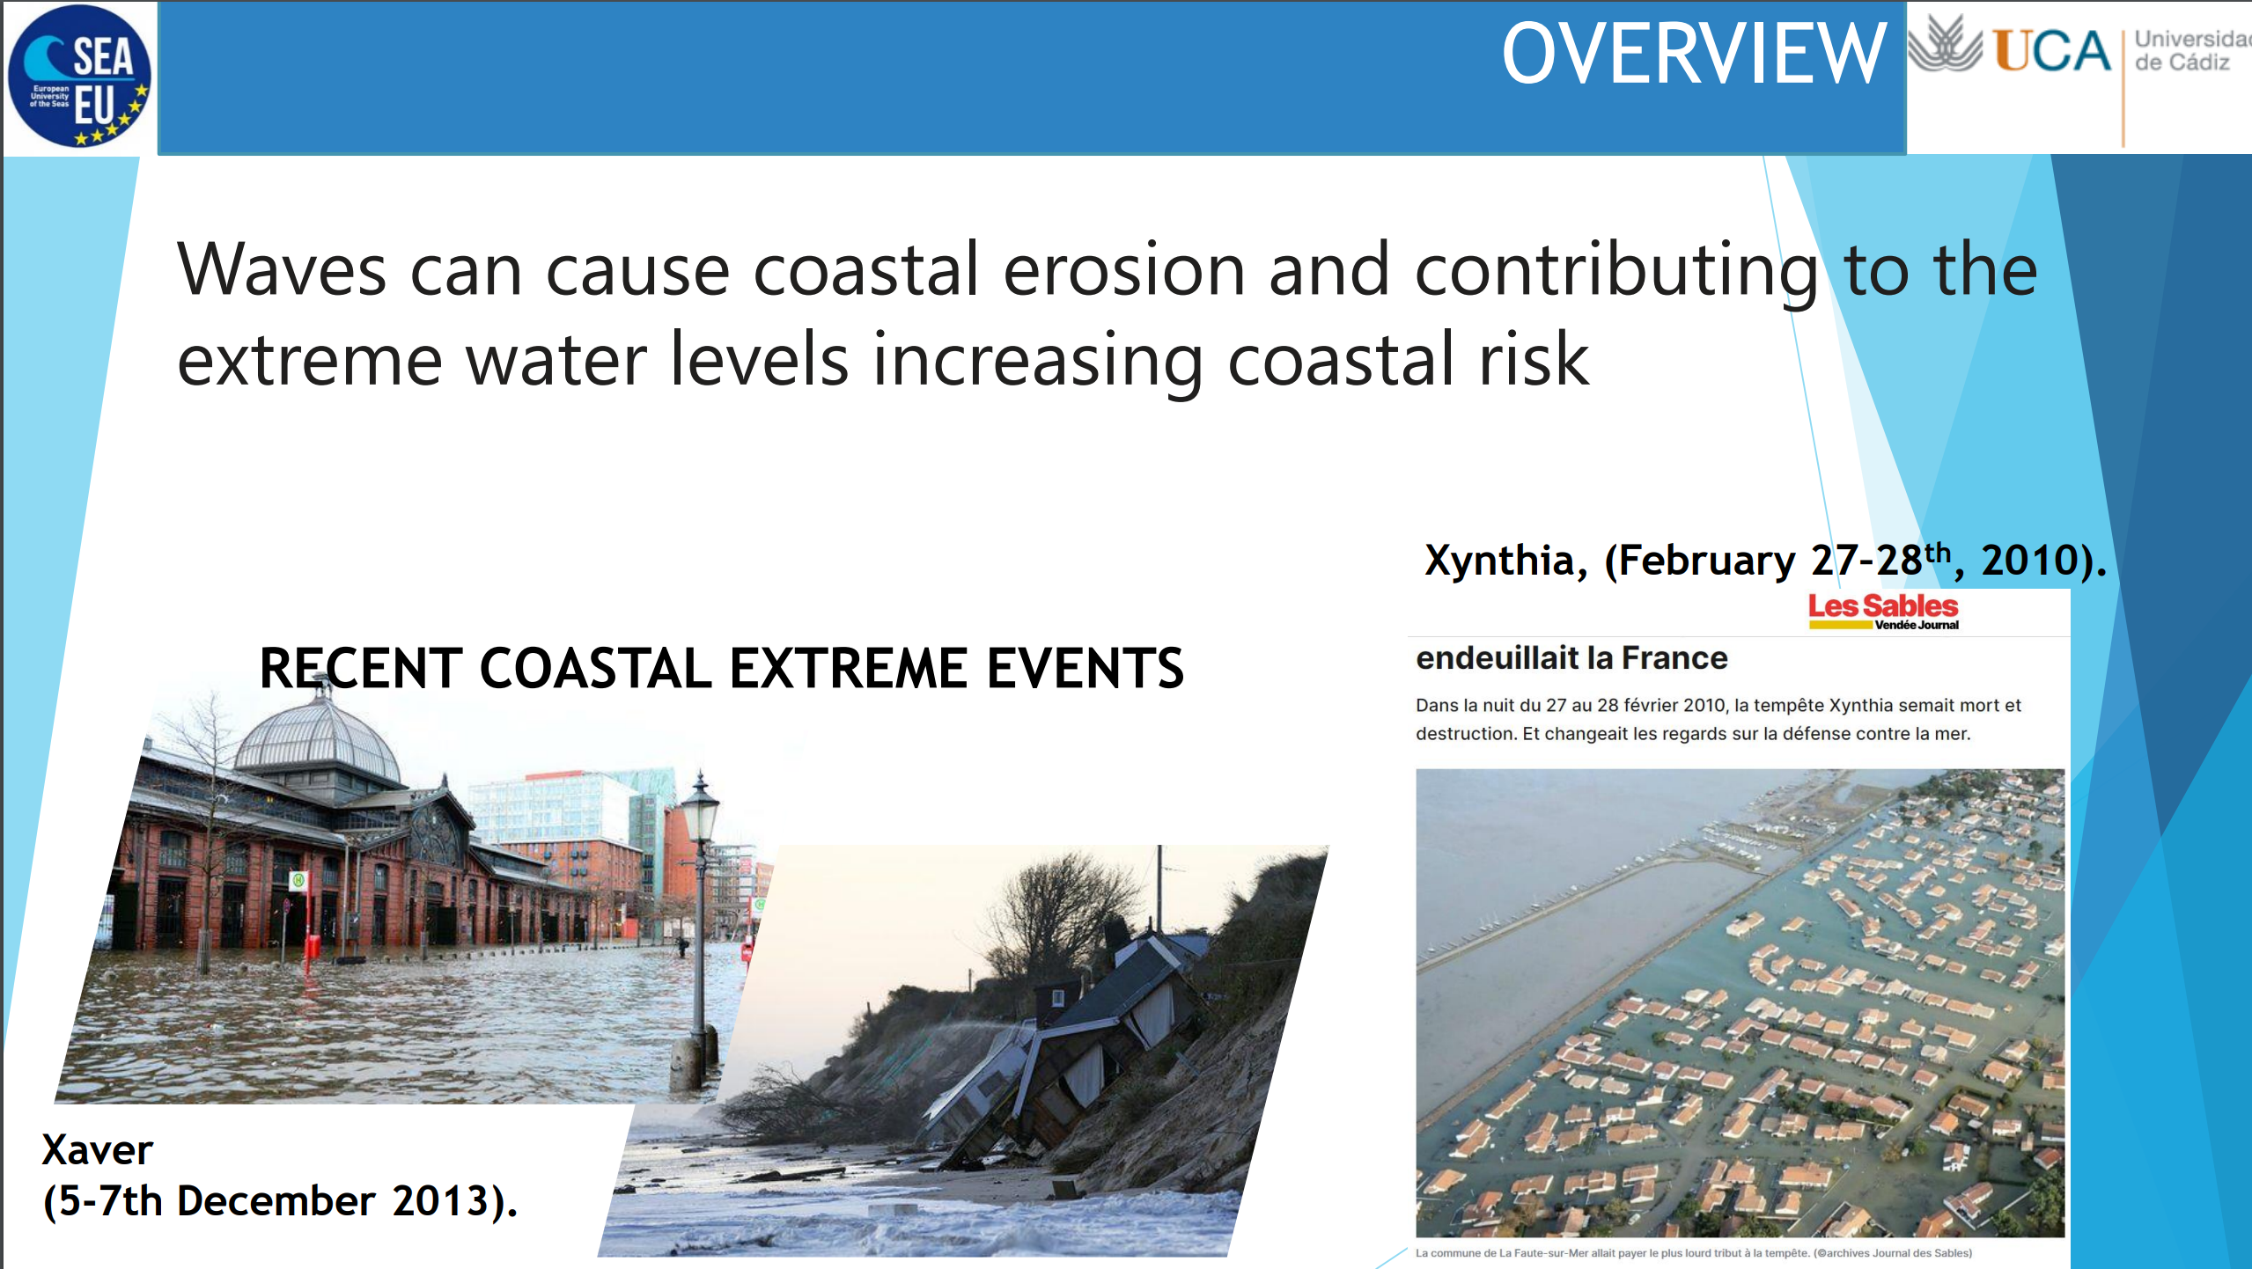

Slide 6

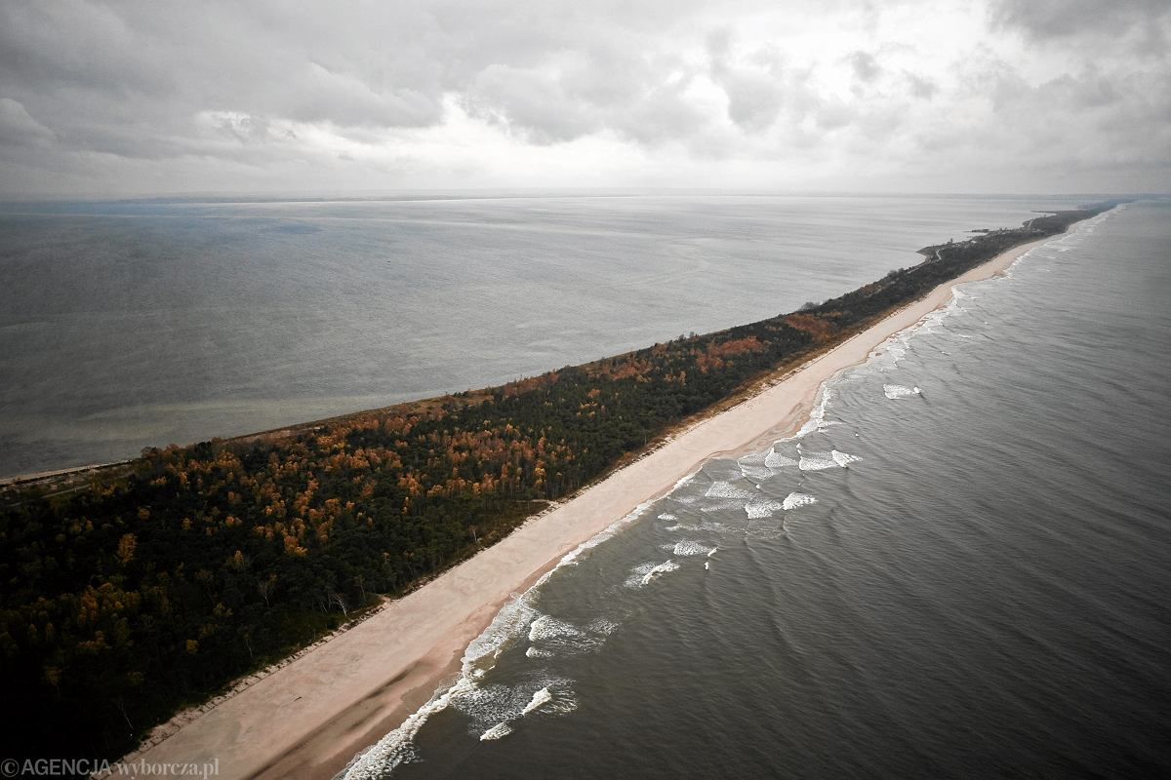
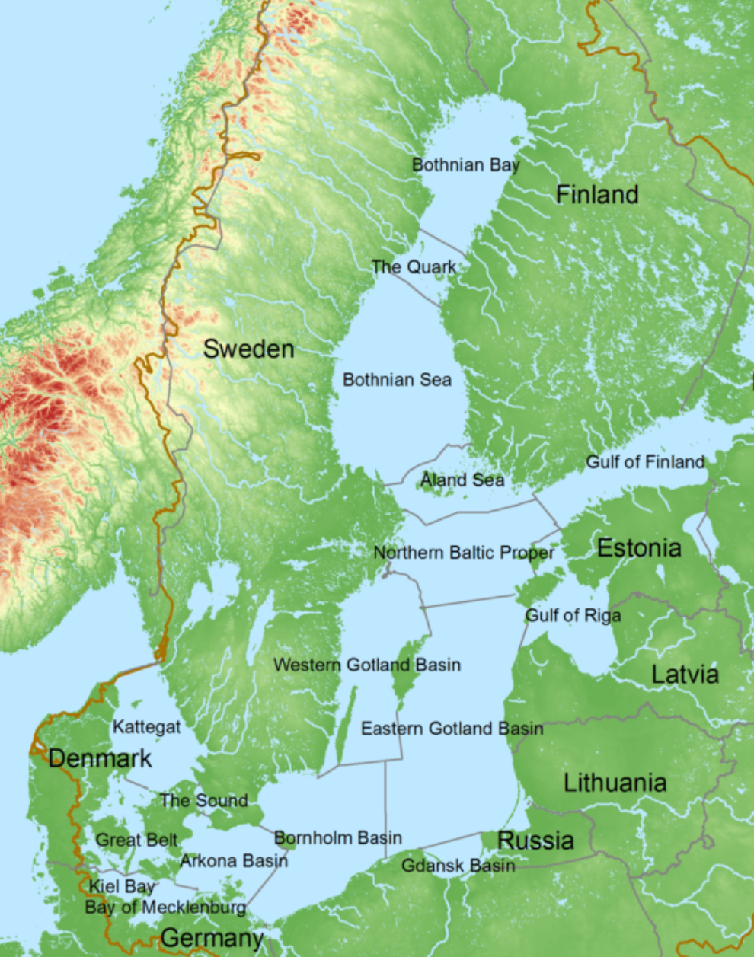
OVERVIEW
Hel Peninsula is identified as one of the first places in the Southern Baltic Sea where from people will need to be displaced due to climate change;
So far, artificial nourishment of coast with sand (~ 100 000 m3/year) reduces the range of erosion areas
Higher and more frequent waves are expected in some areas; modelled change from 8 m (reconstructed for 1958–2001), up to 11 m in 2040–2100.
(Cerkowniak et al, 2015)
© HELCOM

Slide 7
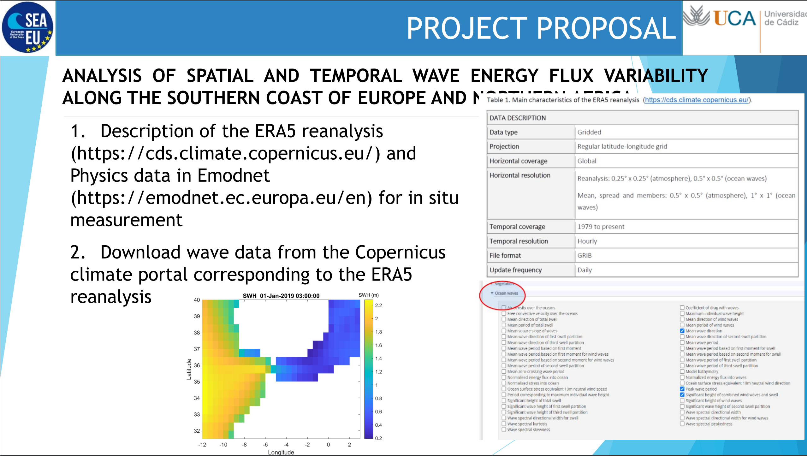
ANALYSIS OF SPATIAL AND TEMPORAL WAVE ENERGY FLUX VARIABILITY
ALONG THE SOUTHERN COAST OF EUROPE AND NORTHERN AFRICA OR AT BALTIC SEA

Slide 8
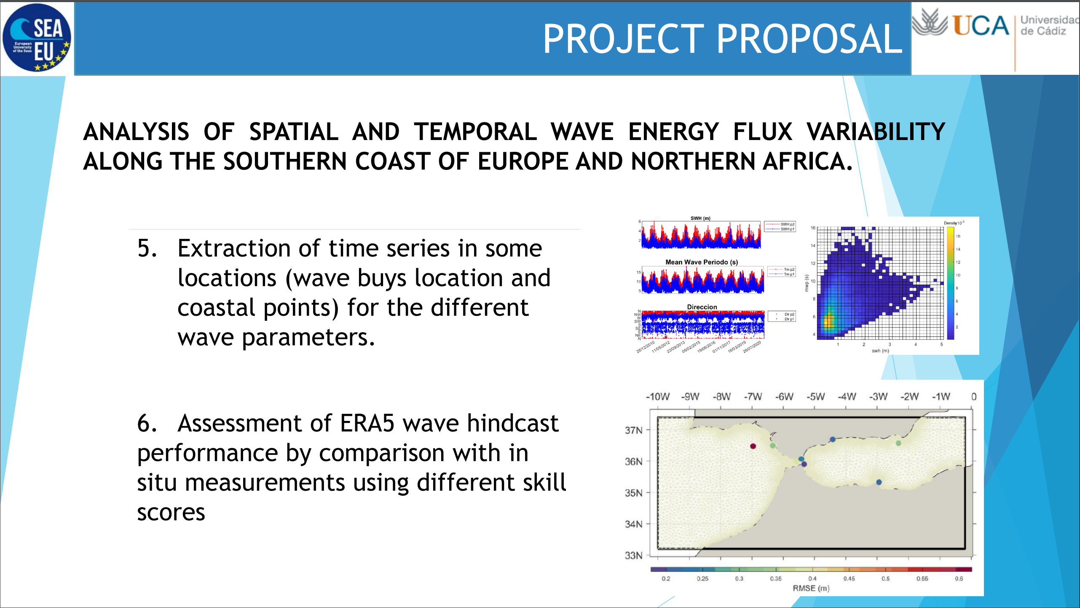
ANALYSIS OF SPATIAL AND TEMPORAL WAVE ENERGY FLUX VARIABILITY
ALONG THE SOUTHERN COAST OF EUROPE AND NORTHERN AFRICA OR AT BALTIC SEA

Slide 9
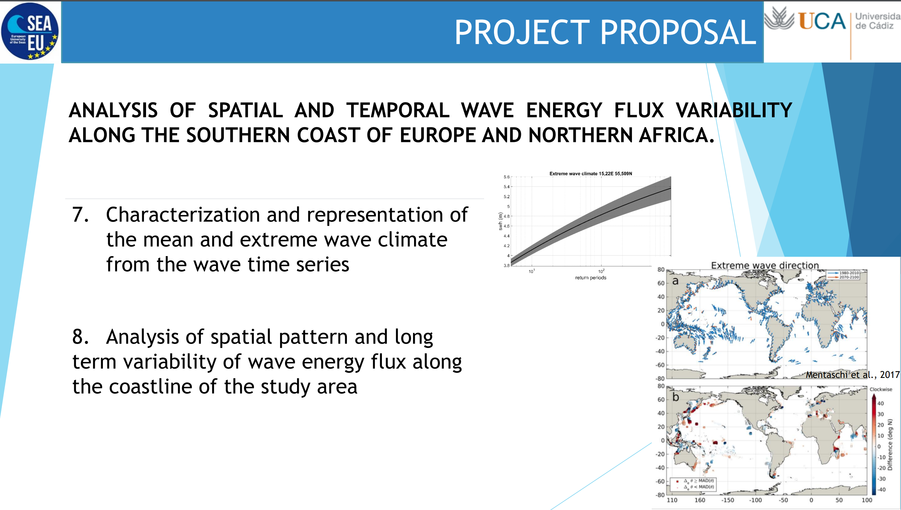
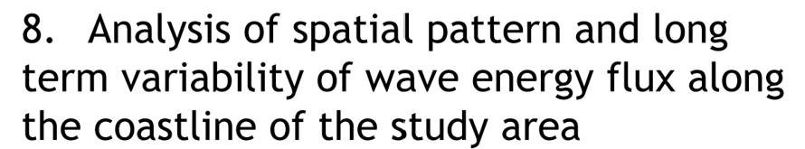
ANALYSIS OF SPATIAL AND TEMPORAL WAVE ENERGY FLUX VARIABILITY
ALONG THE SOUTHERN COAST OF EUROPE AND NORTHERN AFRICA OR AT BALTIC SEA
9. identification of historical storms based on the wave height criterion
10. analysis of the dynamics of the wind wave field during a storm/ visualization of wind wave field of given area

Slide 10
ANALYSIS OF SPATIAL AND TEMPORAL WAVE ENERGY FLUX VARIABILITY
ALONG THE SOUTHERN COAST OF EUROPE AND NORTHERN AFRICA OR AT BALTIC SEA
9. identification of historical storms based on the wave height criterion
10. analysis of the dynamics of the wind wave field during a storm/ visualization of wind wave field of given area

Slide 11
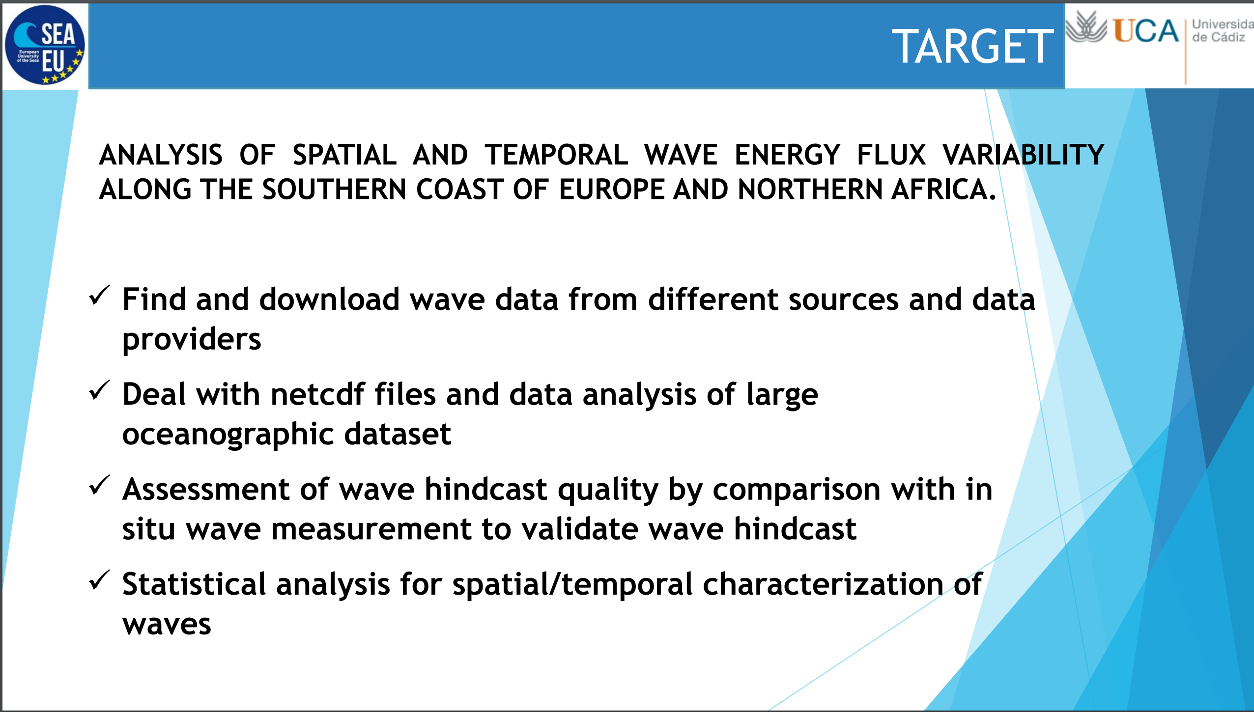
ANALYSIS OF SPATIAL AND TEMPORAL WAVE ENERGY FLUX VARIABILITY
ALONG THE SOUTHERN COAST OF EUROPE AND NORTHERN AFRICA OR AT BALTIC SEA

Slide 12
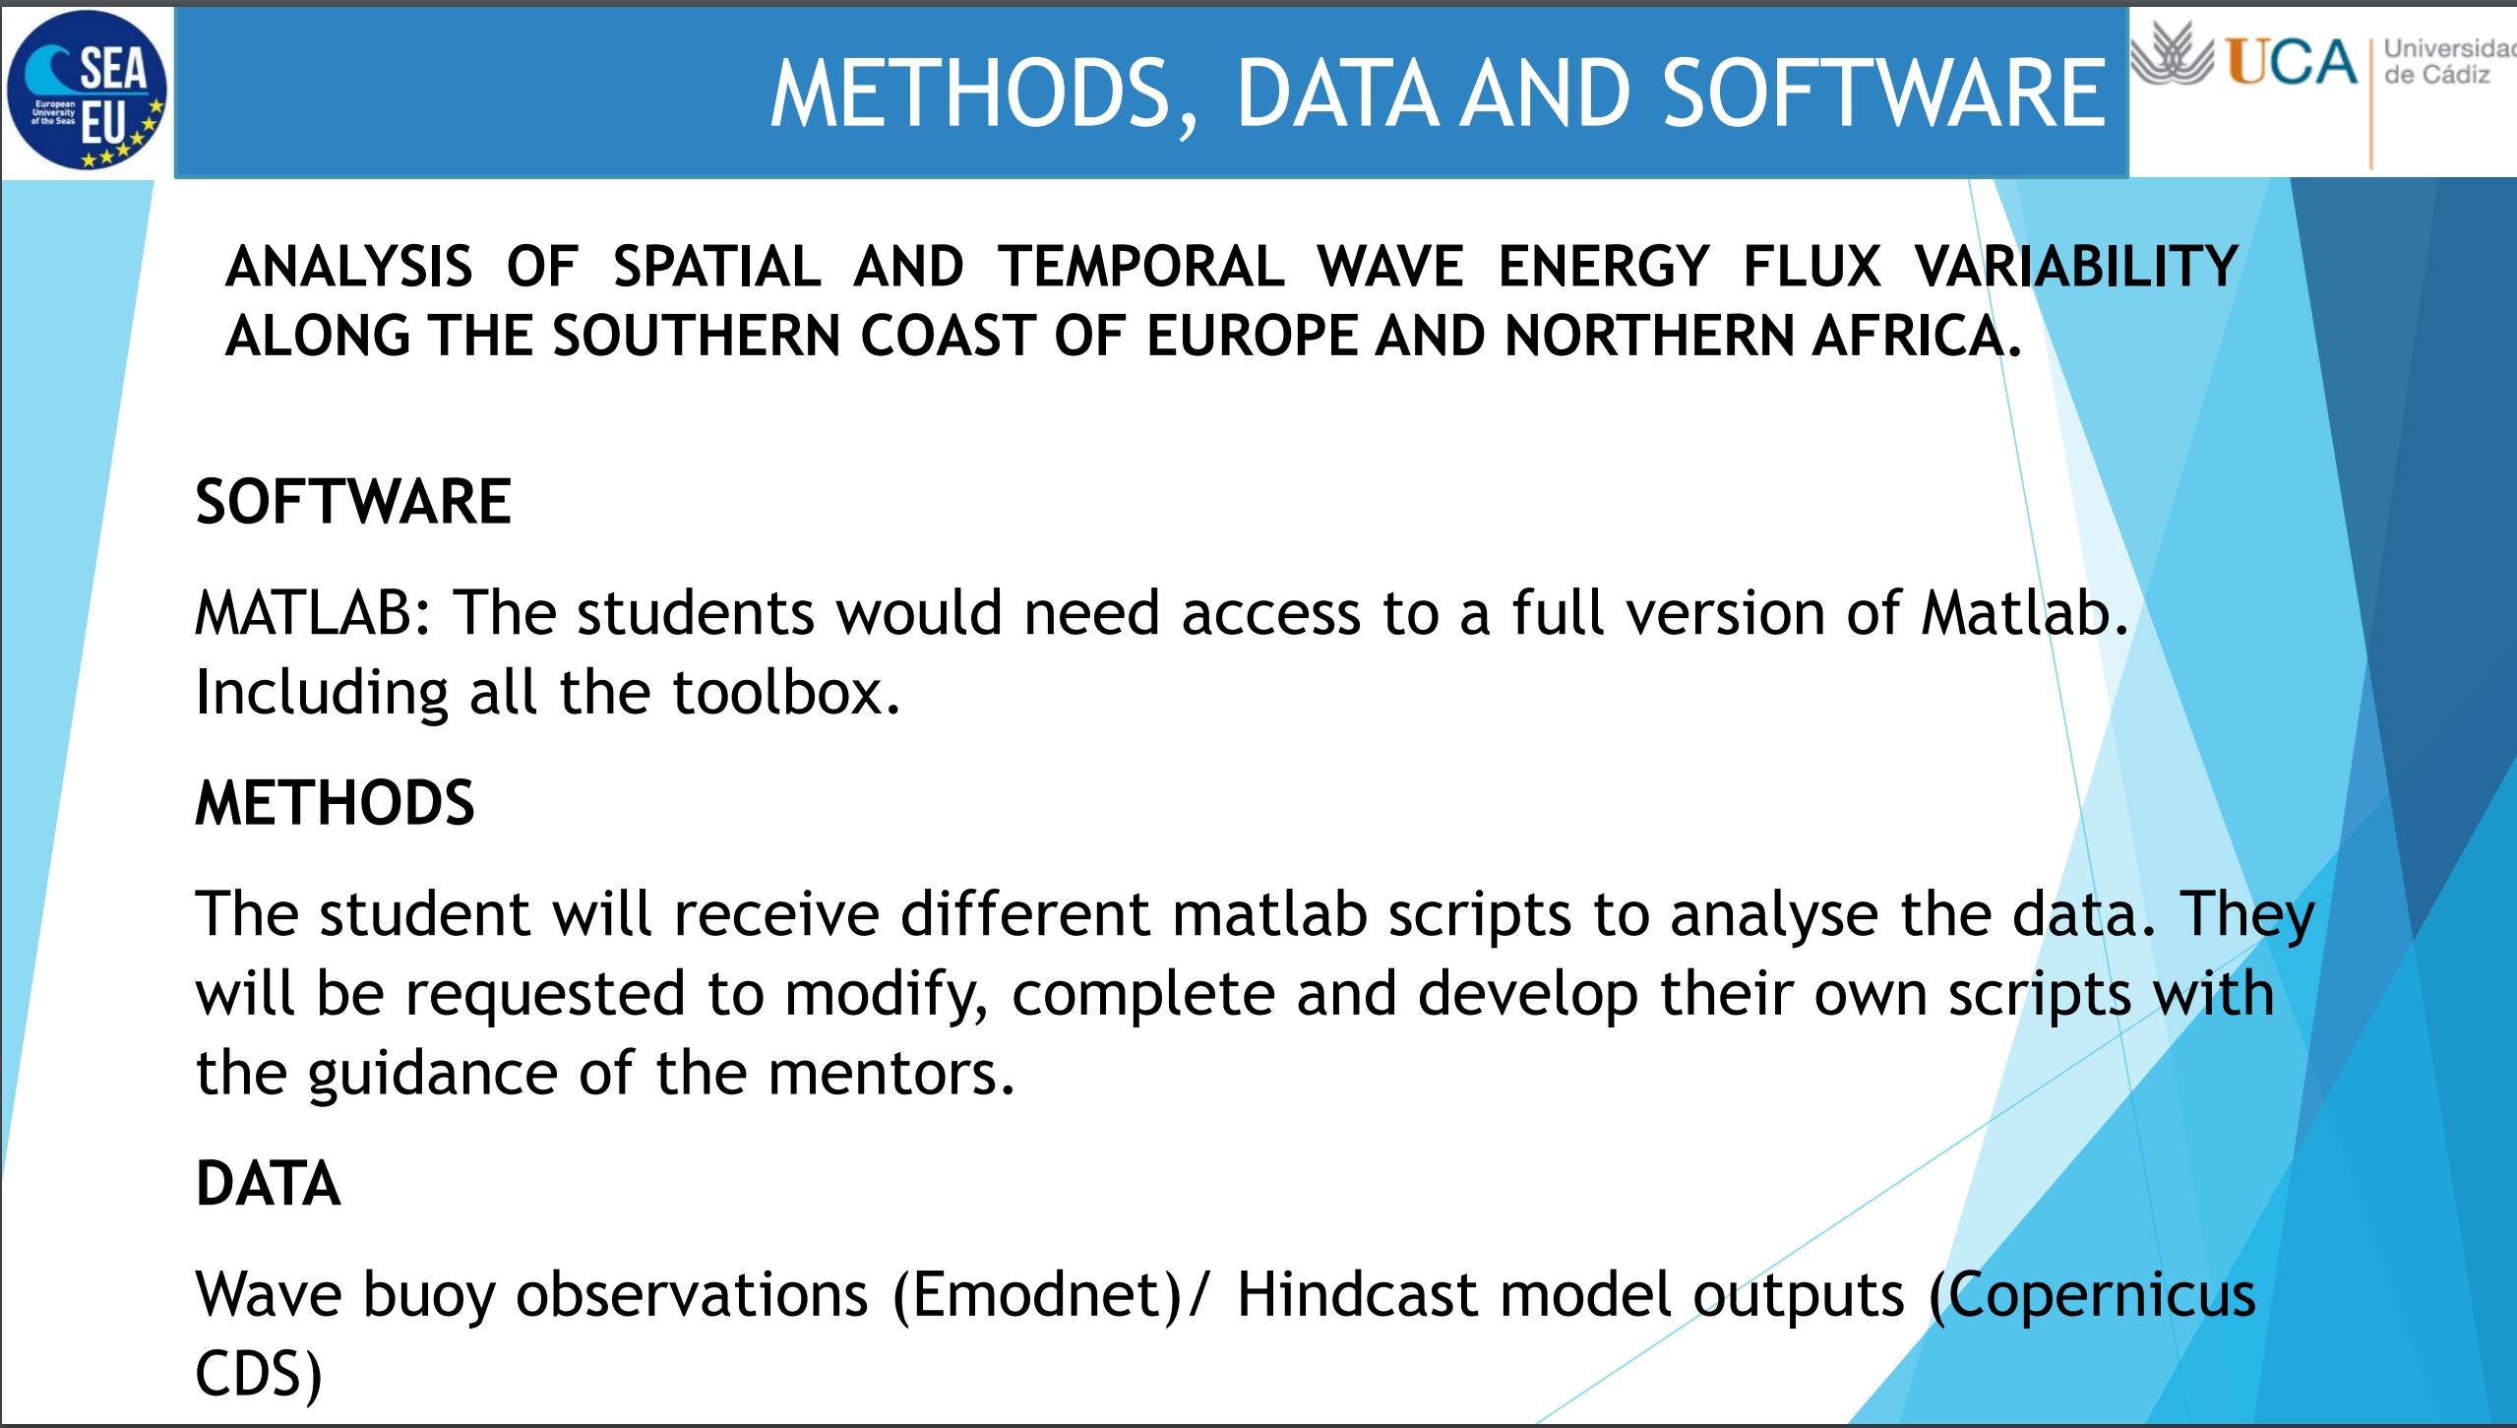
ANALYSIS OF SPATIAL AND TEMPORAL WAVE ENERGY FLUX VARIABILITY
ALONG THE SOUTHERN COAST OF EUROPE AND NORTHERN AFRICA OR AT BALTIC SEA

Slide 13
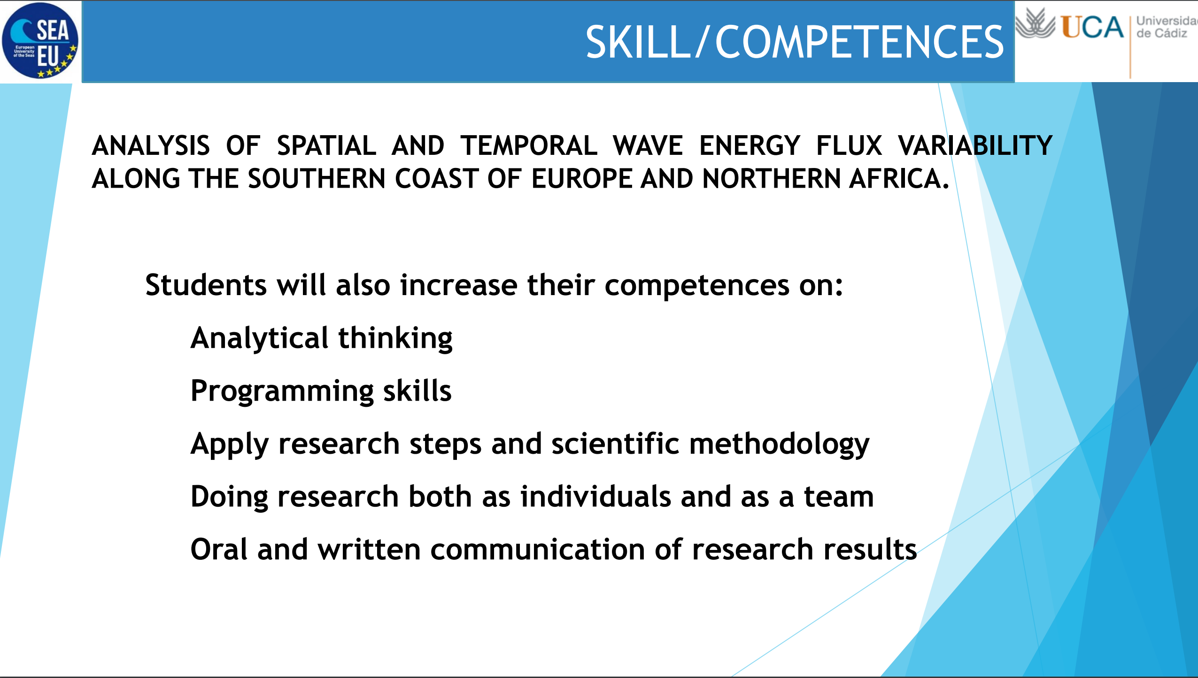
ANALYSIS OF SPATIAL AND TEMPORAL WAVE ENERGY FLUX VARIABILITY
ALONG THE SOUTHERN COAST OF EUROPE AND NORTHERN AFRICA OR AT BALTIC SEA

Slide 14

aleksandra.cupial@ug.edu.pl

