Slide 1
Sea level time series: detecting processes, stationarity and trends
Jadranka Šepić¹, Frano Matić²
¹Faculty of Science, University of Split, Split, Croatia
²University Department of Marine Studies, University of Split, Split, Croatia

Slide 2
Outline of practical
1st part – Jadranka Šepić
Introduction on sea-level processes and available on-line sea level databases
Example: Accessing and downloading data from PSMSL database
MATLAB – basics
MATLAB – simple analysis (loading, plotting, …) of sea-level time series
2nd part – Frano Matić
MATLAB - basic statistical analysis
MATLAB – fitting normal distribution to data
MATLAB – detecting trends: linear regression
MATLAB – climate regimes

Slide 3
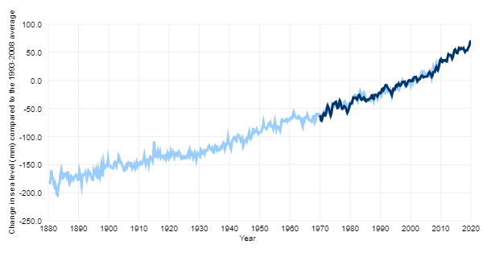
Which processes can we detect in sea level?
Time scale | Process | Spatial scale | Range (order of magnitude) | Predictibility
Longer than 30-year | Climate processes | Global | 100-200 m | Moderate to high predictability up to ~50-100 years in future
2-30 years | Decadal and interannual variabiliy | Regional (e.g. Mediterranean; Adriatic Sea) | 0.5 m | Low predictability
1 year | Seasonal oscillations | Global | 0.1 m | Low to moderate predictability
10 days – 1 year | Longer period atmospheric processes | Regional | 1 m | Low predictability
1 – 10 days | Synoptic processes; storm surges | Regional | 10 m (recorded maxima: 13 m; tropical cyclone Mahina; Australija; March 1899) | Moderate to high predictability – 1-7 days in advance
Daily | Tidal oscillation | Global | Up to 16 m (strongly region dependant) | High predictability/deterministic process
1 min – several hours | Seiche, tsunamis, meteotsunamis | Regional, mesoscale, rarely global (tsunamis) | 10 m (record tsunami: 524 m; Lituya Bay, Alaska, 1958) | Very low predictability
1 – 300 sec | Waves: wind and infragravity | Regional; mesoscale | 10 m | Moderate to high predictability – 1-7 days in advance
CLIMATE: Observed sea level rise during last 140 years

Slide 4
What kind of data we need? And where to find it? (for Europe!)
Time scale | Process | Data requirements | Where to find it?
Longer than 30-year | Climate processes | Monthly or yearly averages | PSMSL; https://www.psmsl.org/ National databases (e.g. Italian national database https://mareografico.it)
2-30 years | Decadal and interannual variability | Monthly or yearly averages | PSMSL; https://www.psmsl.org/; National databases
1 year | Seasonal oscillations | Hourly values; or monthly averages | CMEMS Centre; (http://www.marineinsitu.eu) EMODNET Physics in situ ( https://www.emodnet-physics.eu/map) GESLA (http://www.gesla.org) National databases
10 days – 1 year | Longer period atmospheric processes | Hourly values | CMEMS Centre; (http://www.marineinsitu.eu) EMODNET Physics in situ ( https://www.emodnet-physics.eu/map) GESLA (http://www.gesla.org) National databases
1 – 10 days | Synoptic processes; storm surges | Hourly values
Daily | Tidal oscillation | Hourly values
1 min – several hours | Seiche, tsunamis, meteotsunamis | 1-min values | IOC Sea Level monitoring facility (http://www.ioc-sealevelmonitoring.org) JRC IDSL network (https://webcritech.jrc.ec.europa.eu) National databases (e.g.Croatian database http://faust.izor.hr/autodatapub/postaje)
1 – 300 sec | Waves: wind and infragravity | < 1-min values | JRC IDSL network (https://webcritech.jrc.ec.europa.eu/TAD_server/Device/64) National databases

Slide 5
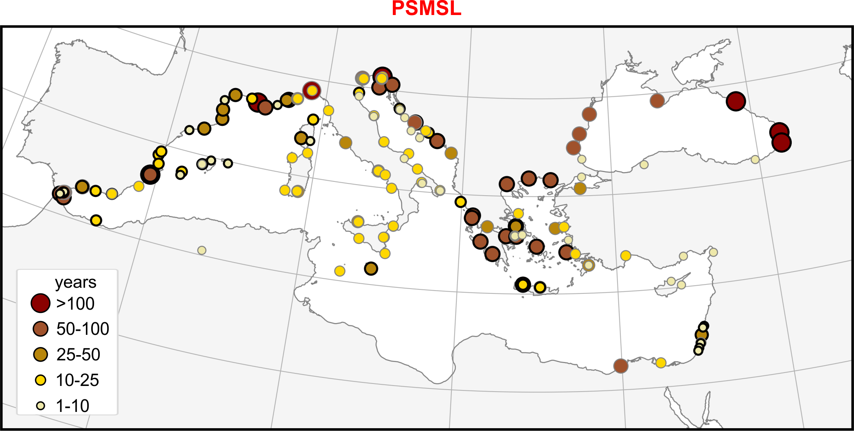
Data availability: Mediterranean and the Black Sea
(Perez-Gomez et al., 2022. https://doi.org/10.5194/os-18-997-2022)

Slide 6
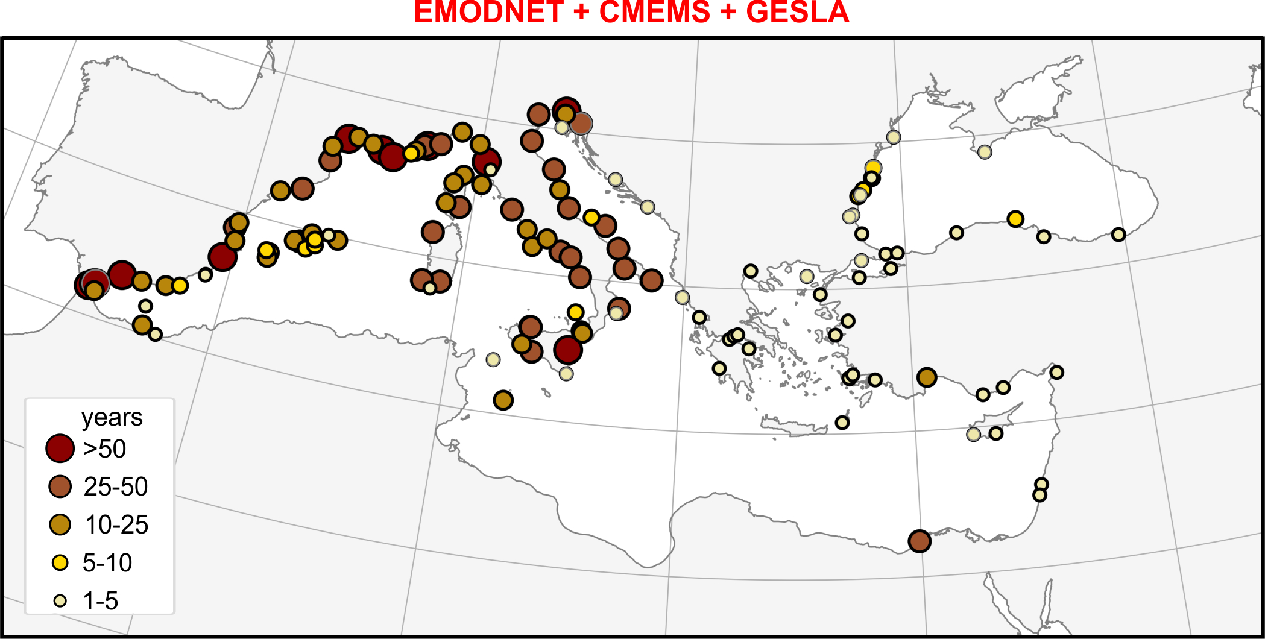
Data availability: Mediterranean and the Black Sea
(Perez-Gomez et al., 2022. https://doi.org/10.5194/os-18-997-2022)

Slide 7
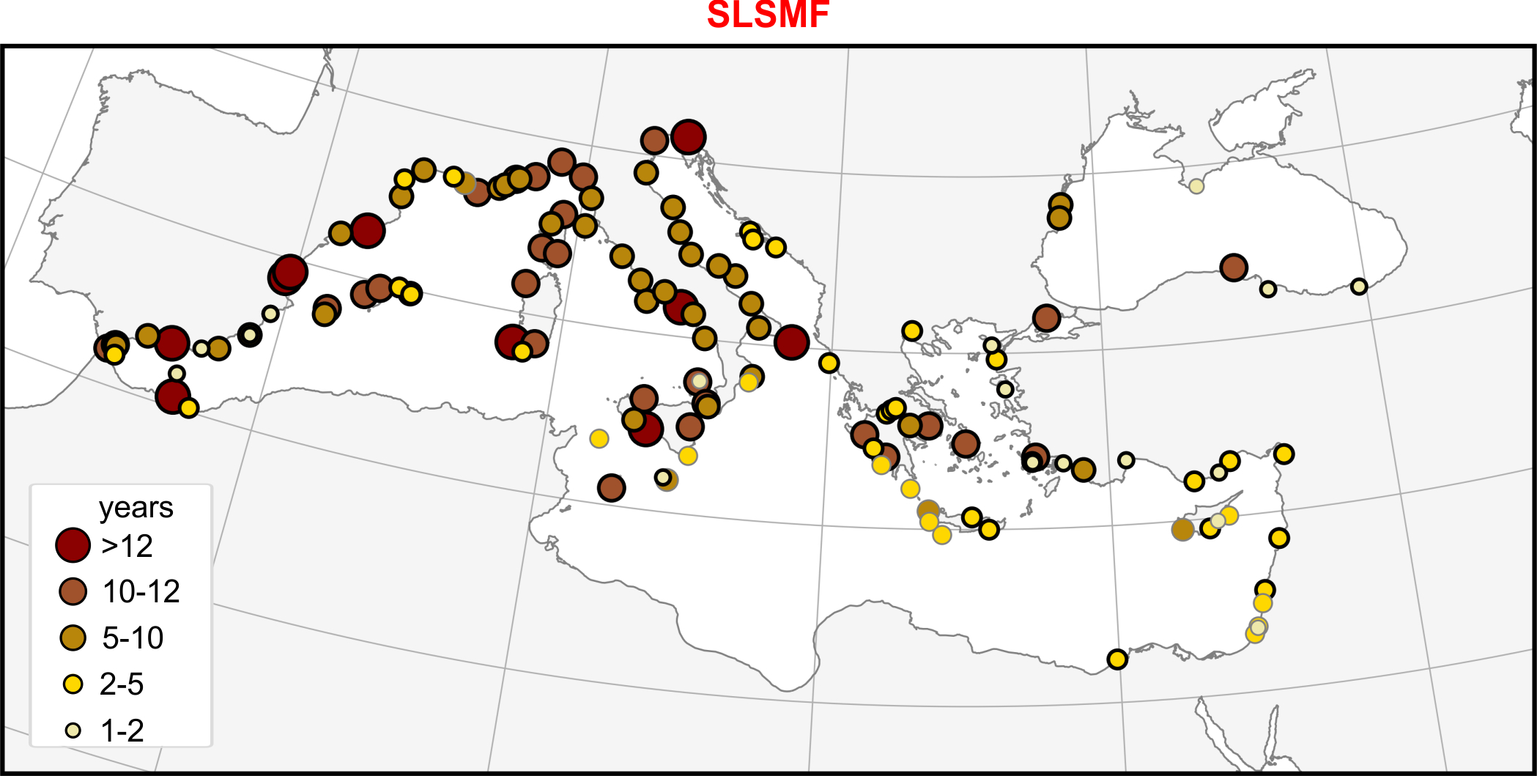
Data availability: Mediterranean and the Black Sea
(Perez-Gomez et al., 2022. https://doi.org/10.5194/os-18-997-2022)

Slide 8
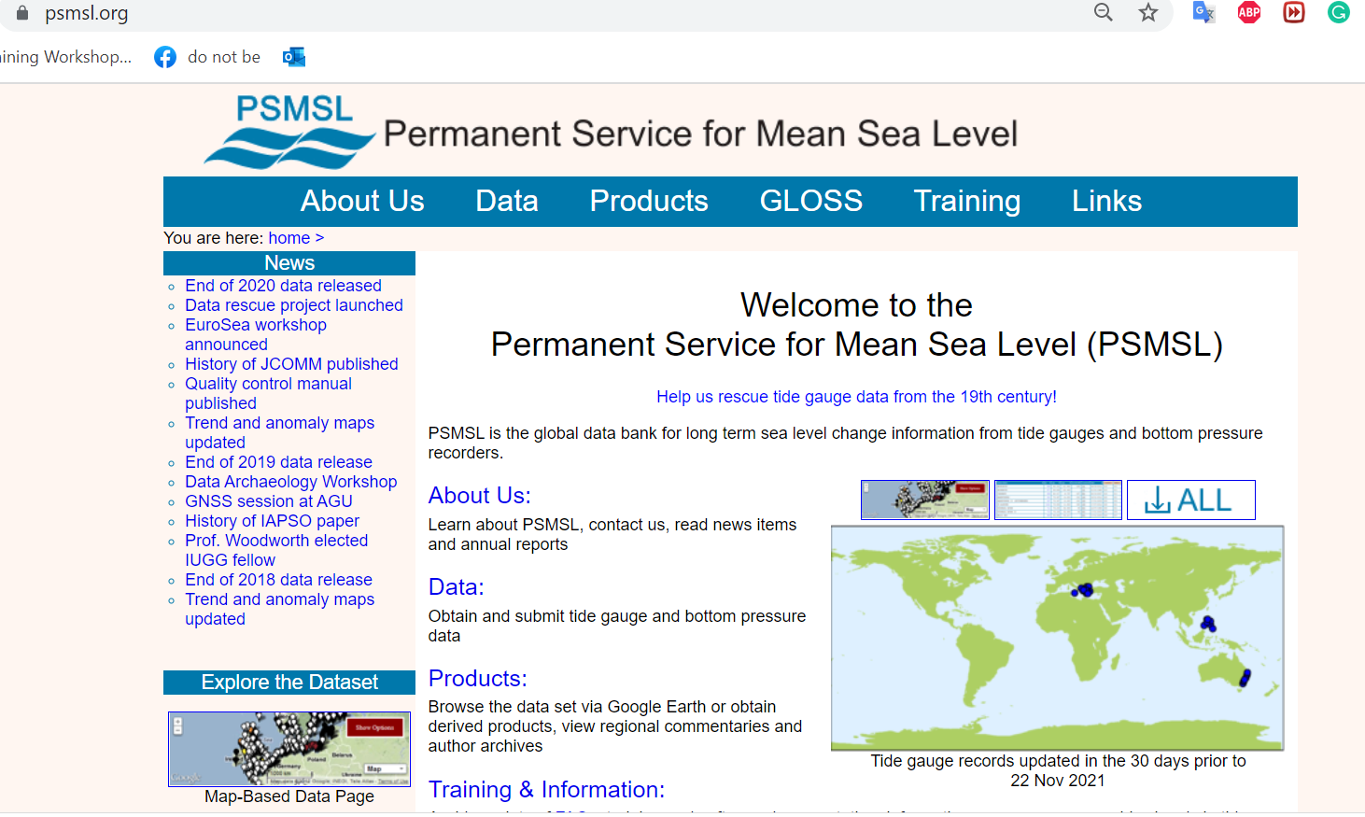
Starting with longer periods: downloading time series from PSMSL
First, we will look into monthly time series.
We will download these from https://www.psmsl.org/ database.
(1) Click on „Data"
1

Slide 9
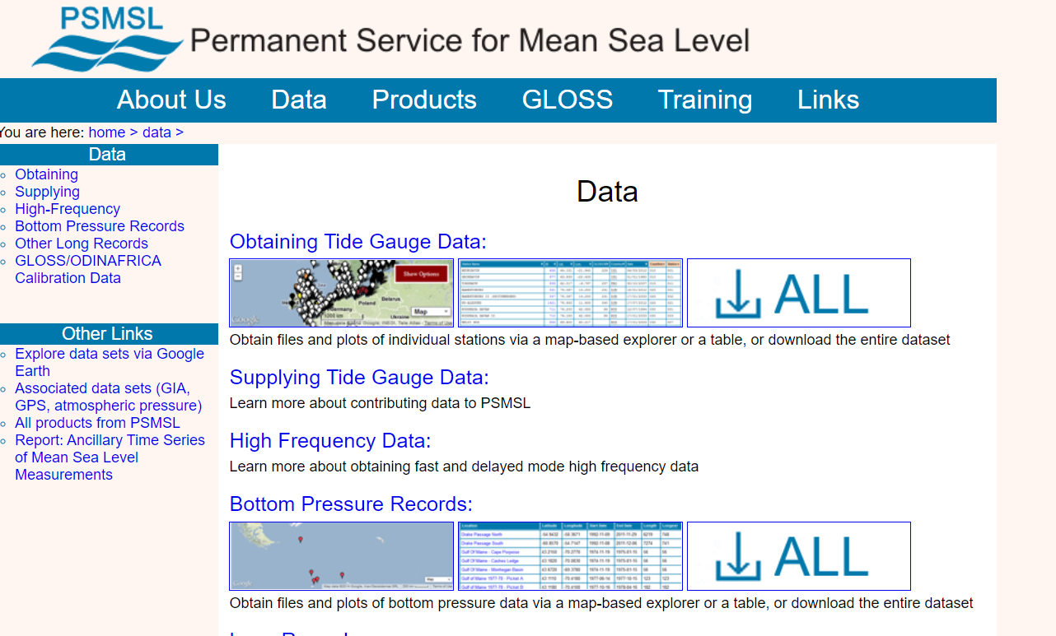
Downloading time series from PSMSL
(2) Click on the map below „Obtaining Tide Gauge Data"
2

Slide 10
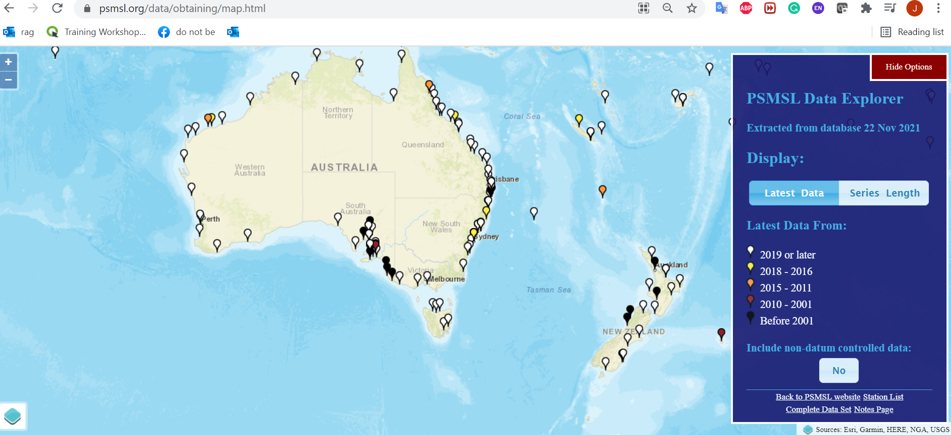
Downloading time series from PSMSL
(3) Link takes us to: https://www.psmsl.org/data/obtaining/map.html
(4) Find Bakar (the Adriatic Sea, Mediterranean) in the map

Slide 11
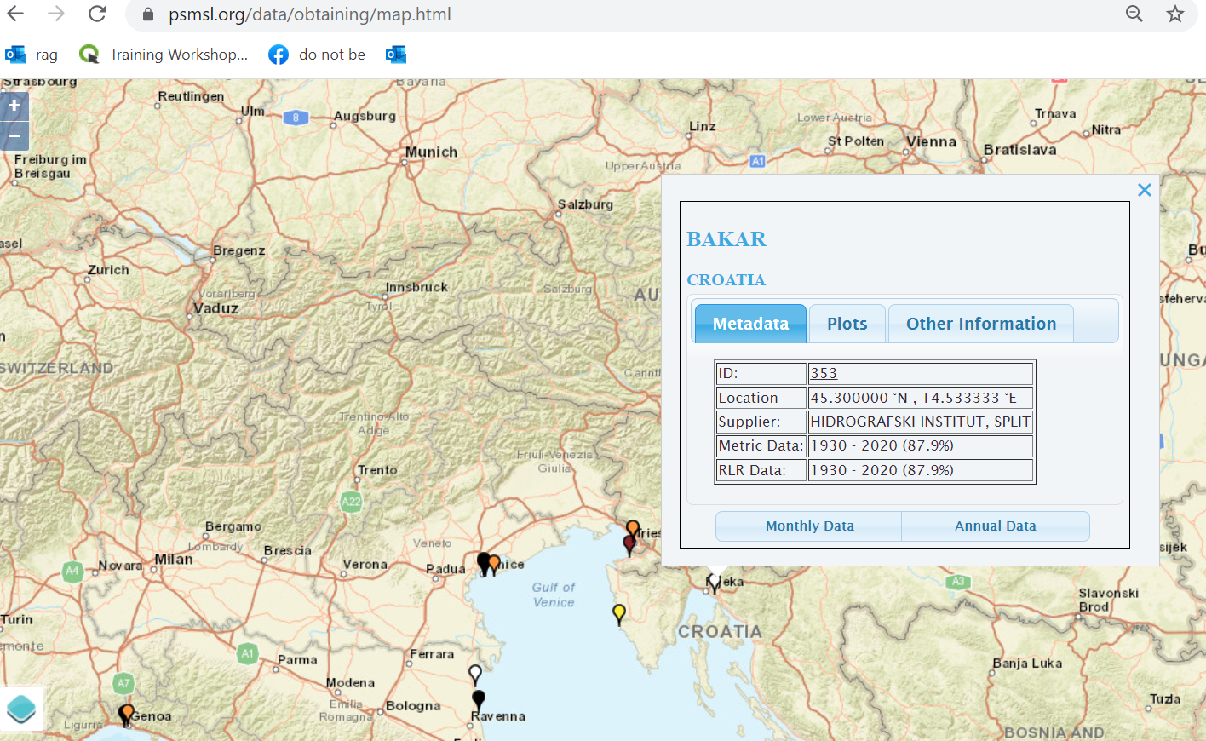
Downloading time series from PSMSL
(4) Find Bakar (the Adriatic Sea, Mediterranean) in the map;
(5) „left click” on the white marker
(6) Click on „Monthly Data"
6

Slide 12
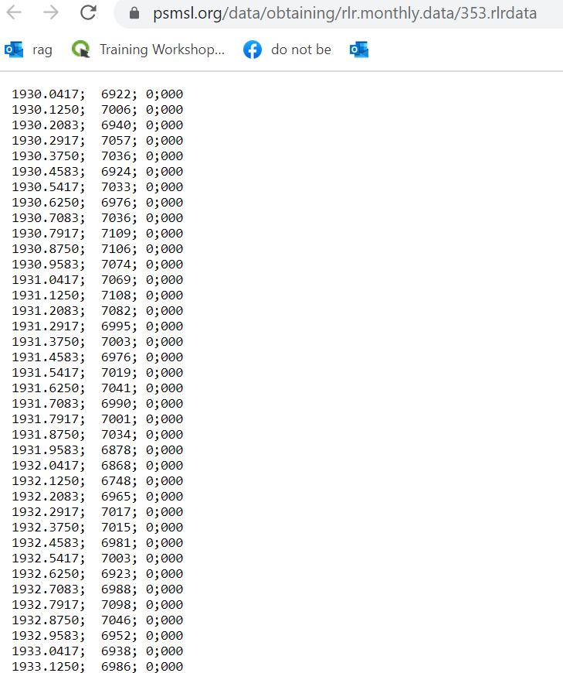
Downloading time series PSMSL
(7) Select All and copy into a text editor (notepad; notepad++; … )
(8) Save in text editor as „bakar_monthly.txt”
There are four columns in the file; in the first one there is time (year); in the second one, there is
sea level (mm); third and fourth are quality indices and are not of our interest at the moment.

Slide 13
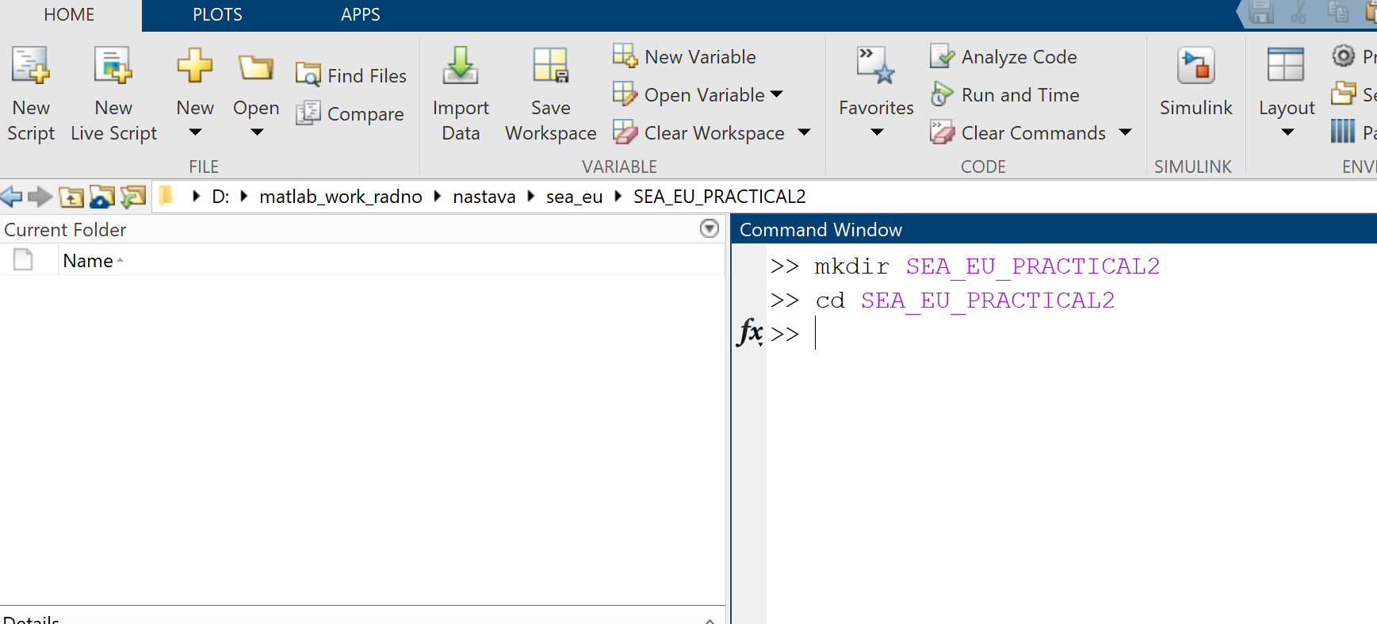
MATLAB: introduction
(9) Open MATLAB
(10) In MATLAB create directory „SEA_EU_Practical_2” and move to it
This is done by typing in command window:
mkdir SEA_EU_Practical_2
cd SEA_EU_Practical_2
(11) We are now in this directory
11
10

Slide 14
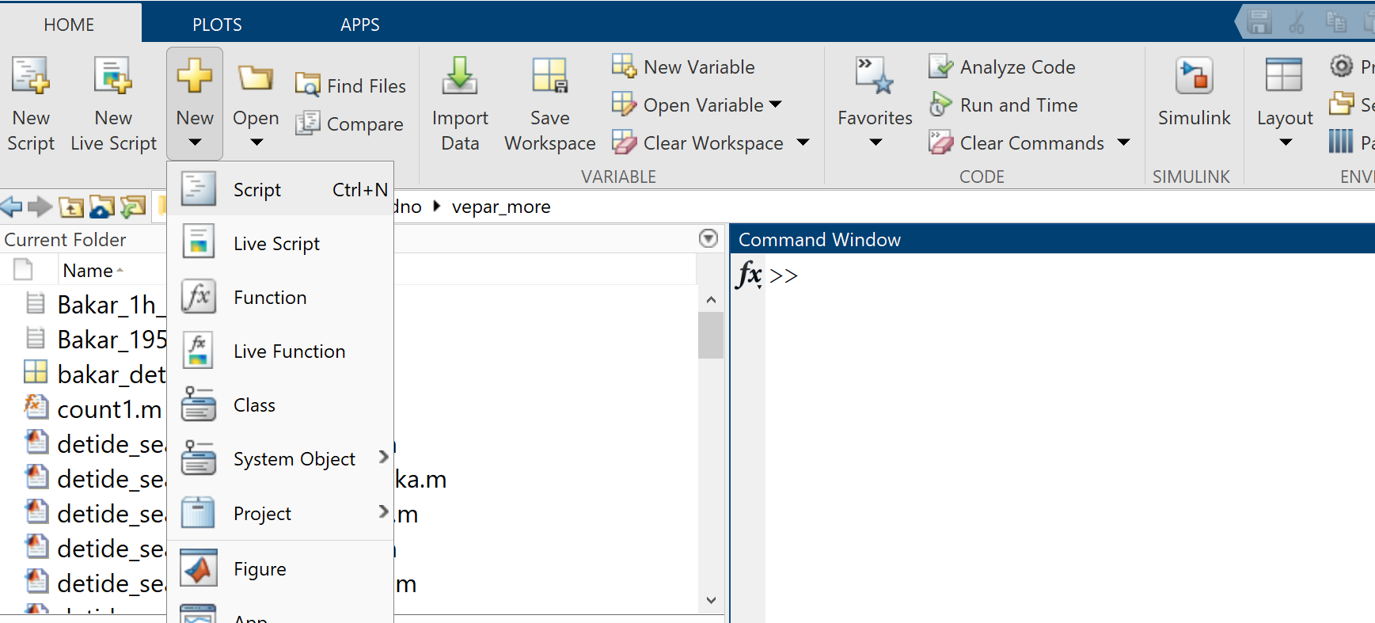
MATLAB: Introduction
(12) Copy „bakar_monthly.txt” into this directory
(13) We will now create a script for loading and visualising these data
(14-15) Click on „New”, and then on „Script” -> a script (empty text file „Untitled” appears in editor)
We now write all our commands in this editor so that we can run them all at once
14
15

Slide 15
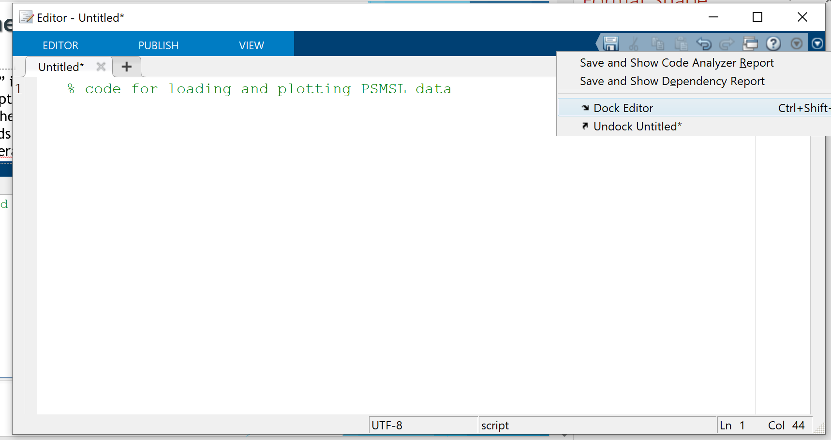
MATLAB: Introduction
(12) Copy „bakar_monthly.txt” into this directory
(13) We will now create a script for loading and visualising these data
(14-15) Click on „New”, and then on „Script” -> a script (empty text file „Untitled” appears in editor)
We now write all our commands in this editor so that we can run them all at once
(16-17) If editor appears as a separate window, we can dock it by clicking on downward „arrow” and then on
„Dock editor” (with „docking” all MATLAB windows are on the same screen).
(18) We can now write some comments in the editor; comments are written with „%” at the beginning of the line – code does not run comments.
16
17
18

Slide 16
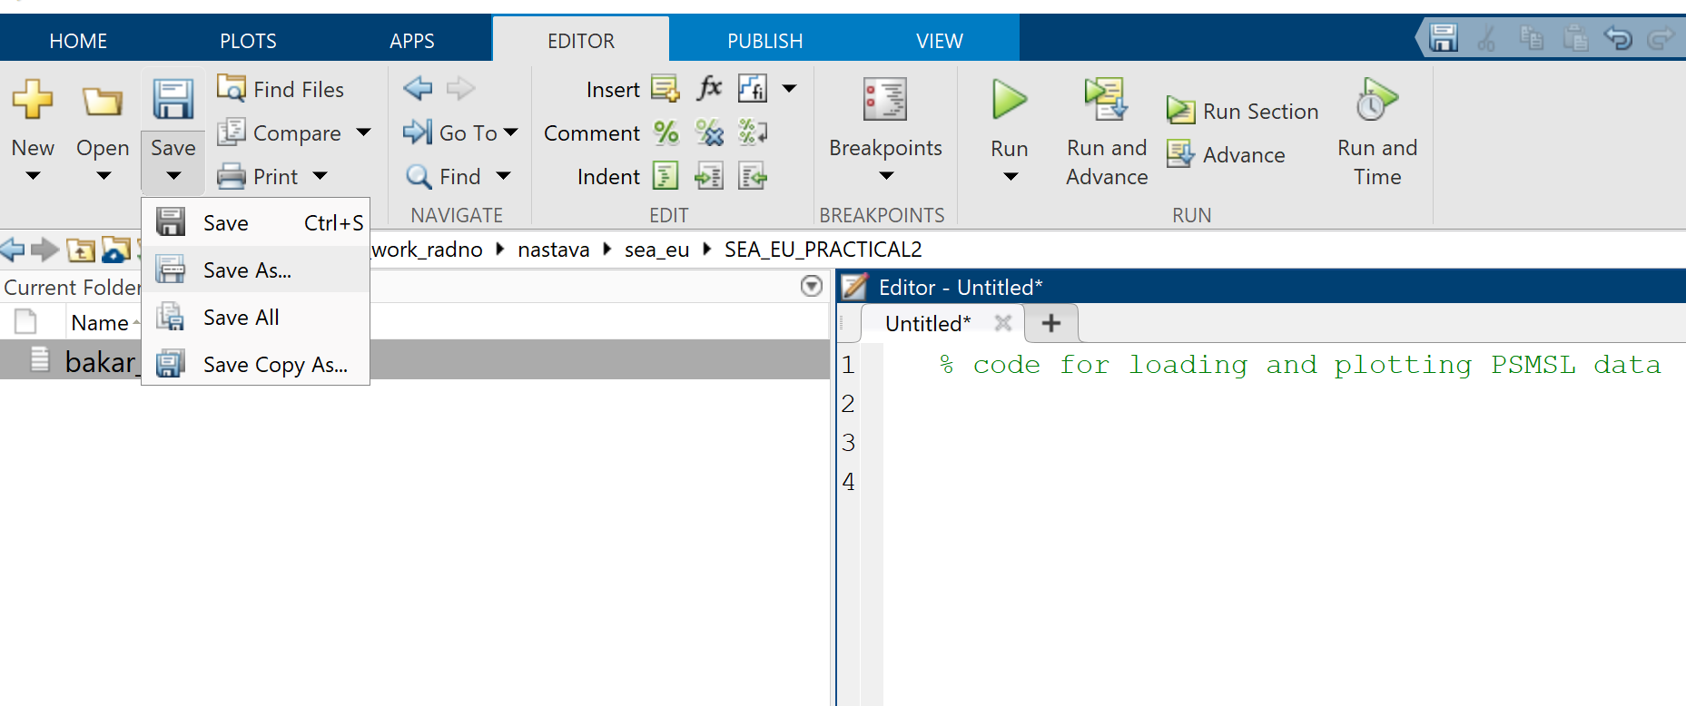
MATLAB: Introduction
(19-20) Save the script so that we can run it; To save script, tab „Editor” (19) must be selected; then (20)
19
20

Slide 17
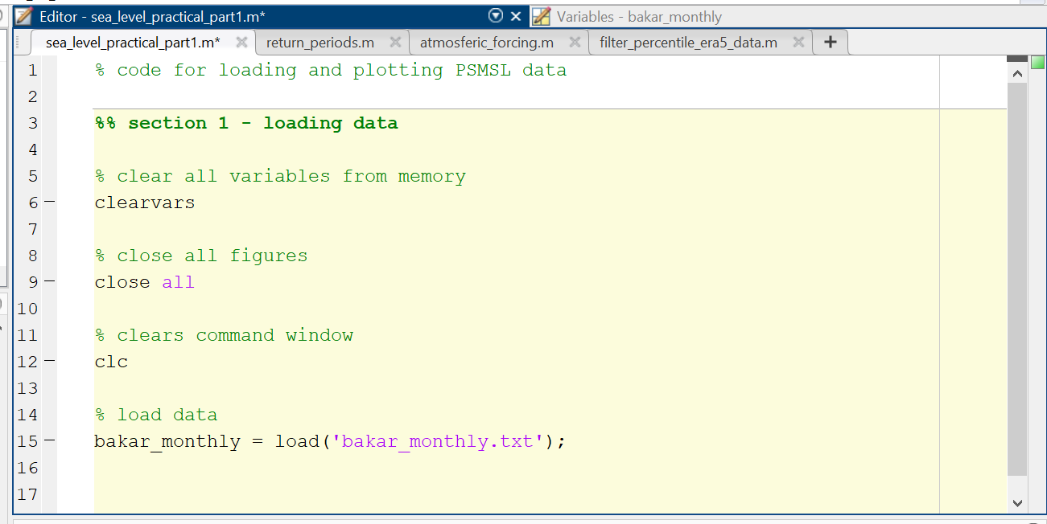
MATLAB: data loading
(21) Save file as „sea_level_paractical_part1.m” ->
(22) Now we can write code
New name
Dividing code into separate sections

Slide 18
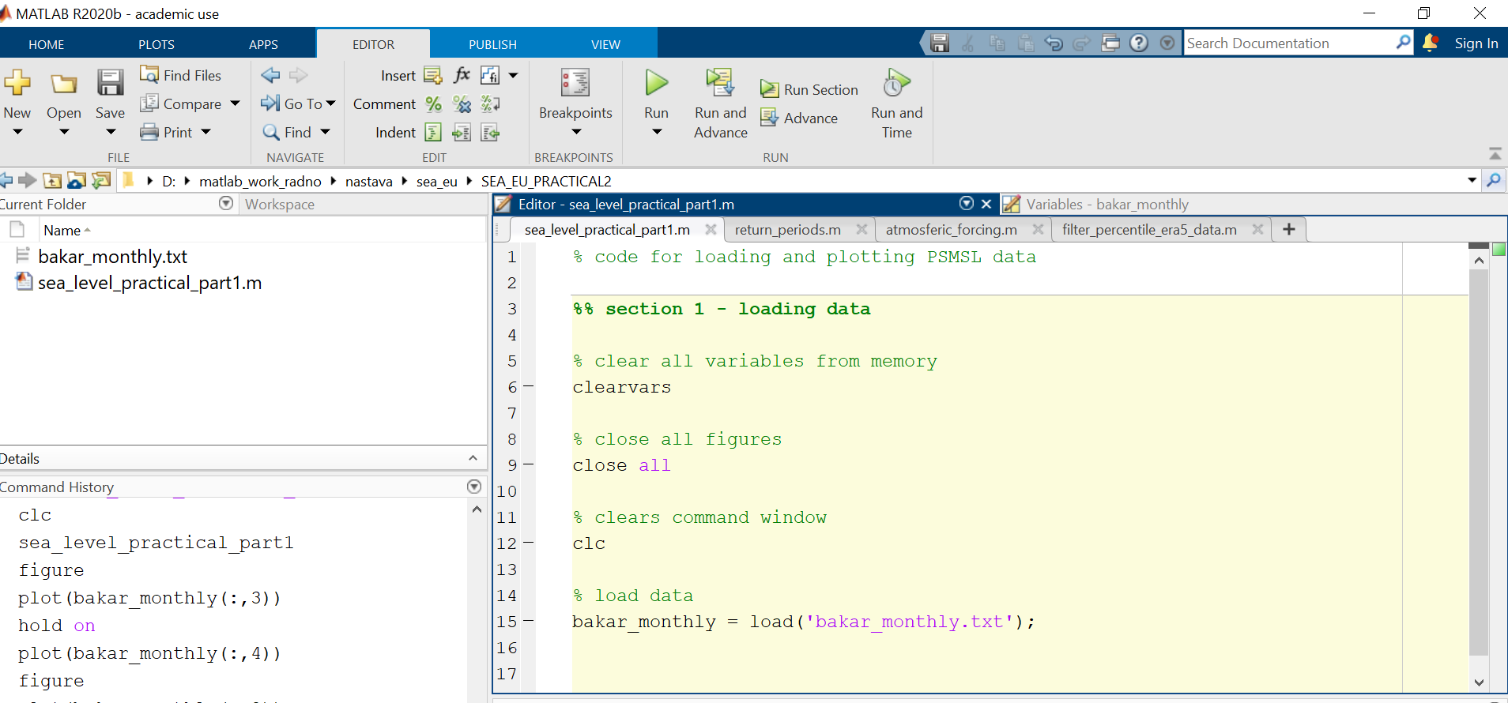
MATLAB: data loading
(23) You can run the entire code at any time by clicking green „play” button
(24) You can run sections of code by placing cursor into the section and clicking „Run Section”
(23)
(24)

Slide 19
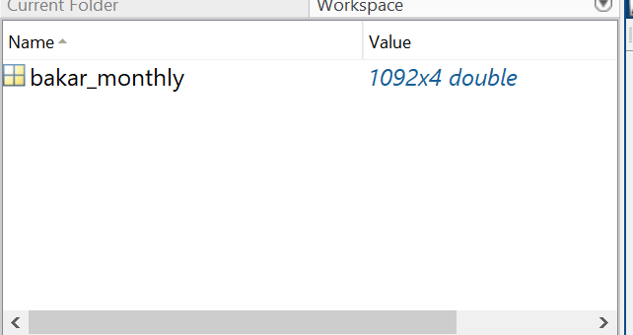
MATLAB: data loading
(25) As a result of running the code (or the first section) variable „bakar_monthly” appears in workspace
(25)

Slide 20
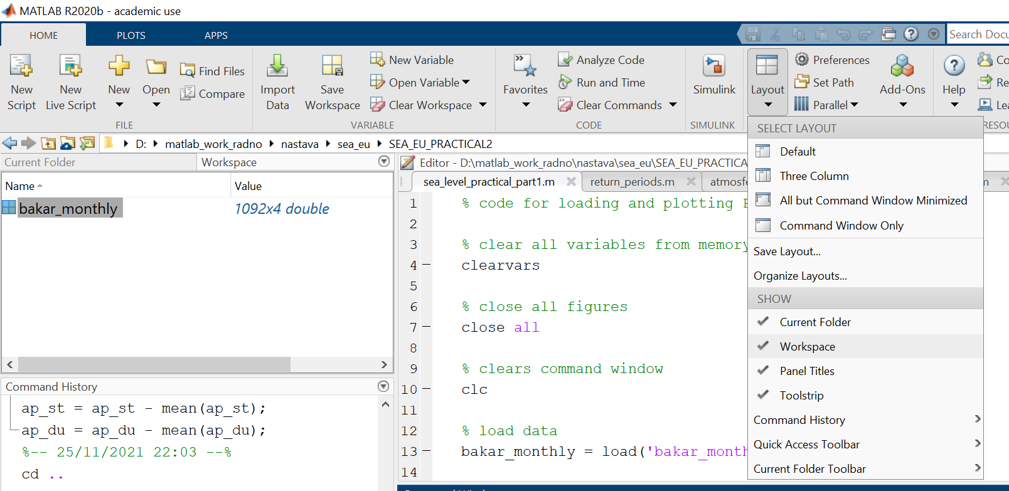
MATLAB: data loading
NOTE: If workspace is not visible, we make it visible by clicking on it in „Layout” on „Home” tab

Slide 21
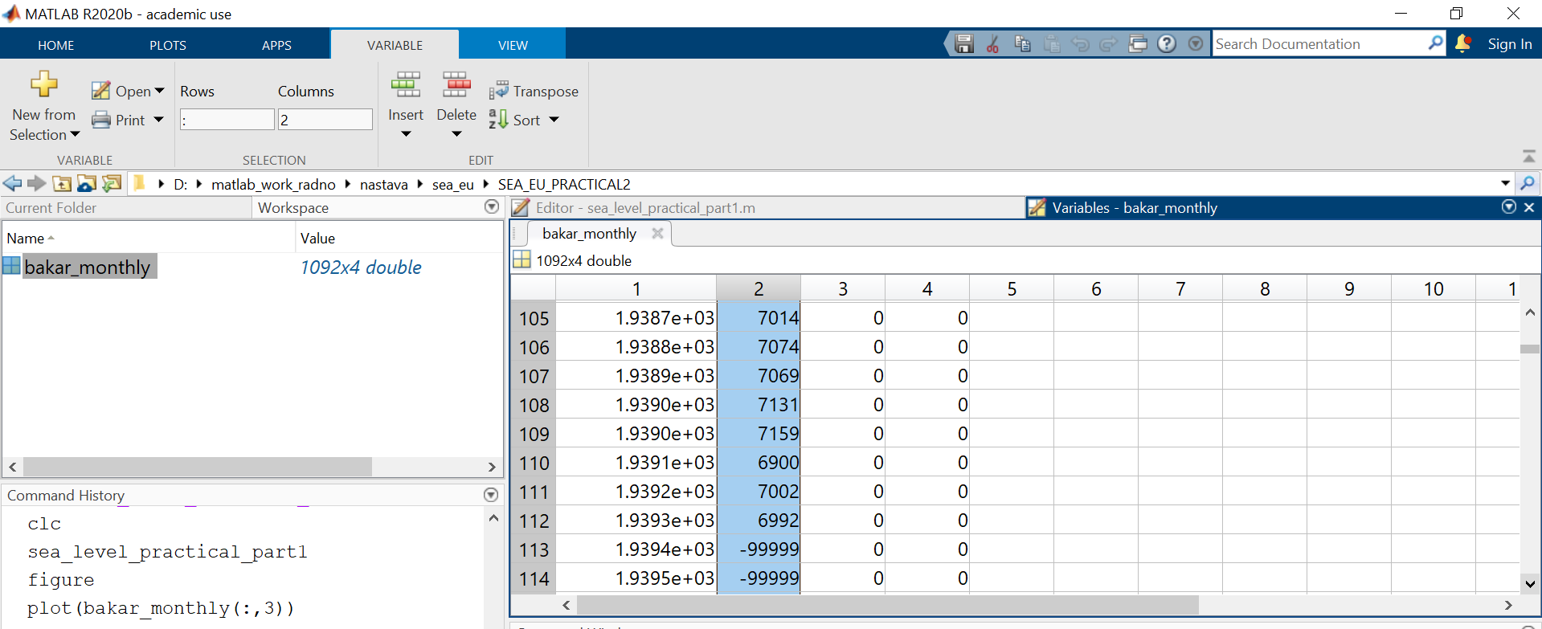
MATLBA: data loading
(26) bakar_monthly is a variable with 1092 rows, and 4 columns; double clicking on it opens it in
Variable window. We see that it has the same format as bakar_monthly.txt; year in column 1; sea level height
In column 2; and quality flags in columns 3 and 4.
(27)
(27) If we scroll through the data, we can see that some sea level heights have value „-99999” – this means „missing data"

Slide 22
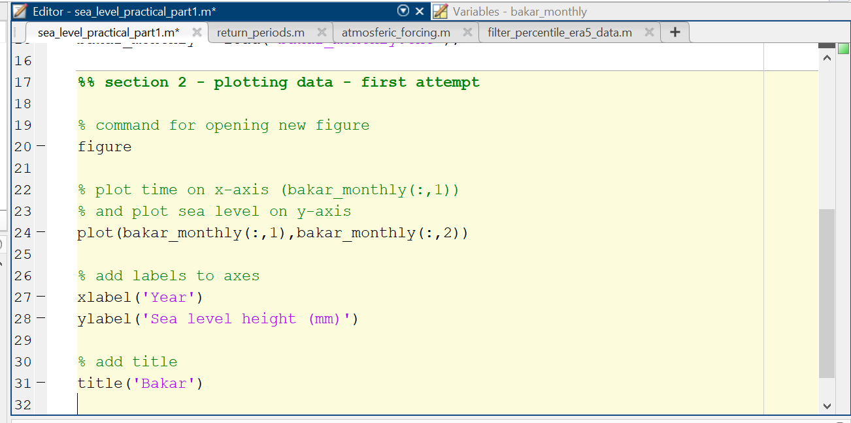
MATLAB: plotting
(28) We will plot the data to see where we have missing values; we write new section for plotting

Slide 23
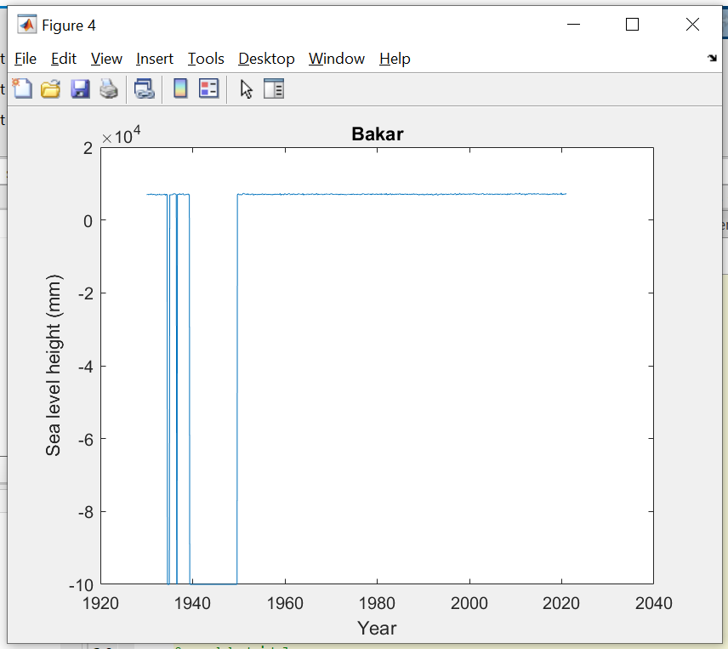
MATLAB: plotting
(29) Running „Section 2” results with a figure. We notice missing data up to ~1947.
Quality of all time series has to be carefully
Inspected – and all problems solved (as best as possible) before proceeding with analysis!

Slide 24
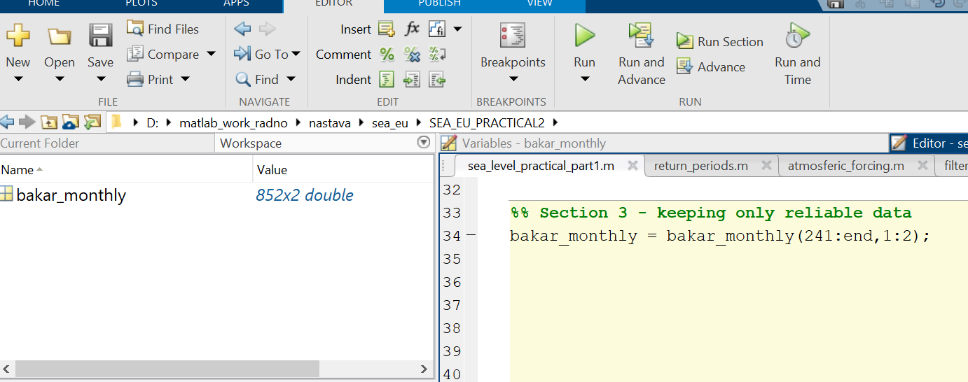
MATLAB: data
(30) We now scroll through the variable and notice that the last missing values is in row 240, i.e. at 1949.6 time – knowing that the long discontinuity was due to the WW2 – and not being sure of continuity of data, we decide to just keep values from 1950 to the end (from point 241 to end).
Variable bakar_monthly now contains 852 time values (starting at 1950.0), and corresponding 852 sea level heights

Slide 25
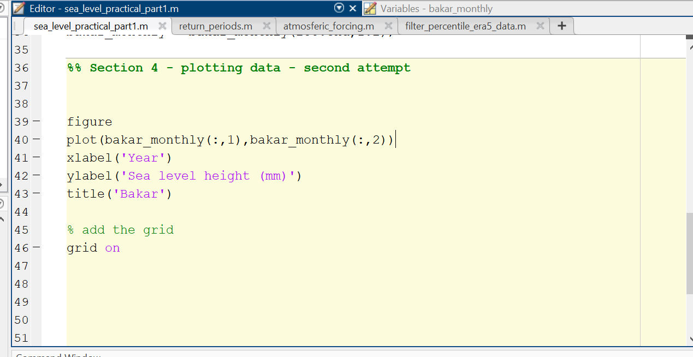
MATLAB: plotting
(31) We now write Section for re-plotting data

Slide 26
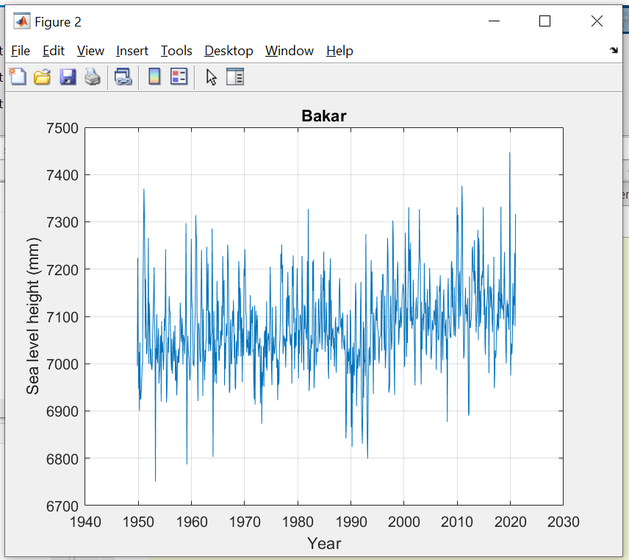
MATLAB: plotting
(32) Running Section 4 results with a new figure of monthly time series;
we seem to notice several processes: climate trend; prolonged periods of unusually low sea levels; months with extremely high sea levels
Months with extremely high sea levels
Trend (?)
Period of low sea levels; regime shift (?)

Slide 27
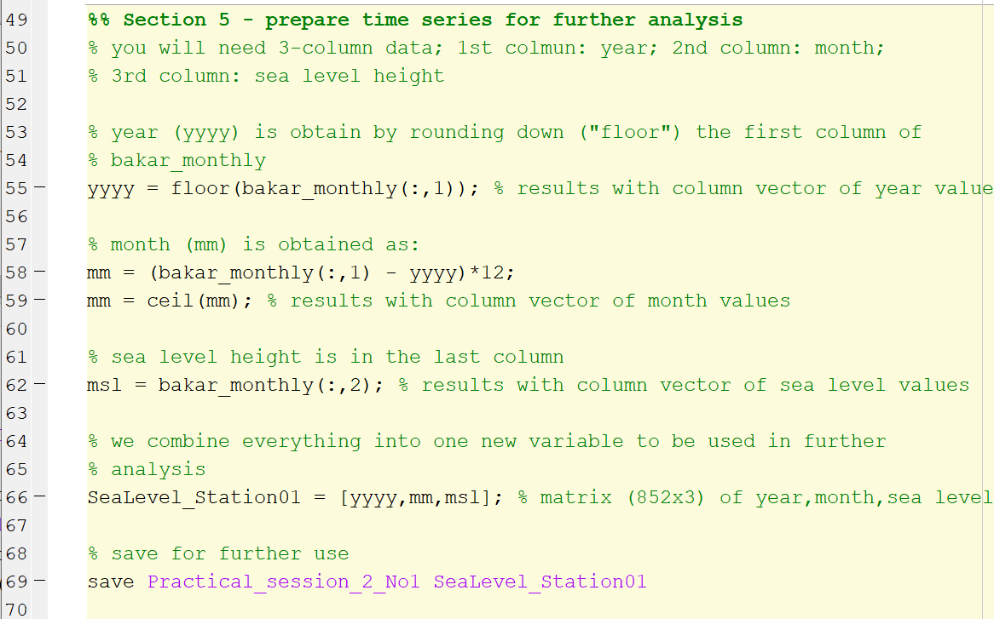
MATLAB: data
(33) We now prepare and save time series to be used in further analysis
You will use this in the second part of the practical (with Frano Matić)

Slide 28
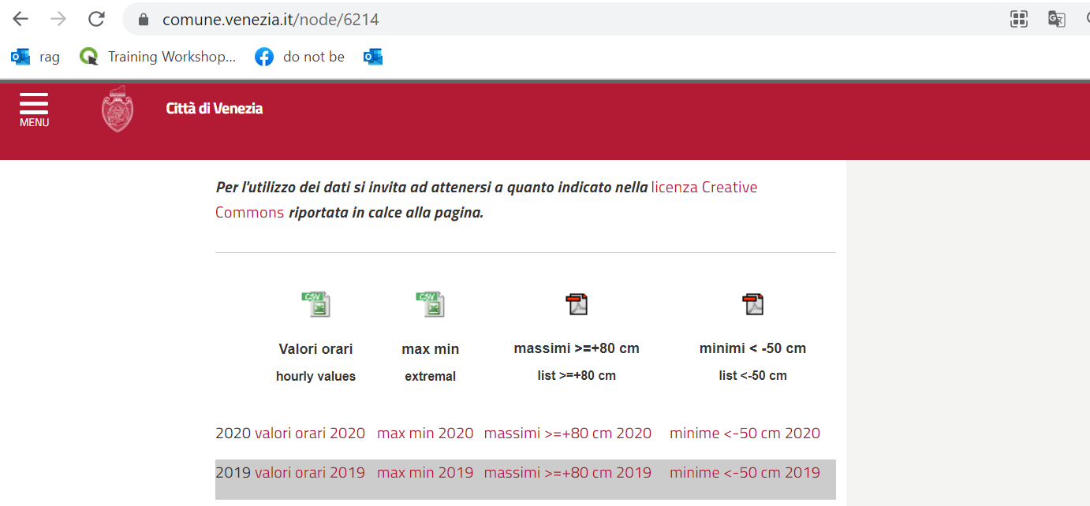
But first… Moving to shorter periods:
(34) Now, we will look into hourly time series; these can be downloaded from data portals listed in Table 2, and from certain national databases.
We will look into Venice hourly sea level data; it can be downloaded from historical archive of Venice: https://www.comune.venezia.it/node/6214 - but we will use already provided data
We can obtain hourly values for 2020 by clicking on this link

Slide 29
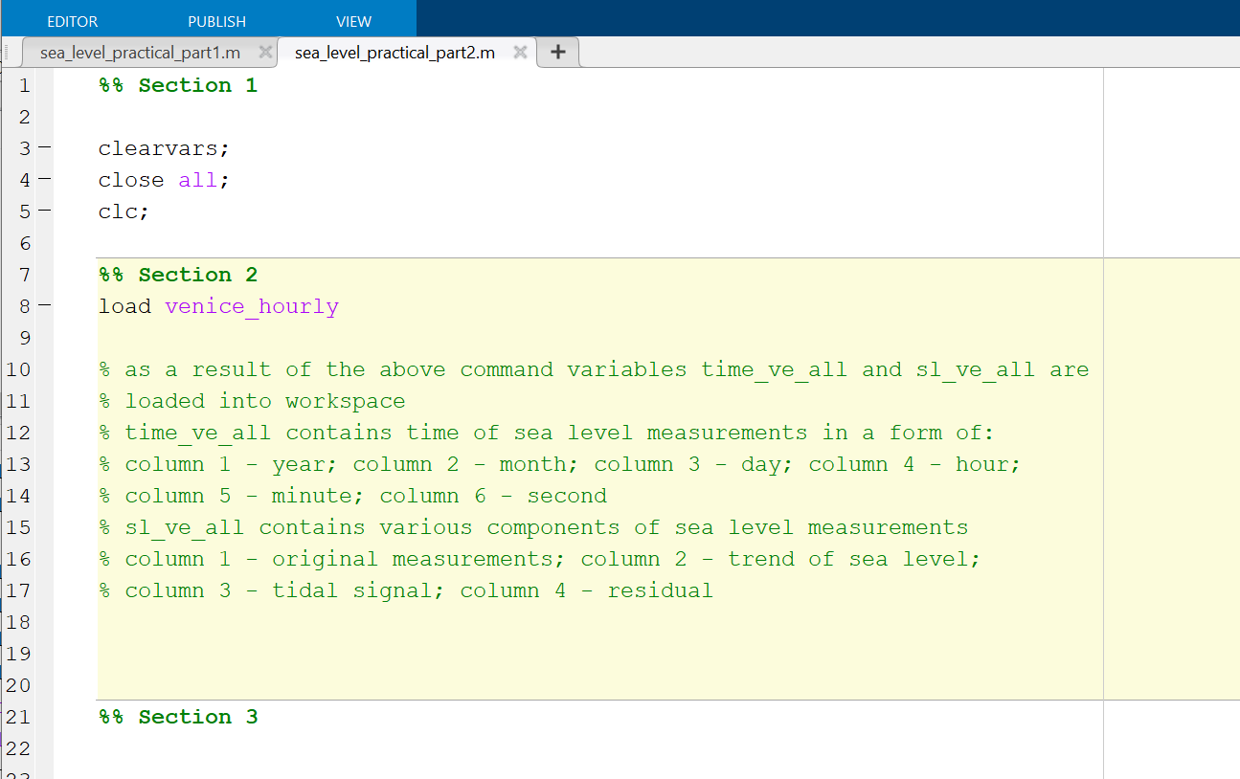
MATLAB: details provided in script „sea_level_practical_part2.m”

Slide 30
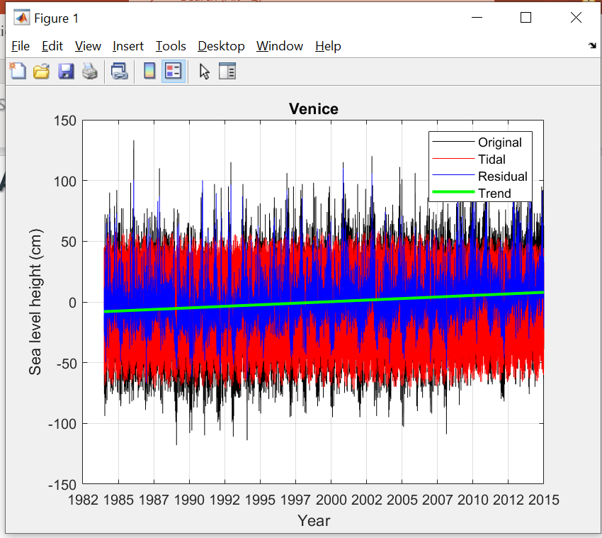
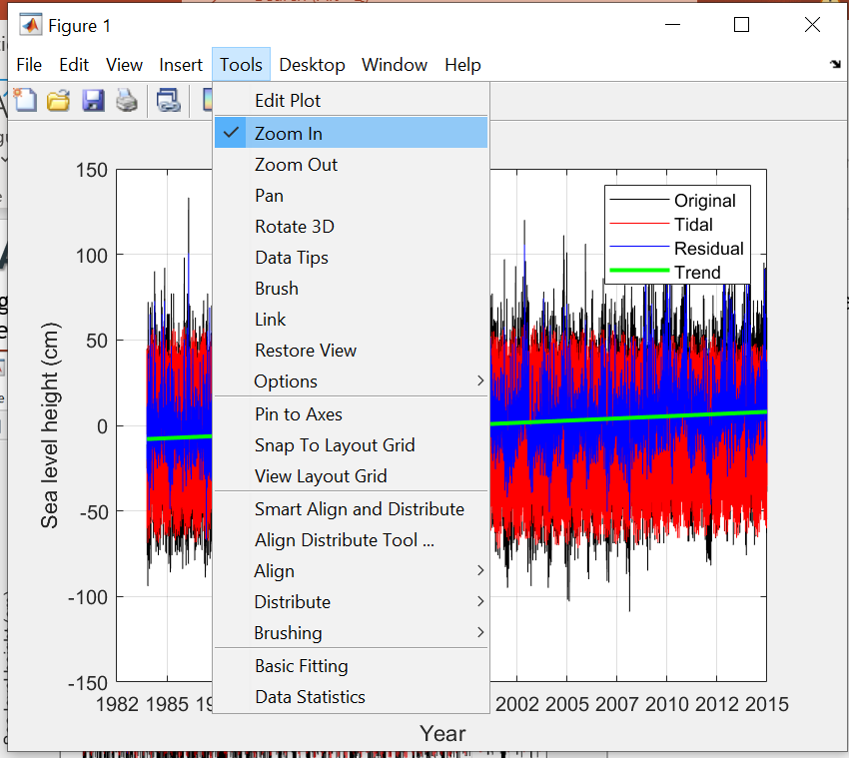
MATLAB: figure
(35) Figure reveals a lot of variation; we can see positive trend; but to check for other processes we need to zoom in.
35

Slide 31
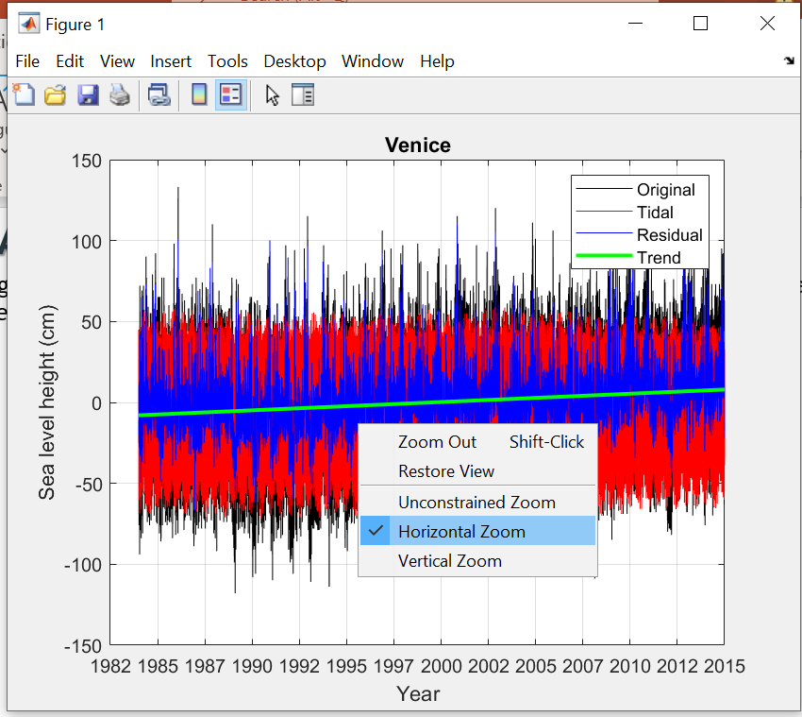
MATLAB: figure
(36) Right click; select „horizontal zoom”.
36

Slide 32
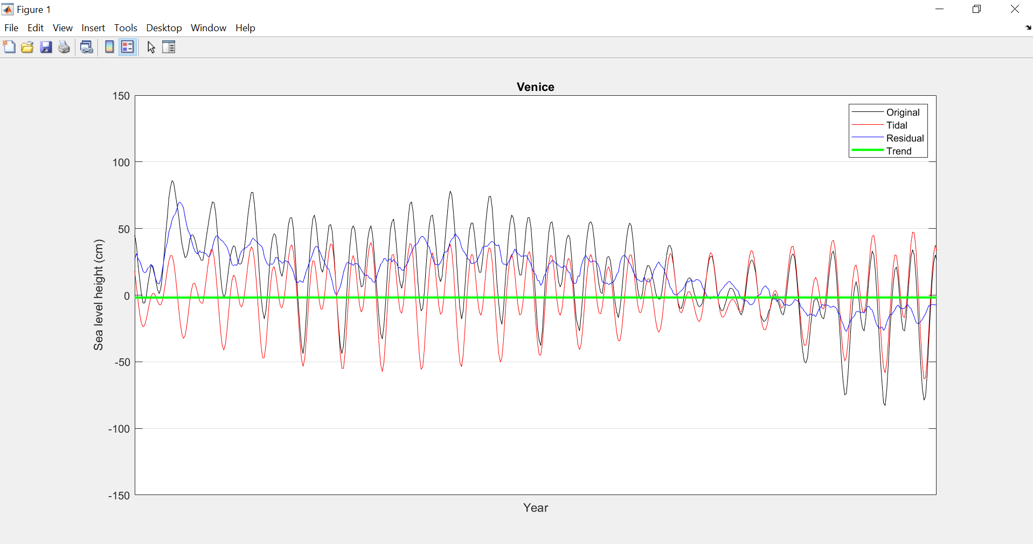
MATLAB: figure
(37) We zoom to a shorter period and examine processes

Slide 33
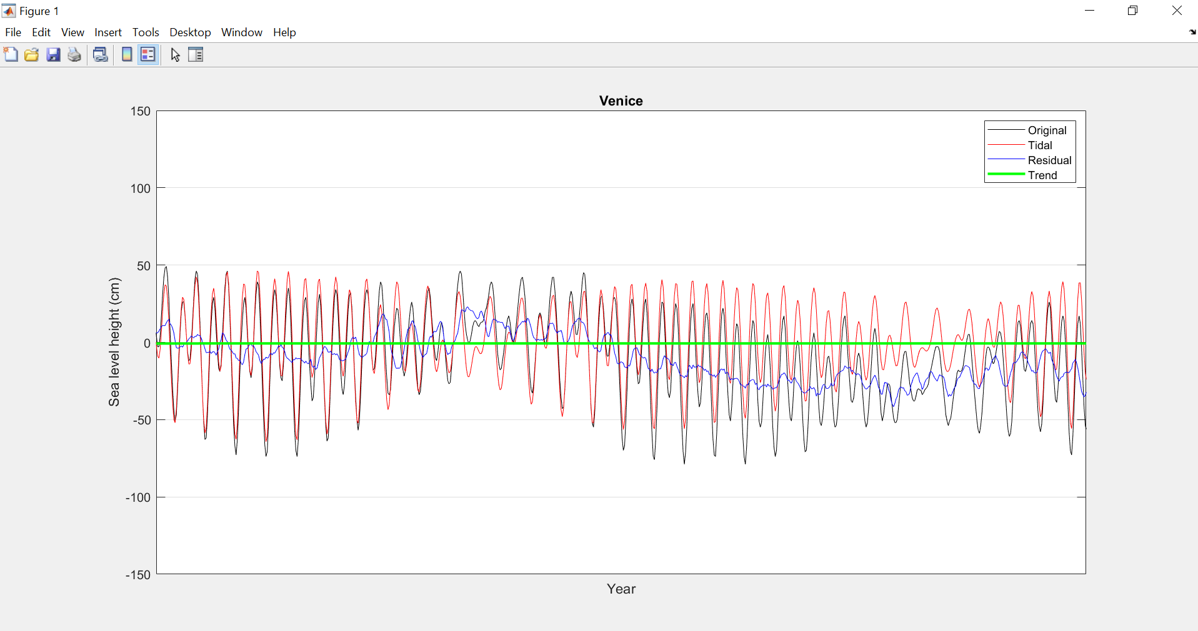
MATLAB: figure
Zooming to interesting processes

Slide 34
And now to statistics…

