Slide 1
International Oceanographic
Data and Information
Exchange (IODE)
Peter Pissierssens, Head IOC Project Office for IODE, Oostende, Belgium

Slide 2
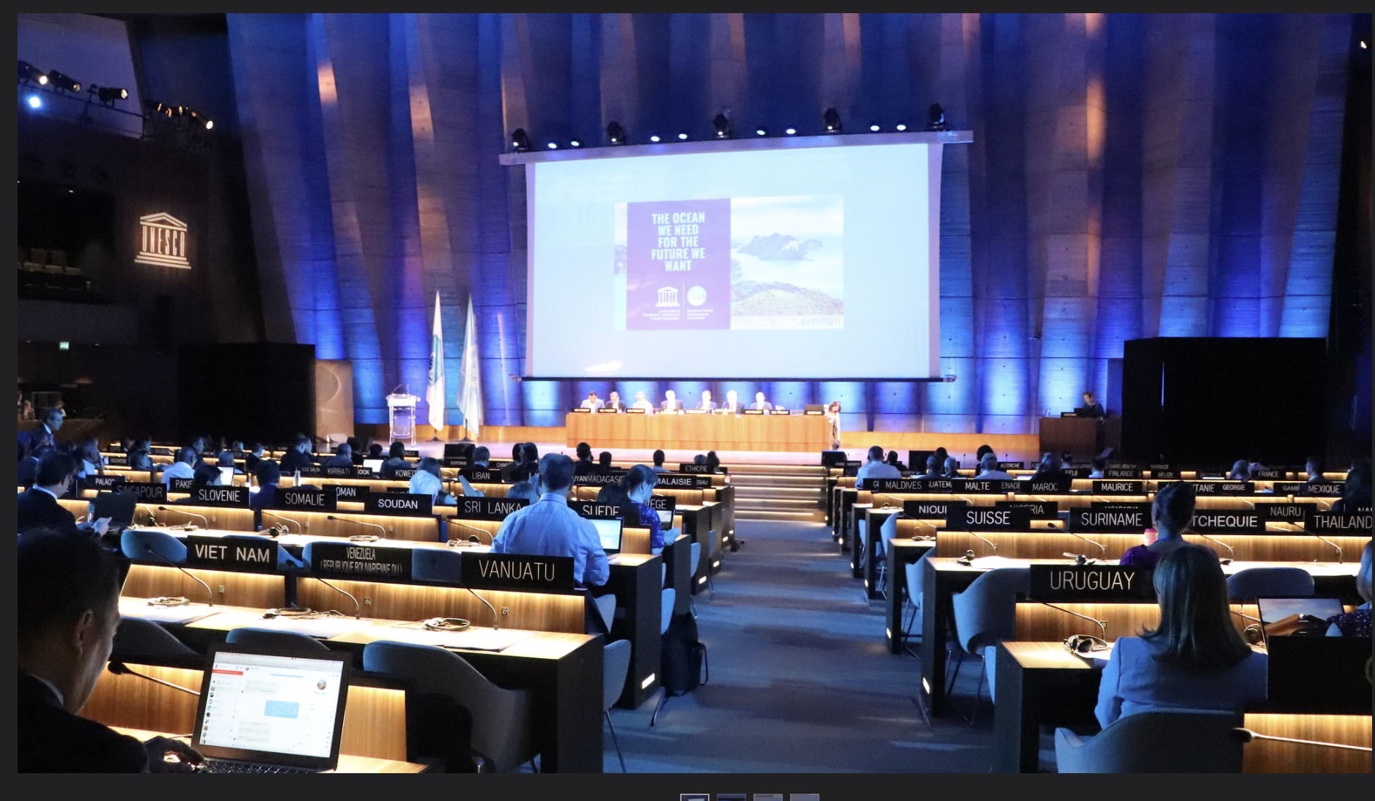
IOC history and governance
Created in 1960 as UNESCO body with functional autonomy
150 Member States (9/2021)
IOC Assembly and Executive Council

Slide 3
ONE PLANET
ONE OCEAN
VISION To bring together governments and the science community in achieving ‘The Ocean We Need for the Future We Want’. MISSION The purpose of the Commission is to promote international cooperation and to coordinate programmes in research, services and capacity-building, in order to learn more about the nature and resources of the ocean and coastal areas and to apply that knowledge for the improvement of management, sustainable development, the protection of the marine environment, and the decision-making processes of its Member States.

Slide 4
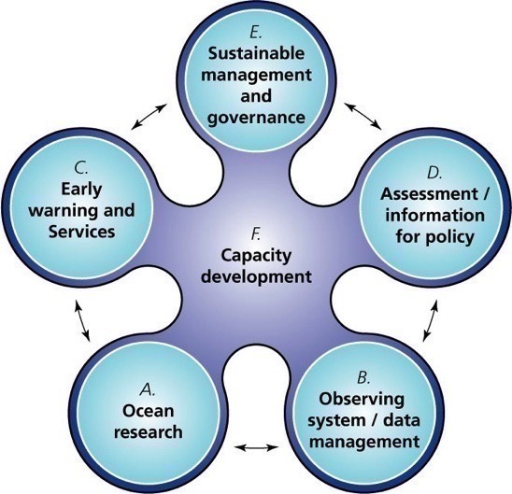
IOC Functions
§
E: contributions to 2030 Agenda and SDG 14, UN, UNFCCC + Paris Agreement, BBNJ, CBD, Sendai;
Coastal zones, LME, …
F: OTGA, CD, GOSR, TMT, Ocean literacy,
Communication,
Education, …
C: Tsunami,
HABs, Ocean
Prediction
and Services,
WMO/IOC JCB, …
D: IPCC,
WOA,
SDG 14.3,
SDG 14.a, GEBCO, …
A: IIOE-2, GOAON,
GO₂NE, Time Series,
TrendsPO, Stressors,
Carbon, GESAMP,
WCRP, …
B: GOOS,
GLOSS,
IODE,
OBIS, …

Slide 5
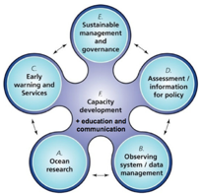

Regular
Mandate
Existing, Emerging and Potential
Components of IOC Work
2020-2021
Integrated
Ocean Management
These factors will keep shaping the future of IOC work

Slide 6
Regular
Mandate
Ocean
Science

Slide 7
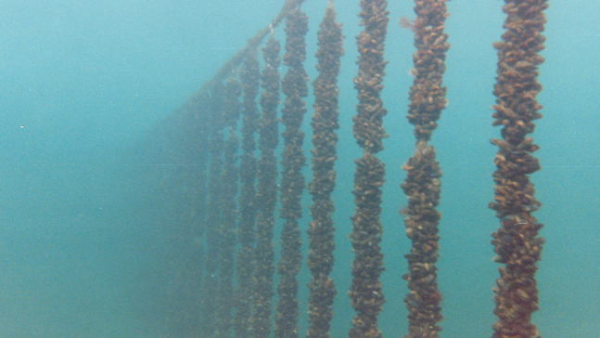
Global HAB
Status Report
The first Global Statistical Analysis of Harmful Algal Blooms shows no significant trend worldwide but specific regions and harmful algal species do show significant increases, pointing to the need for better monitoring and data collection, especially in light of greater societal reliance on coastal marine resources.

Slide 8
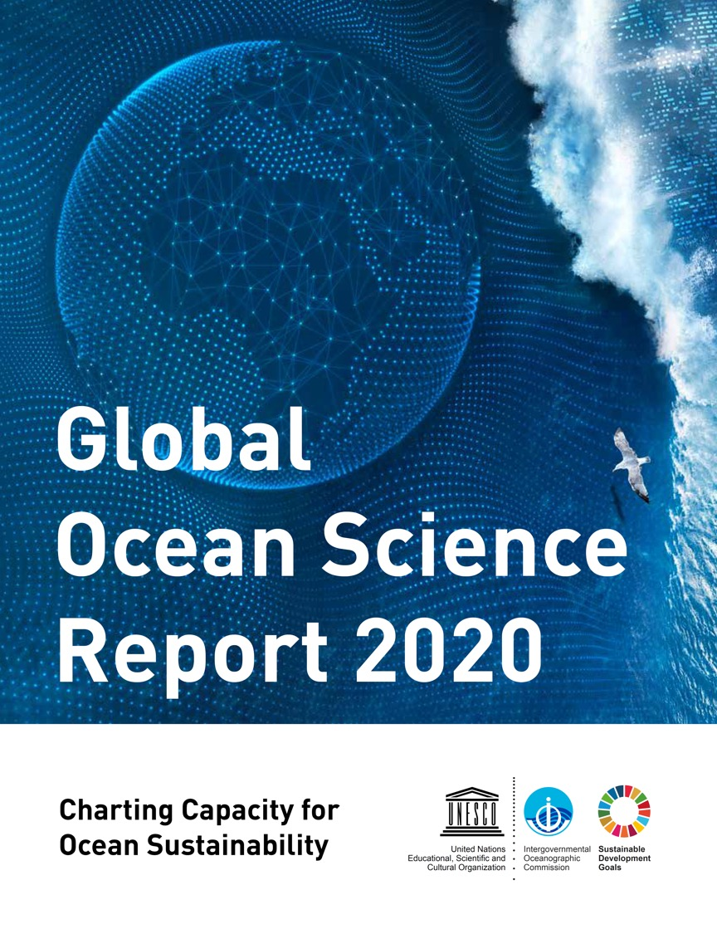
And also:
en.unesco.org/gosr
ioc.unesco.org

Slide 9
Regular
Mandate
Ocean
Observation

Slide 10
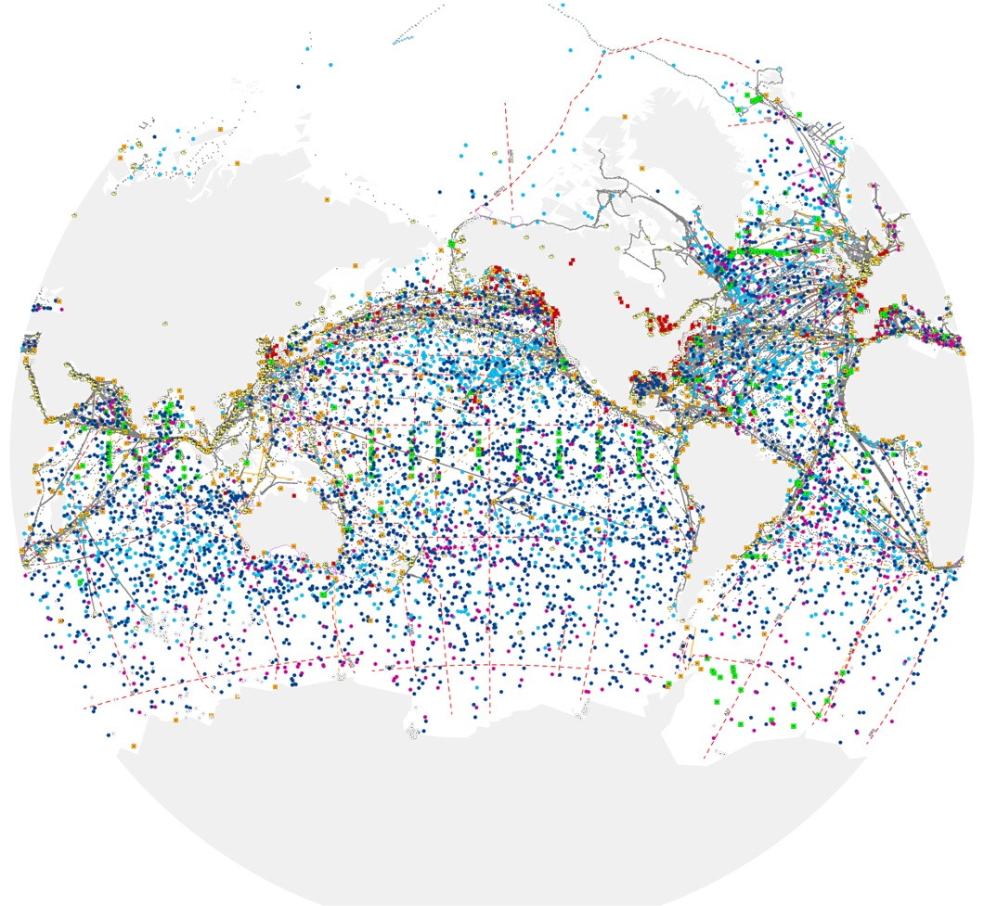
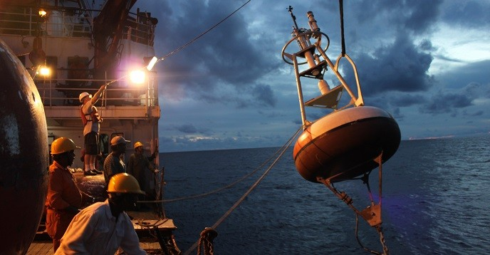
The Global Ocean Observing System
a key infrastructure for climate,
disaster risk reduction, and ocean health
Started 1991
7000+
observing platforms
86
Member States contributing
-10%
reduction in data flow from Covid-19 restrictions
www.ocean-ops.org/reportcard

Slide 11
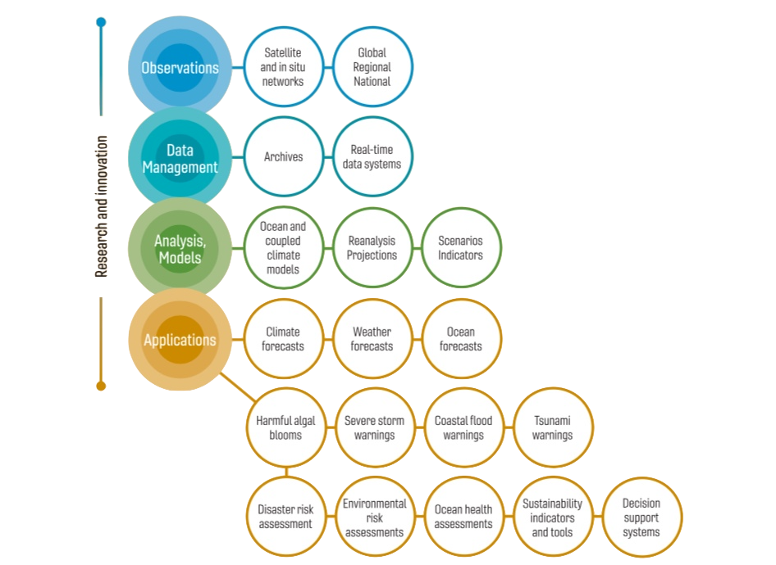
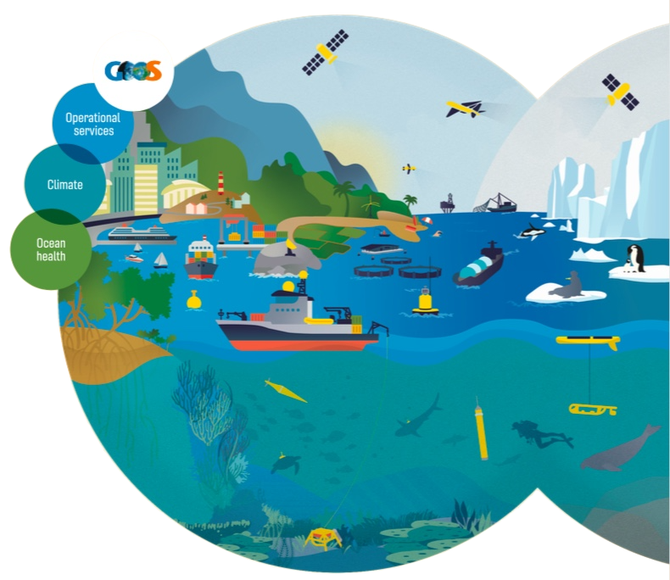
The Global Ocean Observing System
a key infrastructure for climate,
disaster risk reduction, and ocean health
goosocean.org

Slide 12
Regular
Mandate
Tsunami warning and mitigation

Slide 13
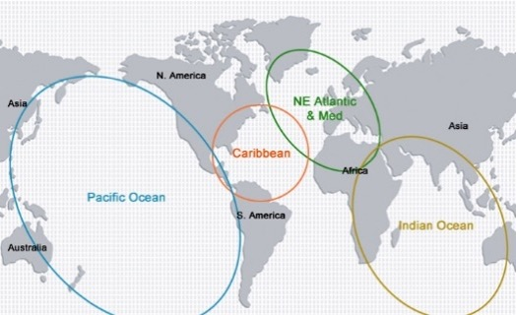
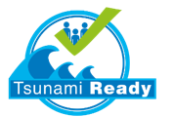
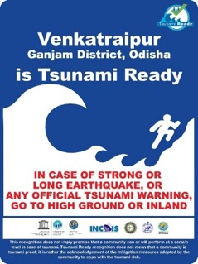
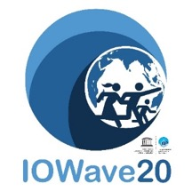
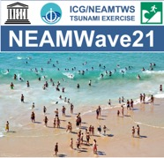
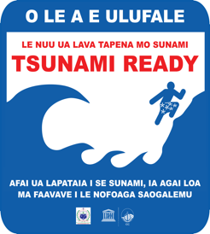
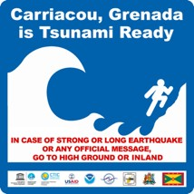
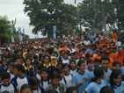
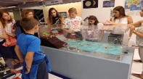
Tsunami Warning Services
Four Intergovernmental Groups coordinating basin-based Tsunami early Warning and Mitigation Systems, with a strong technical component (observations, modelling, forecasting) and reinforced preparedness and awareness programmes.
Regular full-scale or table-top drills and exercises, in all basins: CARIBE WAVE 20 & 21, IOWave20, NEAMWave21 and PACWAVE20
Tsunami Service Providers (TSP) covering all basins to provide tsunami information (statements or threat information) to National Tsunami Warning Centres and/or Tsunami Warning Focal Points
World Tsunami Awareness Day (WTAD) – 5th November each year: a joint effort with UNDRR
First National Tsunami Ready Board in NEAM region established by Italy (May 2021)
Exercise Pacific Wave 2020 (PacWave20)

Slide 14
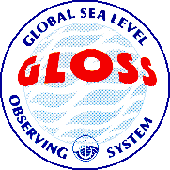
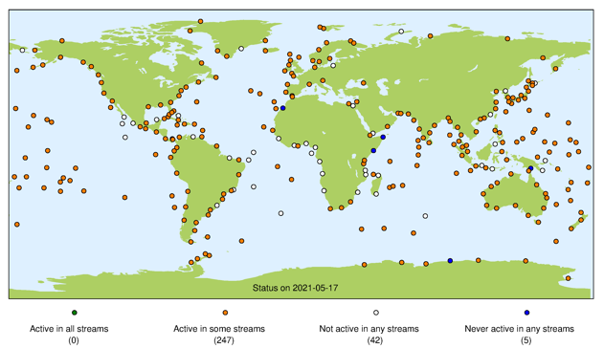
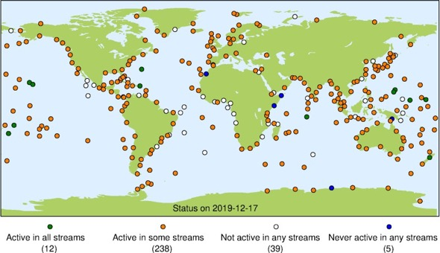
GLOSS Global Sea Level Observing System
December 2019
May 2020
Status Map shows stations reporting via at least one GLOSS data pathway
December 2019: 85% stations reporting (250/294)
May 2020: 84% stations reporting (247/294)
Standard settings examples
Manual on Sea-level Measurements and Interpretation, Volume V: now available in 4 languages IOC/2016/MG/14 VOL.5/Rev.
Quality control of in situ sea level observations: a review and progress towards automated quality control, volume 1 published: IOC/2020/MG/83Vol.1

Slide 15
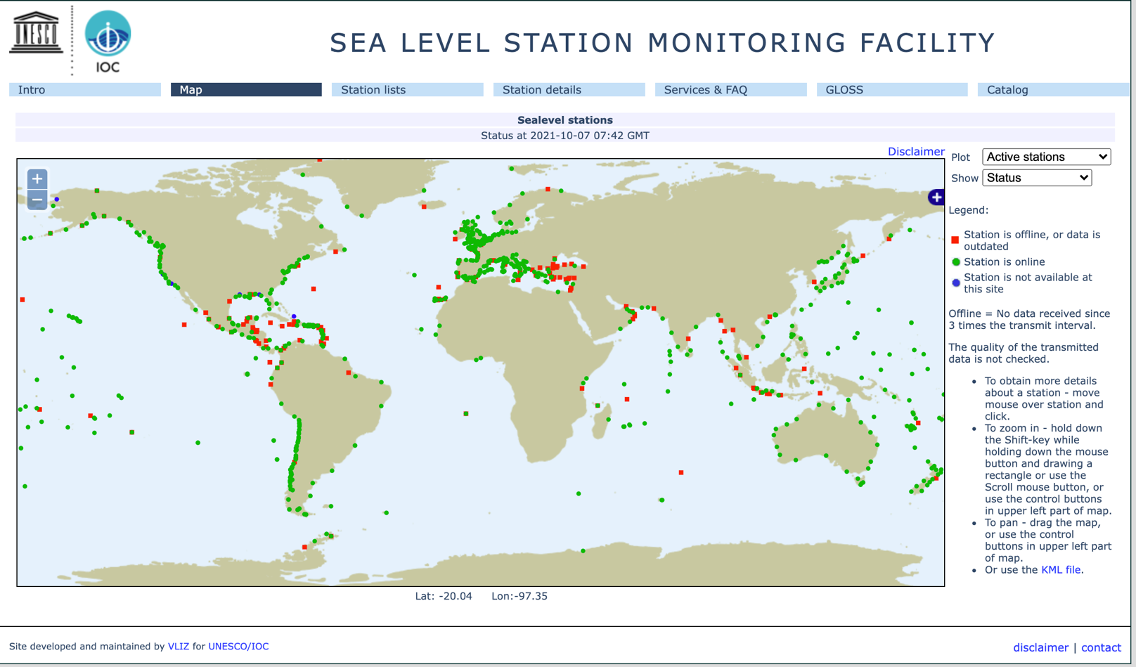
IOC Sea Level Station Monitoring Facility (ISLMF)
Developed and hosted by VLIZ
http://www.ioc-sealevelmonitoring.org/
IOC Sea Level Station Monitoring Facility (ISLMF)

Slide 16
Regular
Mandate
Tsunami warning and mitigation

Slide 17
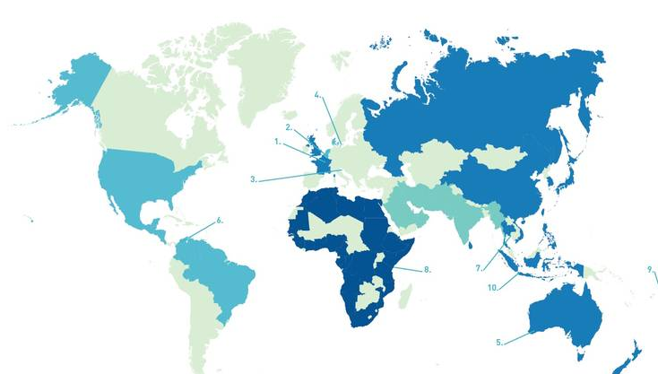
The IOC around the world
Regional Sub-Commissions, Committees, Programme and Project Offices
1. FRANCE (Paris HQ, Brest)
2. BELGIUM (Ostend)
3. ITALY (Venice)
4. DENMARK (Copenhagen)
5. AUSTRALIA (Perth)
6. COLOMBIA (Cartagena de Indias)
7. THAILAND (Bangkok)
8. KENYA (Nairobi)
9. SAMOA (Apia)
10. INDONESIA (Jakarta)
Type to enter a caption.

Slide 18
Regular
Mandate
International Oceanographic Data and Information Exchange (IODE)

Slide 19
What is IODE
Programme of IOC, established in 1961
The main objectives of the IODE Programme are:
  To facilitate and promote the discovery, exchange of, and access to, marine data and information including metadata, products and information in real-time, near real time and delayed mode, through the use of international standards, and in compliance with the IOC Oceanographic Data Exchange Policy for the ocean research and observation community and other stakeholders;
  To encourage the long term archival, preservation, documentation, management and services of all marine data, data products, and information;
  To develop or use existing best practices for the discovery, management, exchange of, and access to marine data and information, including international standards, quality control and appropriate information technology;
  To assist Member States to acquire the necessary capacity to manage marine research and observation data and information and become partners in the IODE network;
  To support international scientific and operational marine programmes, including the Framework for Ocean Observing for the benefit of a wide range of users.

Slide 20
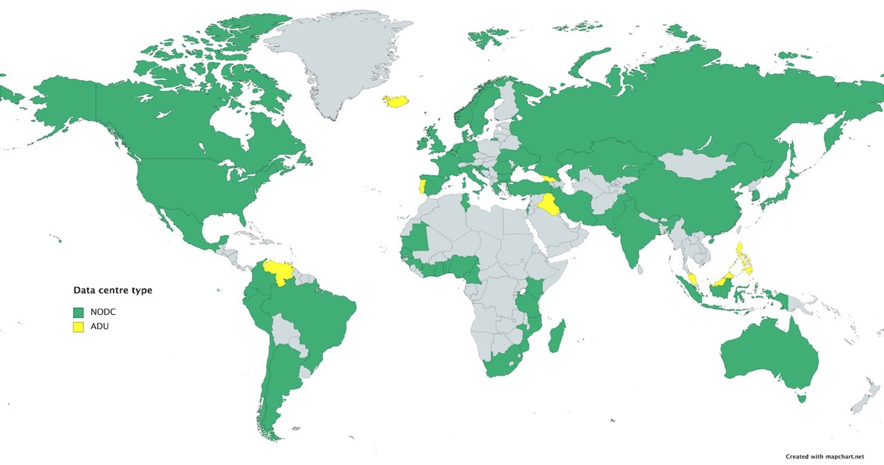
How does IODE function?
Global network of 57 NODCs and 38 ADUs in 66 countries
17 projects implemented by over 1500 national experts
IODE= Mostly research cruise data and other non-realtime
BUT many of the NODCs now deal with both and are also involved in GOOS

Slide 21
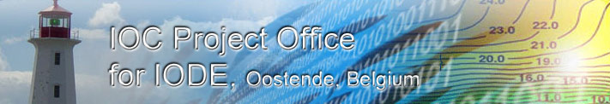
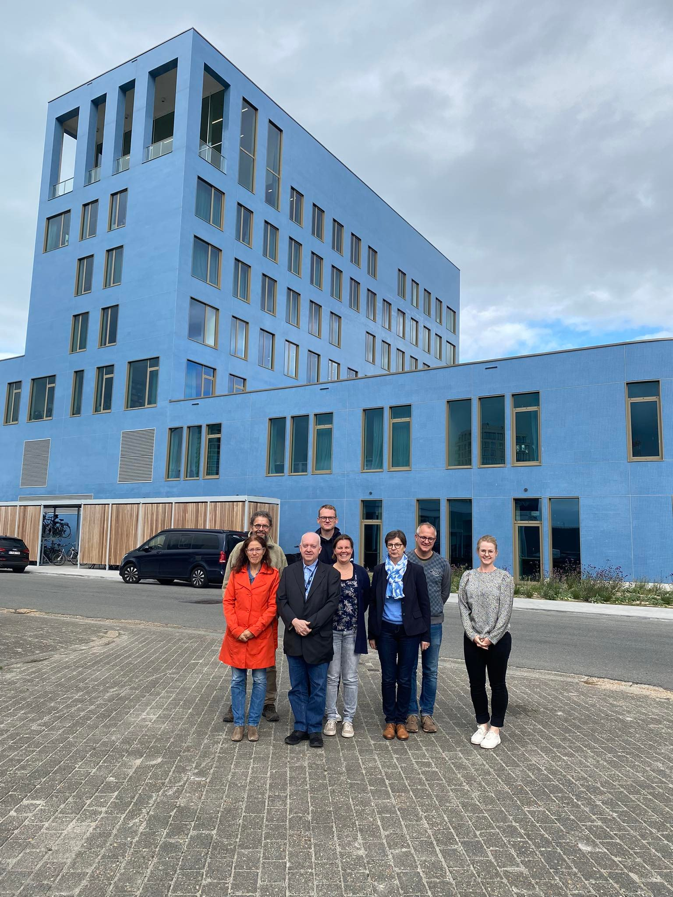
IOC Project Office for IODE, Oostende, Belgium
Established 2005
Housed by Flanders Marine Institute (VLIZ)
Staff support from Govmt. of Flanders
HQ of IODE and IOC CD
8 staff in Oostende
7 staff in the Field (Canada, Cayman Isl, Germany,
S. Africa, Norway, Philippines, Australia)

Slide 22
Data sources within the IODE network
Global online data services
Ocean Biodiversity Information System (OBIS)
World Ocean Database (WOD)
Global Temperature Salinity Profiling Programme (GTSPP)
Underway Sea Surface Salinity Data Archiving Project (GOSUD)
International Quality-controlled Ocean Database (IQuOD)
…
Data Centre online data services
Global network of 98 data centres in 66 countries
+ Nearly all IODE data centres provide data online
+ Most of these can be accessed freely and openly (others are not visible)
- Many different user interfaces and many languages
- Vocabularies different
- Export formats different
- Metadata not always well prepared
- Too many sources and difficult to find

Slide 23
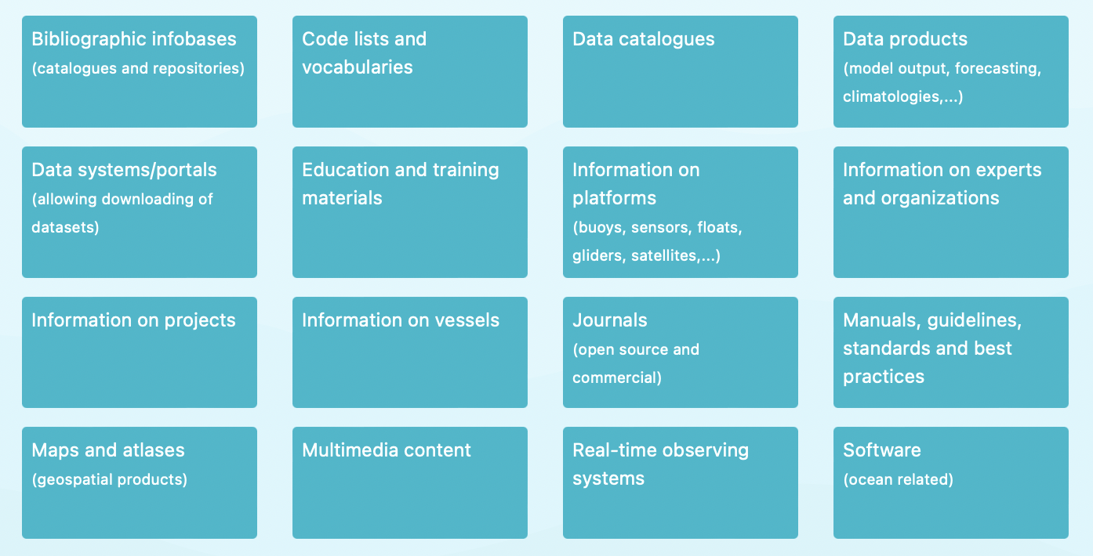
Discovering online
data sources: ODISCat
https://catalogue.odis.org
The ODIS "Catalogue of Sources" aims to be an online browsable and searchable catalogue of existing ocean related web-based sources/systems of data and information as well as products and services. It will also provide information on products and visualize the landscape (entities and their connections) of ocean data and information sources.
> 3000 sources

Slide 24
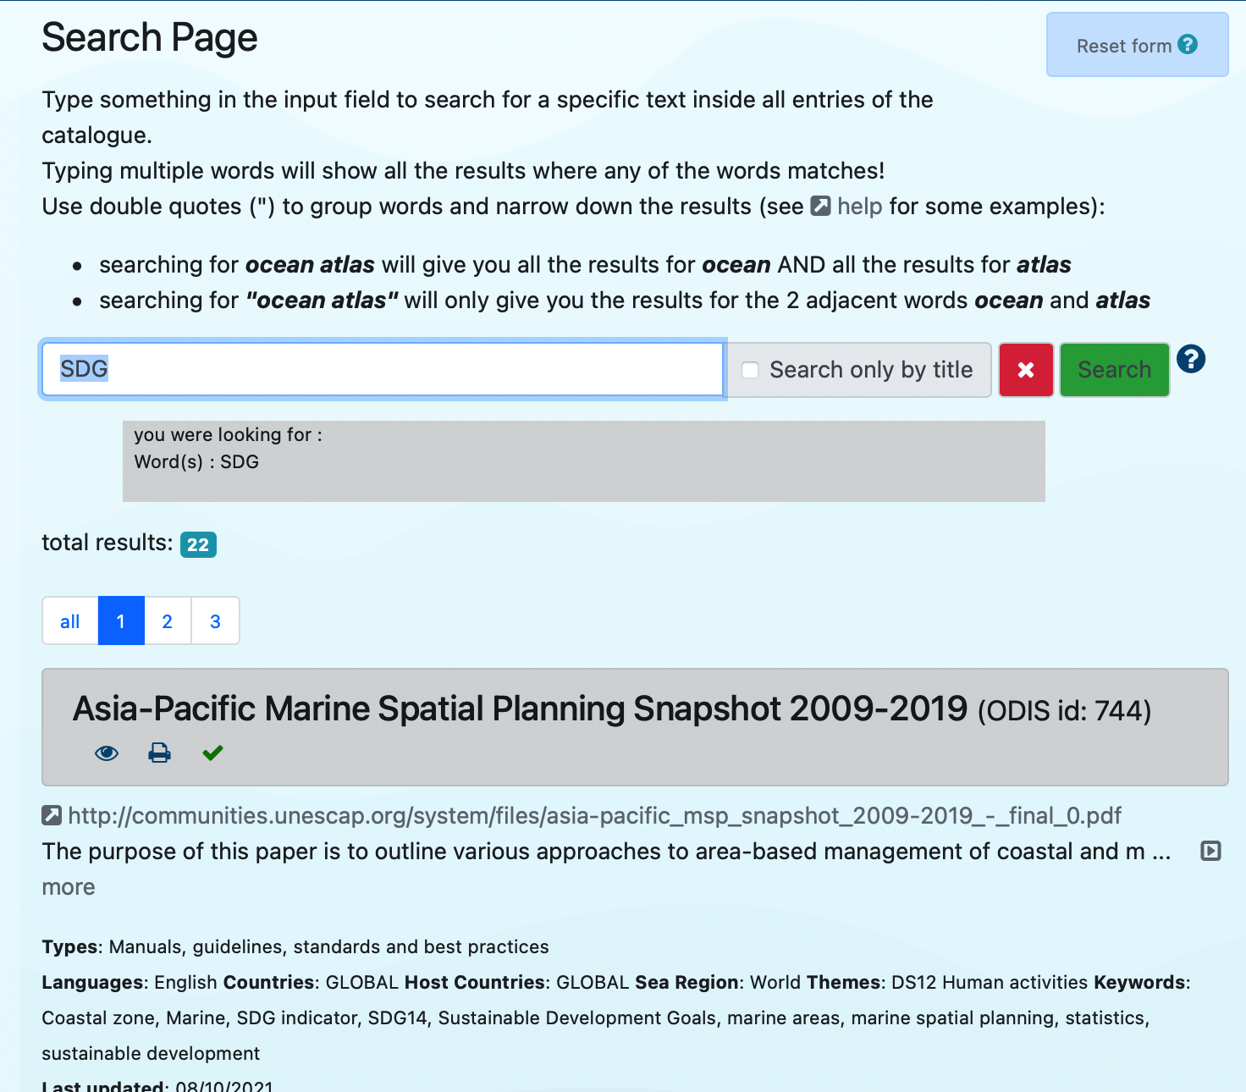
Discovering online
data sources: ODISCat
The ODIS "Catalogue of Sources" aims to be an online browsable and searchable catalogue of existing ocean related web-based sources/systems of data and information as well as products and services. It will also provide information on products and visualize the landscape (entities and their connections) of ocean data and information sources.

Slide 25
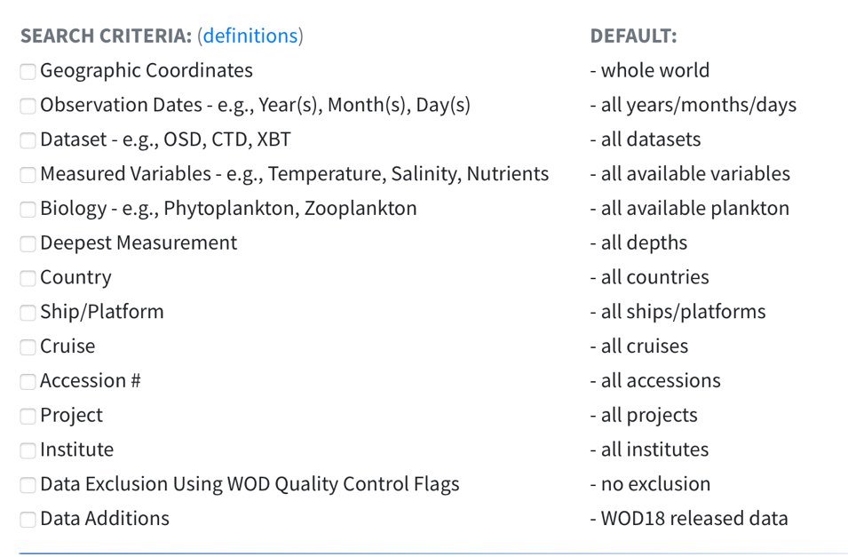
World Ocean Database (WOD)
https://www.ncei.noaa.gov/products/world-ocean-database
The World Ocean Database (WOD) is world's largest collection of uniformly formatted, quality controlled, publicly available ocean profile data. It is a powerful tool for oceanographic, climatic, and environmental research, and the end result of more than 20 years of coordinated efforts to incorporate data from institutions, agencies, individual researchers, and data recovery initiatives into a single database.
WOD data spans from Captain Cook's 1772 voyage to today
Original versions of the 20,000+ datasets in the WOD are available through the NCEI archives

Slide 26
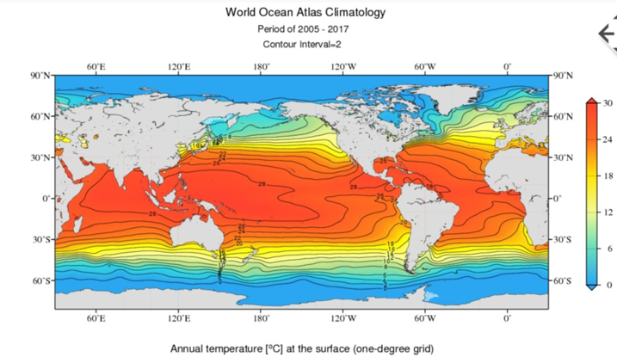
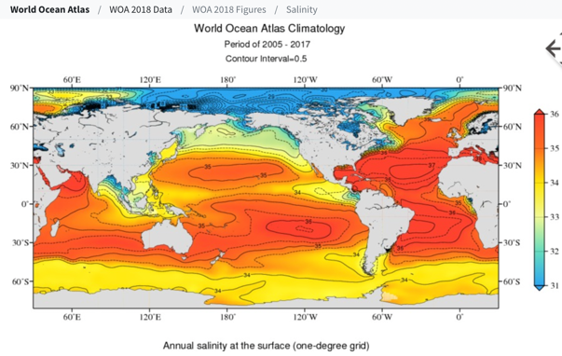
World Ocean Atlas (WOA)
https://www.ncei.noaa.gov/products/world-ocean-atlas
The World Ocean Atlas (WOA) is a collection of objectively analyzed, quality controlled temperature, salinity, oxygen, phosphate, silicate, and nitrate means based on profile data from the World Ocean Database (WOD). It can be used to create boundary and/or initial conditions for a variety of ocean models, verify numerical simulations of the ocean, and corroborate satellite data.

Slide 27
IODE Activities
IODE Projects
  AquaDocs: repository of documents and publications
  eDNA Expeditions in Marine World Heritage sites Project
  GODAR: Global Oceanographic Data Archaeology and Rescue
  GOSUD: Global Ocean Surface Underway Data Pilot Project
  GTSPP: Global Temperature-Salinity Profile Program
  ICAN: IODE International Coastal Atlas Network Project
  IQuOD: International Quality Controlled Ocean Database
  OBIS: Ocean Biodiversity Information System Project
  OBPS: IODE/GOOS Ocean Best Practices System Project
  OceanExpert: Global Directory of Marine (and Freshwater) Professionals Project
  ODIS: Ocean Data and Information System Project
  ODISCat: Ocean Data and Information System Catalogue of Sources Project
  OIH: Ocean InfoHub Project
  OTGA: OceanTeacher Global Academy Project
  PacMAN: Pacific islands Marine bioinvasions Alert Network Project
  QMF: IODE Quality Management Framework Project
  WOD: World Ocean Database

Slide 28
ODIS: From digital ecosystems to the digital biosphere
ODIS (Ocean Data and Information System) will be one of many digital ecosystems in the “digital biosphere” needed to address the SDGs and their successors
Oceans (ODIS)
Resilient food
system
Atmosphere
Planetary
Access to
education
Mariculture
Cities
Terrestrial
Ocean literacy
Healthy oceans

Slide 29
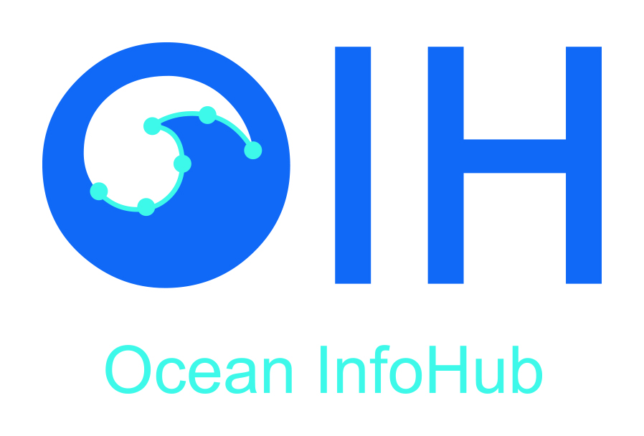
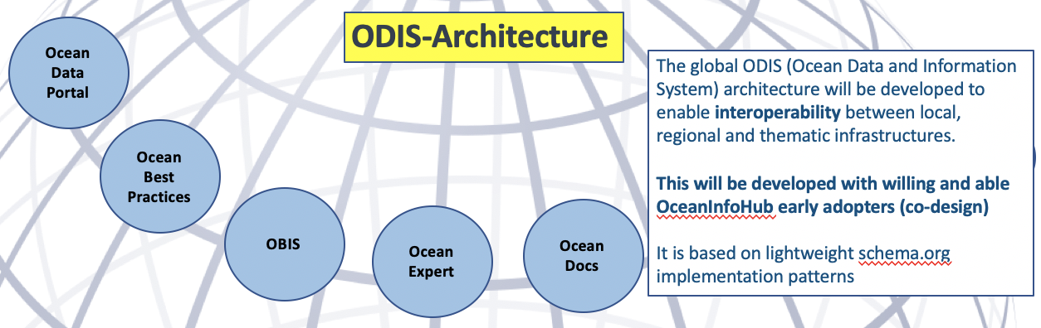
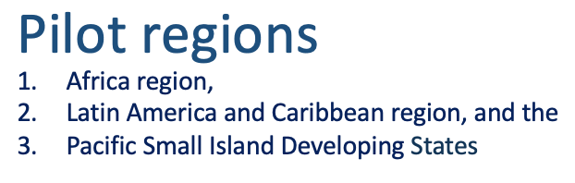
The IOC Ocean InfoHub Project
The OIH/ODIS will first work with global IOC-associated online resources – including:
  OceanExpert : People
  AquaDocs : Documents and Publications
  The GOOS/IODE Ocean Best Practices System
  Data: the Ocean Biodiversity Information System (OBIS)
  Data: the World Ocean Database (WOD)
extended by partnerships with EurOcean, Marinetraining.eu, EMODNET, and other sources in the IOC ODIS ODIScat.
The IOC Ocean InfoHub Project (OIH) is a global initiative to improve access to marine and coastal data and information.
It is a three year project that commenced in April 2020
The intention is to develop interoperability between existing information systems, thus improving the flow of information to end users.

Slide 30
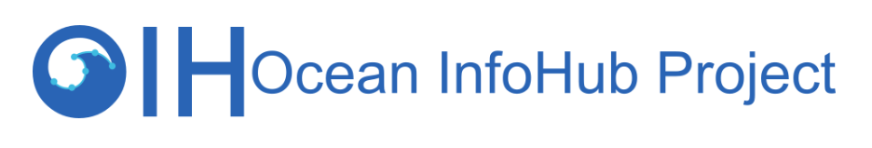
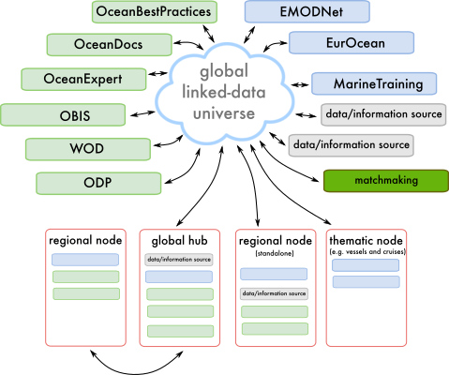
UN Systems
(some) partners

Slide 31

For 21 years now, we have been building a central global platform that provides free access to the world’s ocean biodiversity and biogeographic data.
Notes:
For 21 years now, we have been building a central global data platform that provides free access to the world’s ocean biodiversity and biogeographic data. The OBIS system has grown with 20 million records last year and will grow even more rapidly in the coming years with new innovative observing technologies being put in place, such as environmental DNA and automated imaging devices. OBIS is one of the main building blocks for the development of an integrated Ocean Observing System aimed to develop the key indicators to report on the Health status of our Ocean and its natural resources. As such OBIS is already one of the primary sources of information to support activities under the Convention on Biological Diversity, and assessments under the UN regular process and the Intergovernmental platform on biodiversity and ecosystem services (IPBES). The recently launched IOC global Harmful Algal Bloom Status report used the HAB data from OBIS.

Slide 32


http://www.obis.org
Ocean Biodiversity Information System (OBIS) is a data clearing-house on marine biodiversity. OBIS connects a myriad of stakeholders at national, regional and international level and plays a role in developing standards, protocols, tools and training in managing biodiversity observation data to support research, ecosystem assessments and management.
The volume of new biodiversity data explodes (>100 million records)
New technologies (acoustics, optics, genetics) result in a ten-fold of new data published in OBIS.
In the past 2 years OBIS published the same amount of new data compared to the previous 20 years combined.

Slide 33
Extinction intensity in tropical areas
http://www.obis.org
These maps, based on OBIS data for over 800 fish and invertebrate species, show the calculated extinction and invasion intensity between 2000 and 2050 under RCP 8.5 climate change scenarios.
RCP: Representative Concentration Pathways
Invasion intensity in polar regions
Notes:
OBIS data for over 800 fish and invertebrate species have been used to perform multi-model projections of climate change effects on global marine biodiversity, under two IPCC scenarios (RCP 2.6 and RCP 8.5). These maps show the calculated extinction and invasion intensity between 2000 and 2050 under RCP 8.5 (units: relative to current number of species).
Overall, the median rate of latitudinal poleward centroid shift was predicted at 15 km per decade under RCP 2.6, and 25 km per decade under RCP 8.5.
Average invasion intensity is predicted to be 6% of initial species richness under RCP 2.6, but up to 15% at high latitudes. Under high emissions, invasion intensity is up to 26% in the arctic ocean.
Hotspots of local extinction are concentrated in lower latitude regions, where the average extinction rate is around 8%. Also note the extinction hotspot in the Mediterranean.

Slide 34
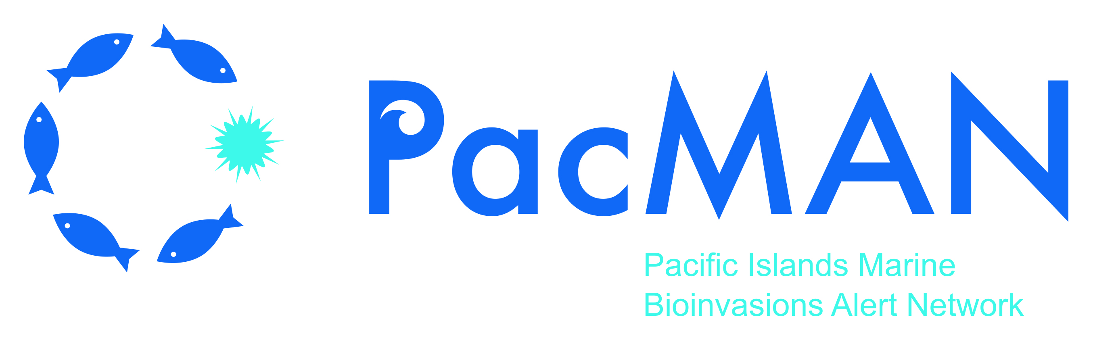
OBIS in partnership with the University of the South Pacific
PacMAN is a 3-year project funded by the Flanders Unesco Science Trust Fund (FUST)
Address the threat of invasive marine species for small island developing states (SIDS), with the initial location at Suva port in Fiji:
  The project will measure baseline biodiversity and detect marine invasive species through the use of environmental DNA sampling, metabarcoding and quantitative PCR.
  Strong local stakeholder involvement to understand the needs of the community, the current state, and to ensure ownership of the project results
  Training program for local scientists and environmental managers on project protocols through the OceanTeacher Global Academy (OTGA) – in collaboration with RTC SPC.
  Sustainable data management and sharing data processing pipelines through the Ocean Biodiversity information system (OBIS)
  Developing a decision support tool to provide early warnings of invasive species presence

Slide 35
eDNA Expeditions in Marine World Heritage sites
Engaging citizen-scientists in revealing the richness and
vulnerability of biodiversity for the conservation of UNESCO
sites in a changing climate
eDNA expeditions is a 2-year joint project between the Ocean Biodiversity Information System (OBIS) and the Marine Programme of the World Heritage Centre, funded by the Flanders Unesco Science Trust Fund (FUST) and Flanders General Trust Fund (FUT).
A citizen science project aimed at creating baseline information on the diversity of marine fish and endangered species at flagship marine protected sites:
  Citizens, led by the local site managers, will collect environmental DNA samples of the protected area
  Samples will be sent to a central laboratory for processing and sequencing
  The data collected will be made available through OBIS and a dedicated web portal for the project
  Strengthening the network with the site managers across the globe as well as the international eDNA scientific community
  Strong communication of the scientific results of the project, to inspire the next generation of ocean scientists, and show the importance of marine protected areas as refugia for ocean life.

Slide 36
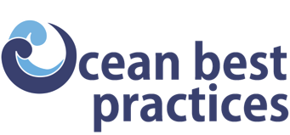
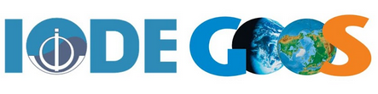
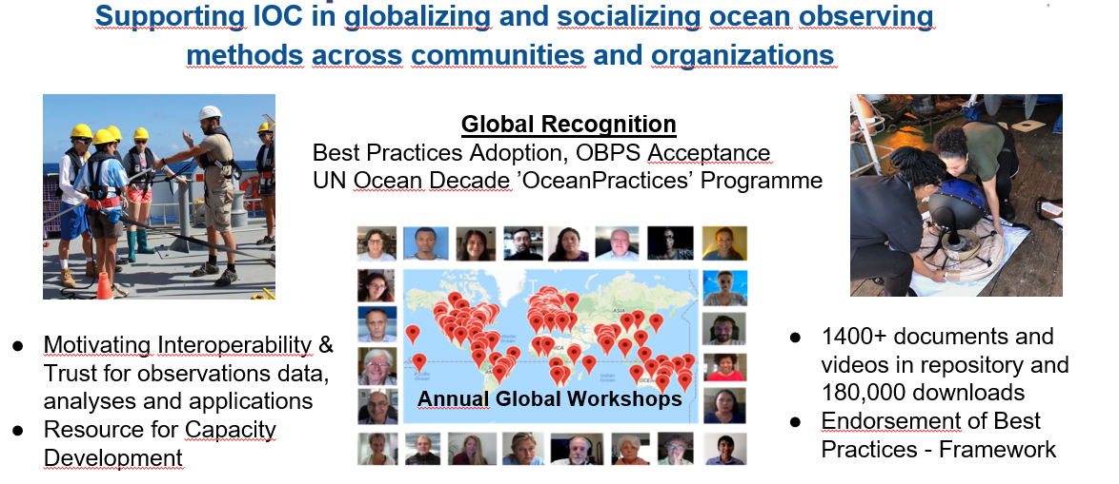

Slide 37
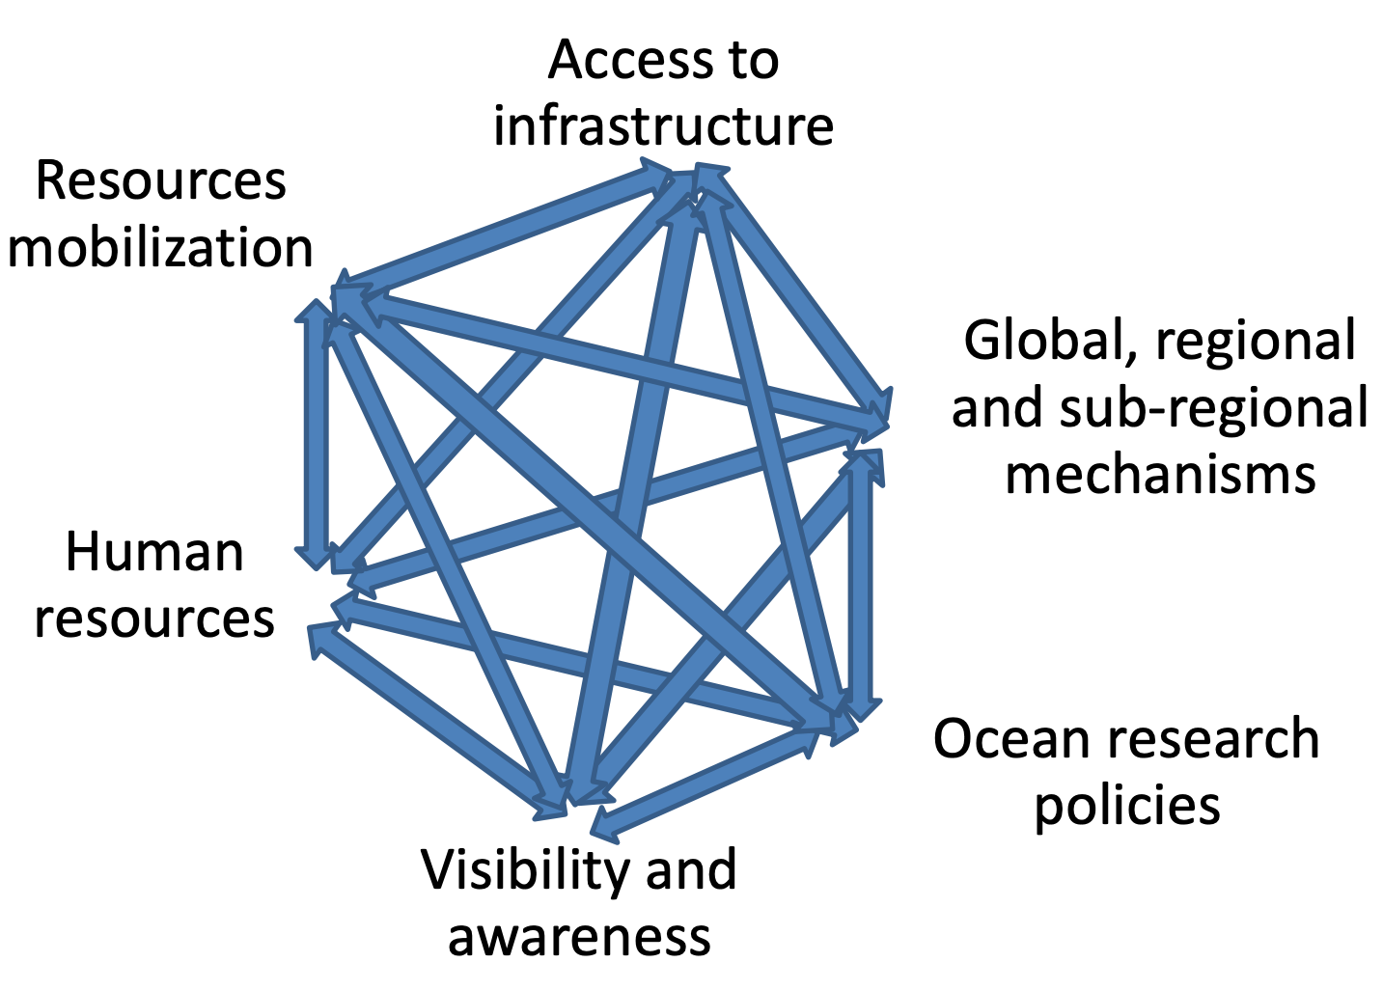
IOC CD Strategy 2021-2025
OUTPUTS OF THE IOC CD STRATEGY
IOC CD Strategy Vision
Through international cooperation, IOC assists its Member States to collectively achieve the IOC’S high-level objectives (HLOs), with particular attention to ensuring that all Member States have the capacity to meet them.
Current version extended to 2023
Preparations under way for IOC CD Strategy 2023-2030
IN SUM: 6 OUTPUTS, 13 ACTIVITIES, 23 ACTIONS

Slide 38
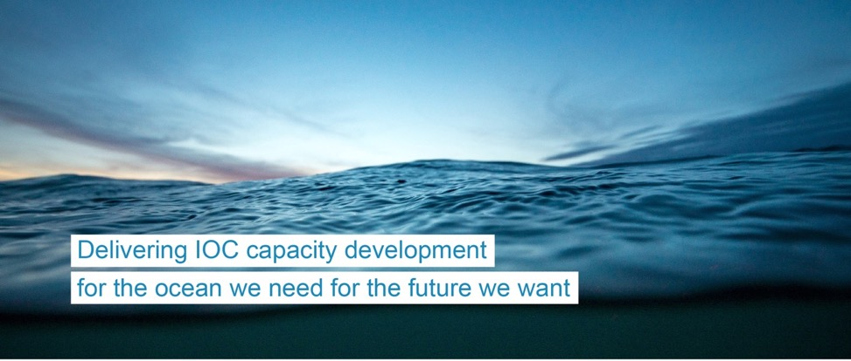


OceanTeacher
Global Academy
Delivering as One
www.ioc-cd.org
www.oceanteacher.org
ioc.training@unesco.org
Notes:
The second phase of the OceanTeacher Global Academy started in April 2020. It’s a 3-year project, funded by the Government of Flanders, Belgium.
Its main goals are to:
1) Develop a portfolio of packaged courses (related to the needs of IOC and other partners and stakeholders)
2) Deliver courses online and/or blended learning, on demand
It builds on the legacy of the previous project and includes new initiatives and challenges now in place, such as the 2030 Agenda and its SDGs and the UN Decade of Ocean Science for Sustainable Development.
New, ready to deliver course topics are being made available online. And the network of Training Centres is expanded.
OTGA-2 fosters collaborations beyond UNESCO/IOC to position itself as the training platform for ocean related topics within the UN and beyond.

Slide 39

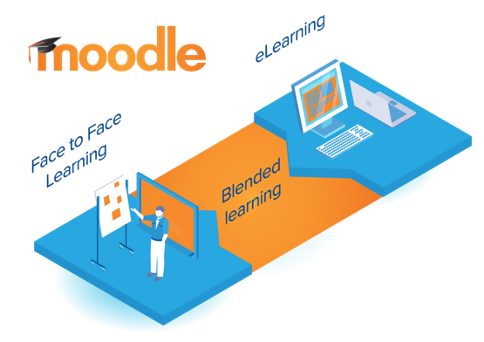
OceanTeacher Global Academy
Building human capacity
Open Access
Learn anywhere,
anytime
Moodle:
Modular
Object
Oriented
Dynamic
Learning
Environment
Notes:
The e-Learning Platform is the backbone of OTGA. As a Learning Management System, it facilitates Face to face learning, blended and online learning.
The platform allows
Sharing content and learning between organisations / stakeholders
Co-creating content and knowledge
Recognition for the organisations as well as course developers
Widely available (learn anywhere, anytime)
Enables creation of a community of practitioners and learner collaboration

Slide 40
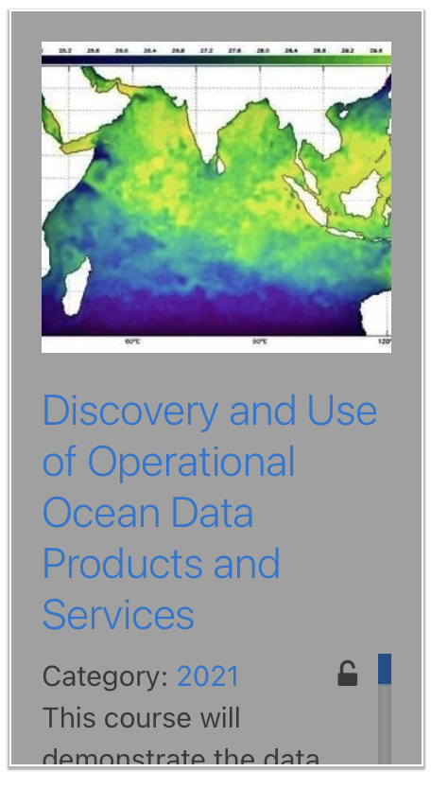
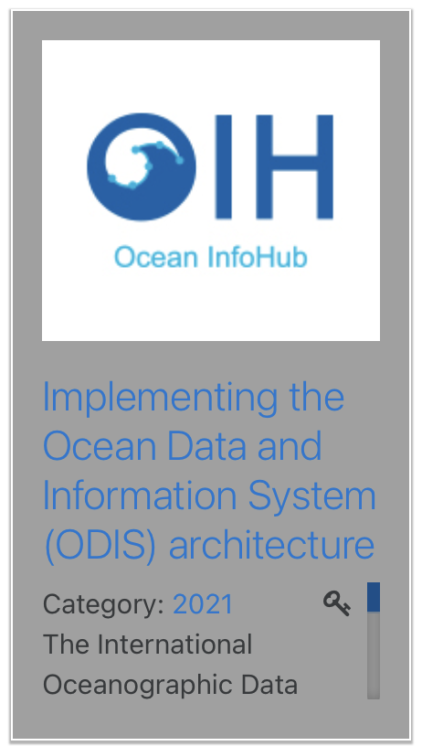
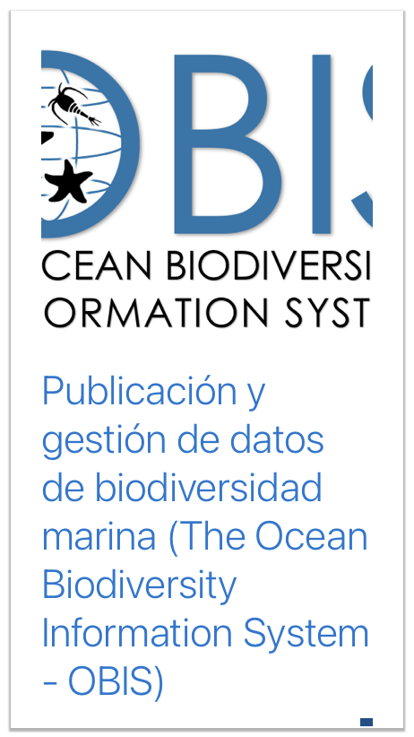
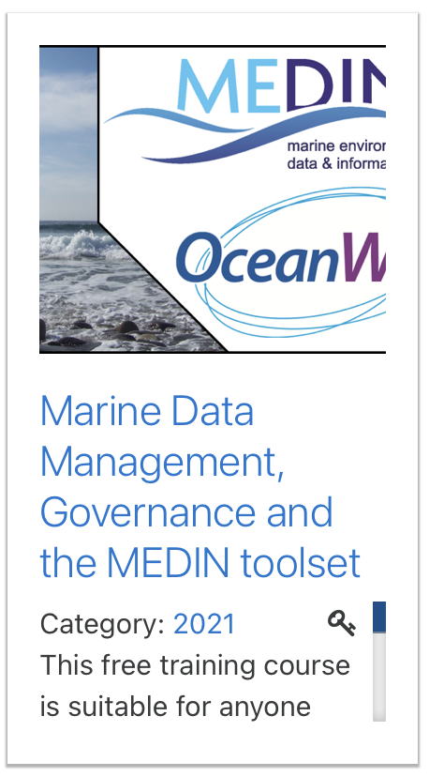
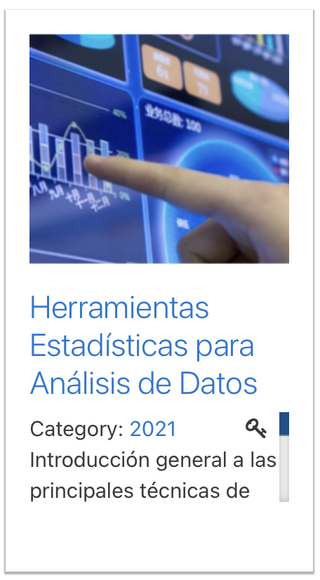
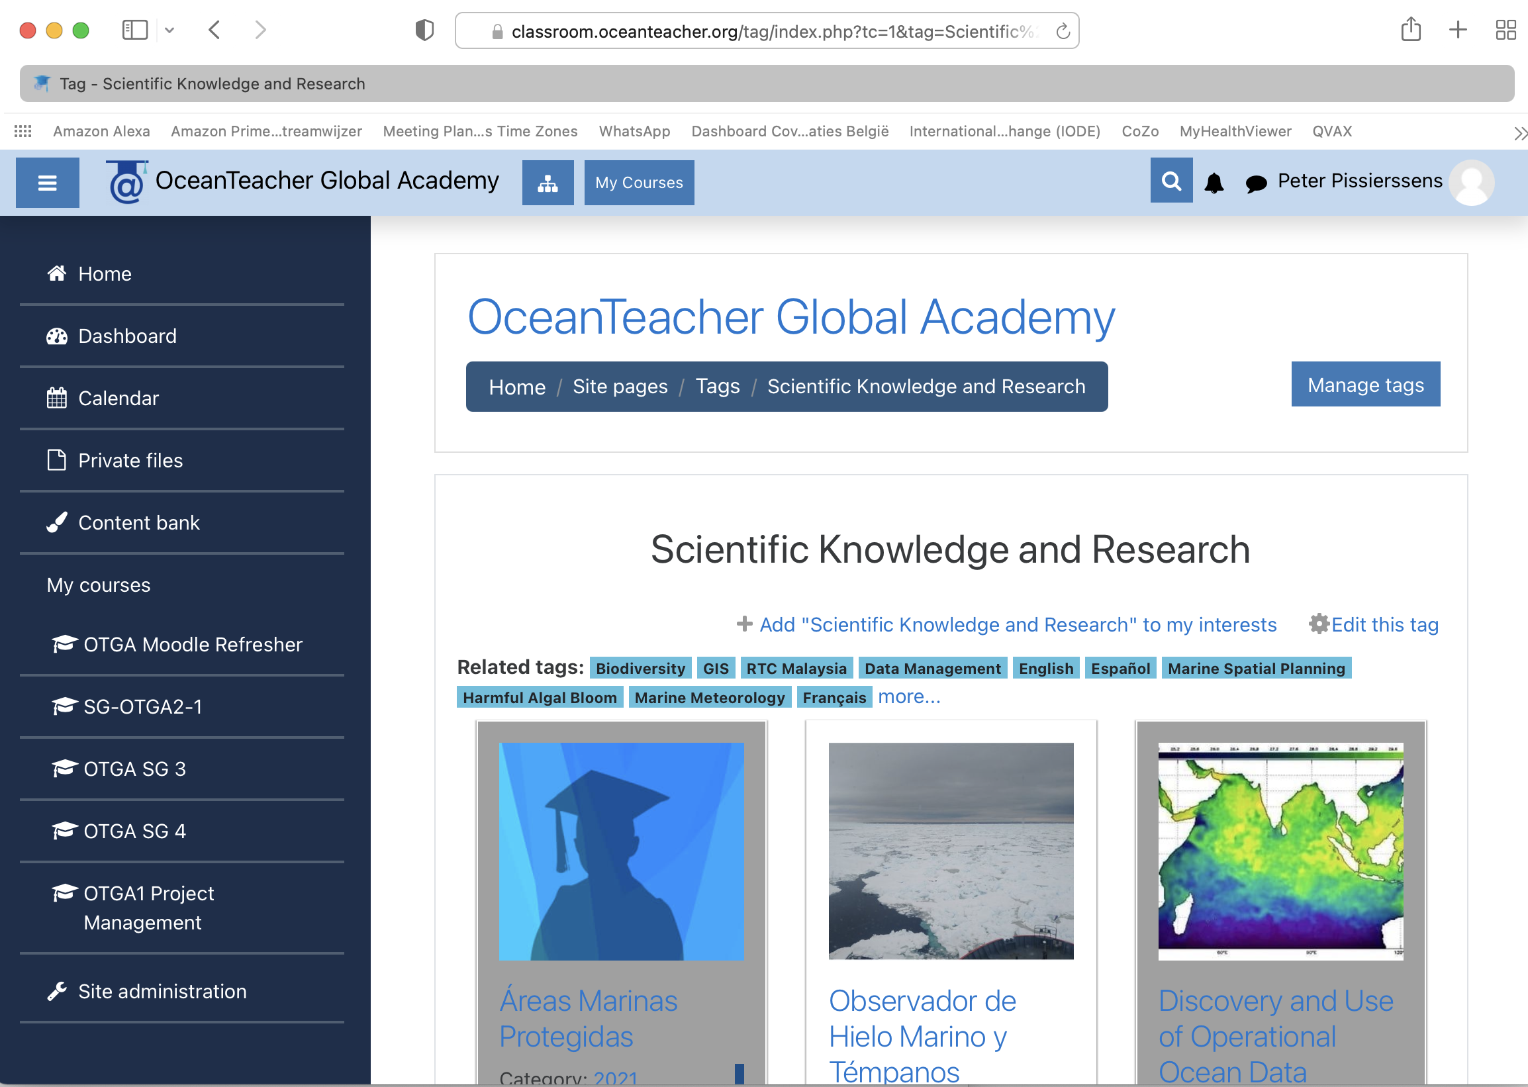
OceanTeacher Courses in data and information management
20 different courses related to D&IM

Slide 41
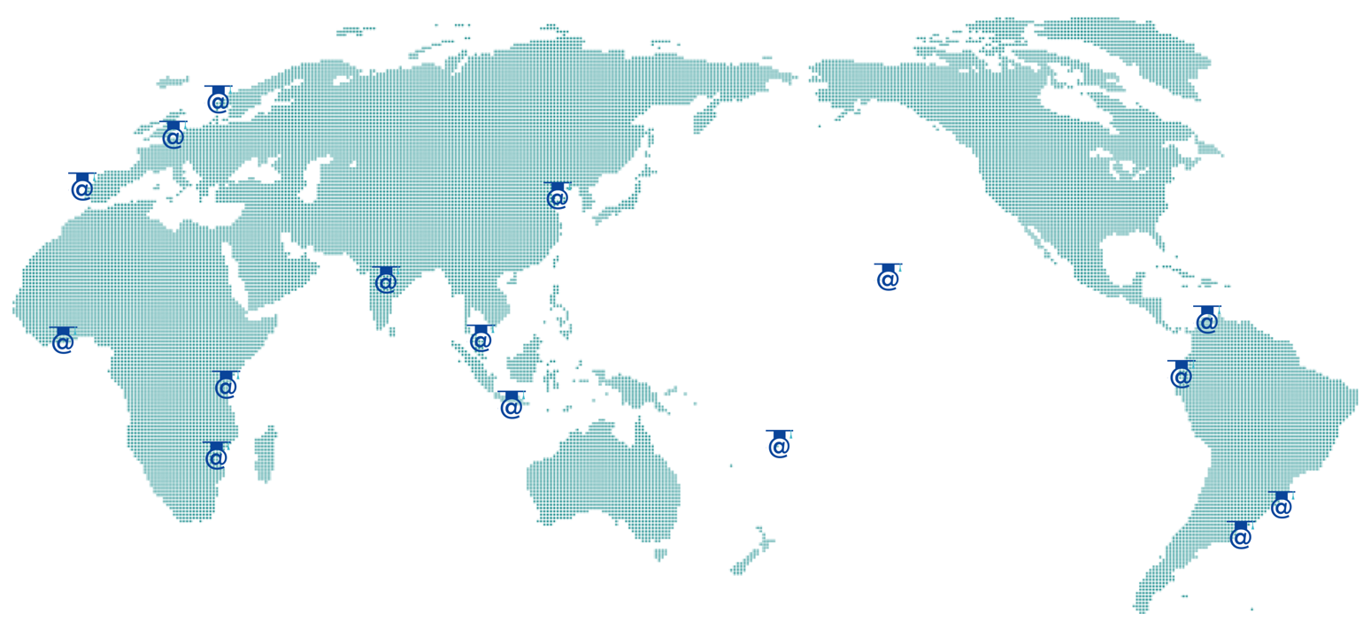

OceanTeacher Global Academy:
Network of Regional and Specialized Training Centres
Notes:
An essential component of the OTGA approach to training is its global network of Training Centres.
OTGA works in partnership with the IOC Member States and its institutions, and it’s now a network of 16 Regional and Specialised Training Centres. These RTCs and STCs play an essential role, as they help tailoring courses to the regional specific needs and they host the face-to-face courses in the languages that are relevant to the Regions and focus on relevant regional needs and topics.

Slide 42
UN Decade of Ocean Science for Sustainable Development

Slide 43





10 Ocean Decade Challenges
Vision
The science we need for
the ocean we want
Mission
Transformative ocean science solutions for sustainable development, connecting people and our ocean.
Understand and beat marine pollution
Increase community resilience to ocean hazards
Expand the global ocean observing system
Create a digital representation of the ocean
Build skills, knowledge and technology for all
Change humanity’s relationship with the ocean
Protect and restore ecosystems and biodiversity
Develop a sustainable and equitable ocean economy
Unlock ocean based solutions to climate change
Sustainably feed the global population
Decade Action Framework
Ocean Decade Actions
28
6
Programmes
Contributions
UN-led Actions
33

