Slide 1




Met-Ocean data sets: climate, reanalysis, forecast and in situ data
Tomás Fernández (Universidad de Cádiz)
tomas.fernandez@uca.es

Slide 2

Contents
Met-Ocean data types and characteristics
Analysis, reanalysis and climatology
Overview of some data sets
Some CMEMS products description (PHYS and INSITU)
Data lexicon: quality information and product user manual

Slide 3
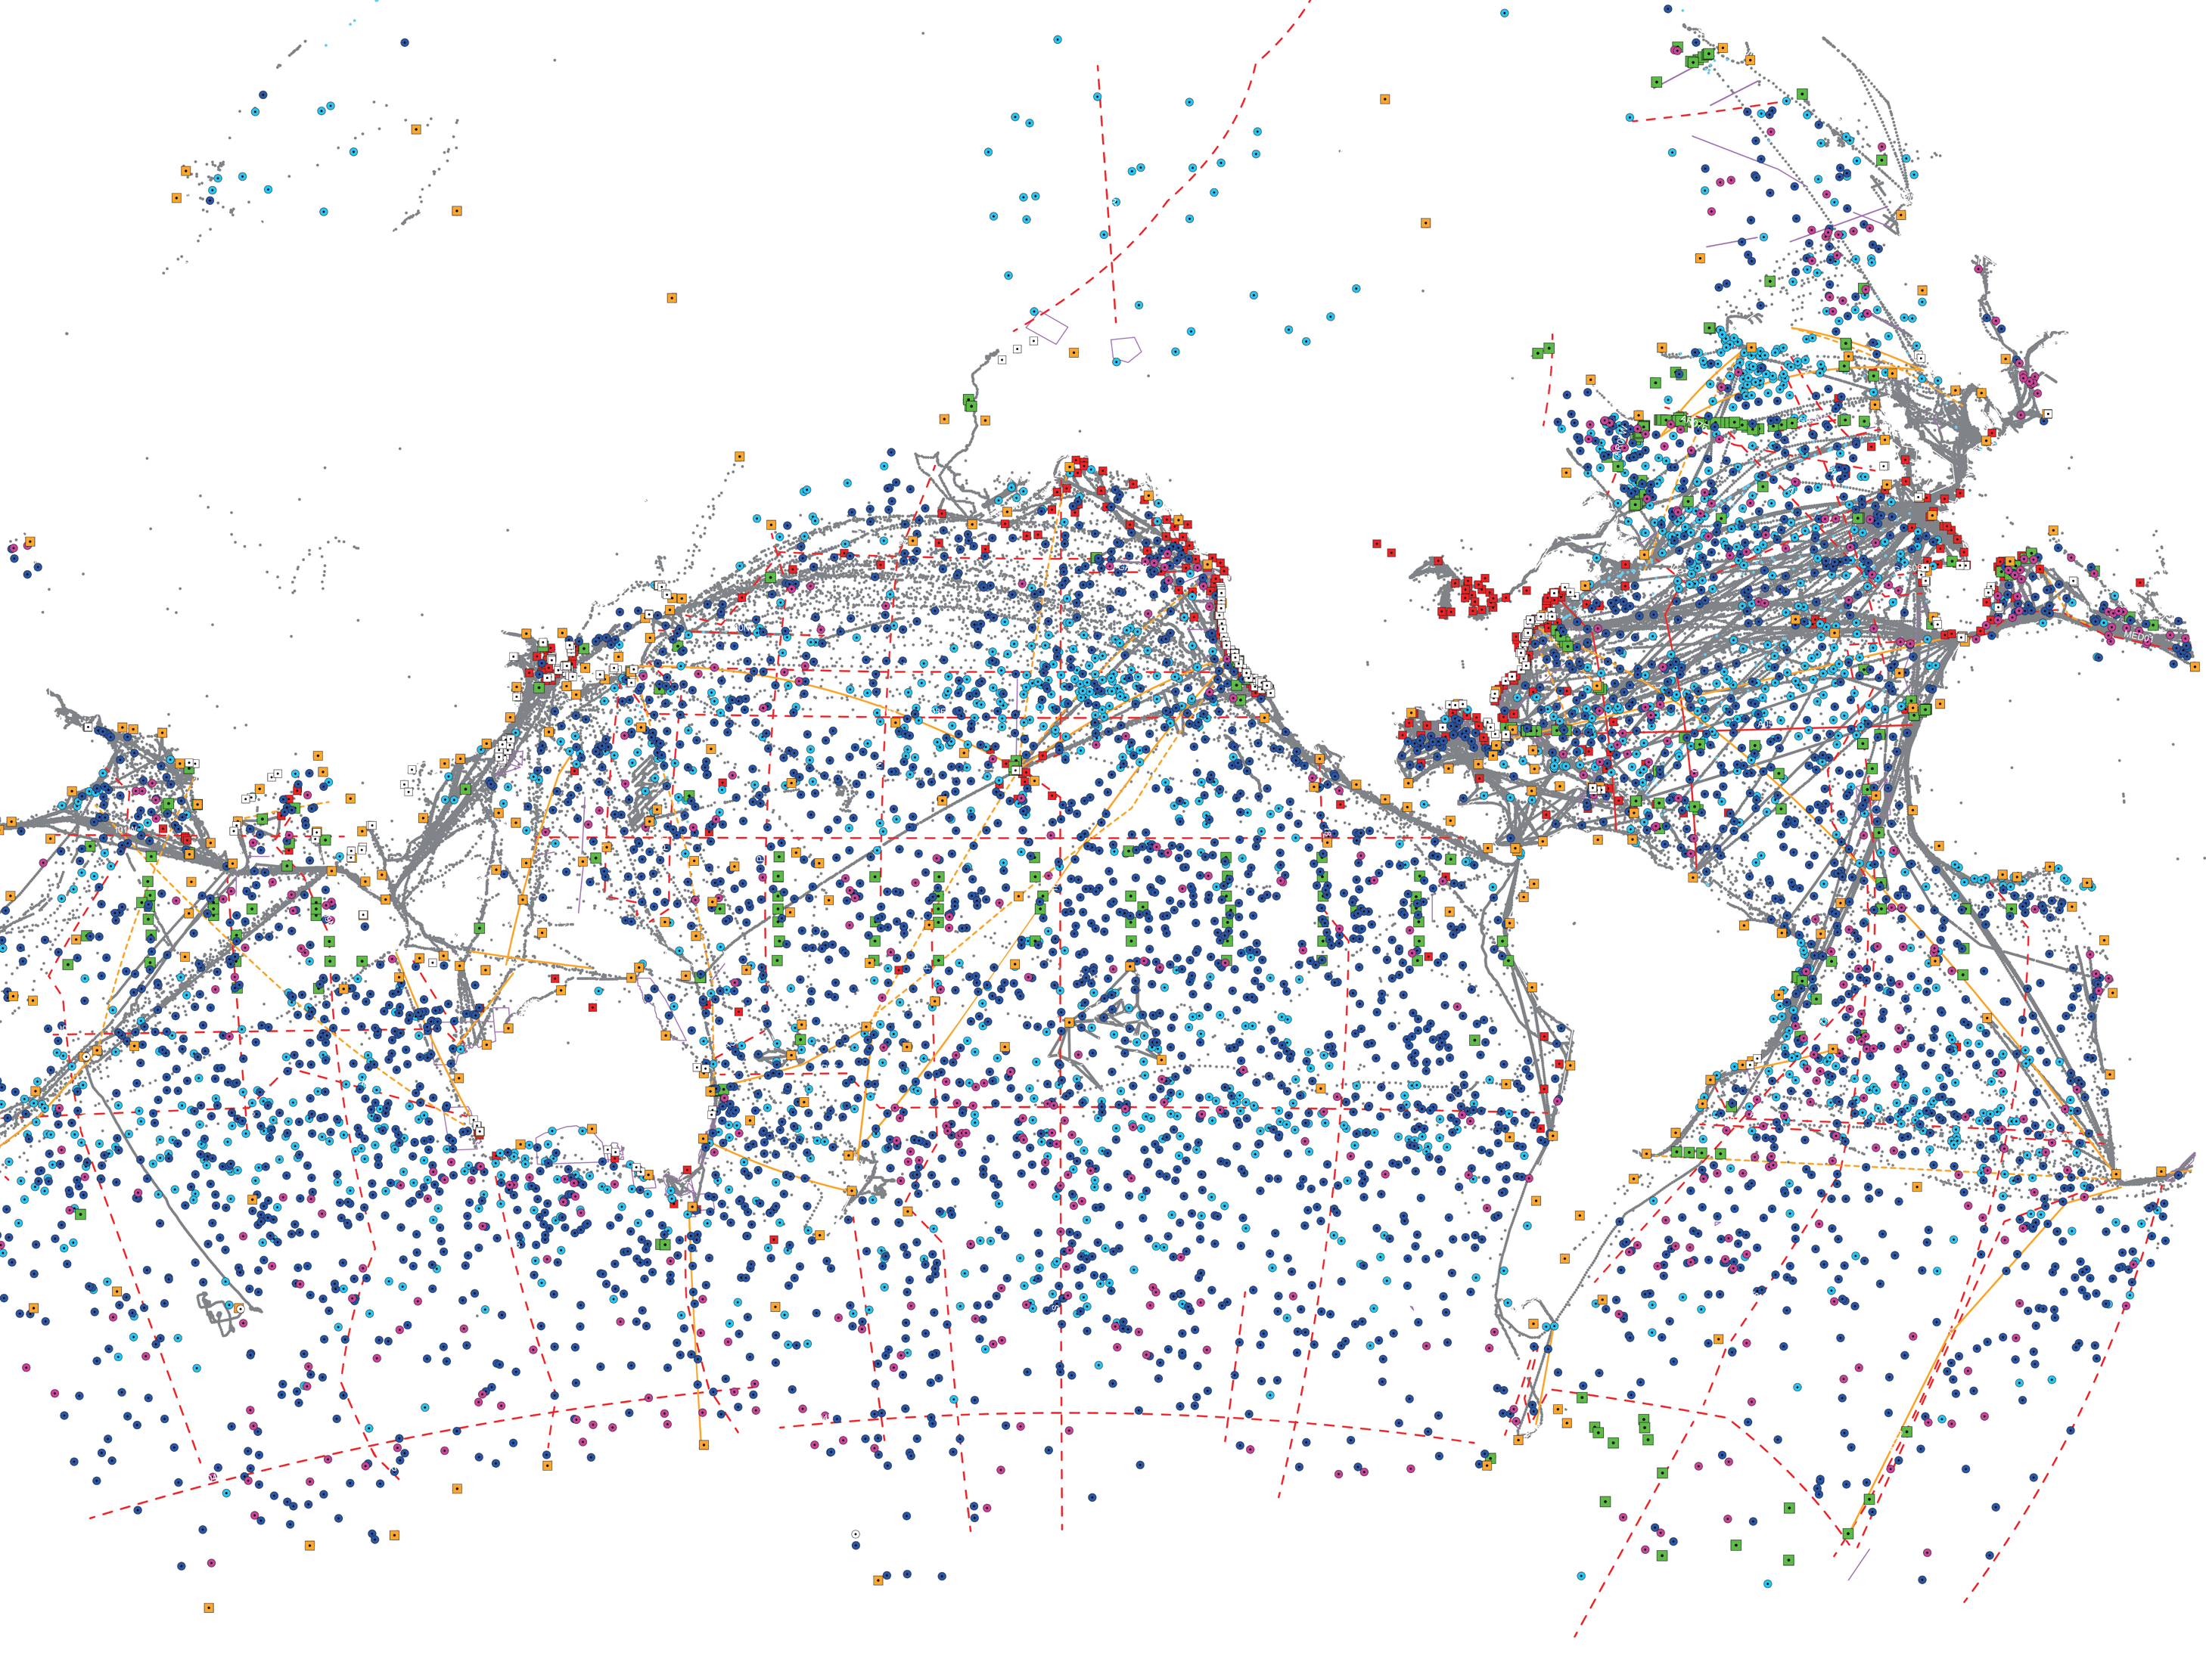
Metocean data
Meteorology and ocean physics data. Part of the Earth System data.
At present a quite complete observing system (in situ and remote).
Not evenly distributed obs, fewer back in time.
We need a long and reliable record for:
Climate change
Ocean health
Forecast and warning
Ocean observing system report card 2021

Slide 4
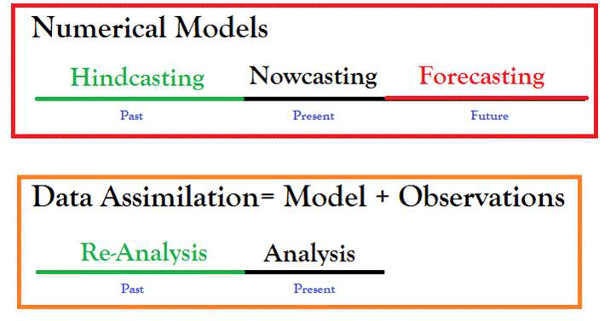
Metocean data types (products)
From Siva Reddy PhD Thesis (2015) DOI:10.13140/RG.2.1.4459.4326
Notes:
It should be noted that model products cannot exist without observations (calibration, validtion and initial and boundary conditions), but assimilation are special procedures for “correcting” the model output in accordance to the best observed state of the system (ocean)

Slide 5
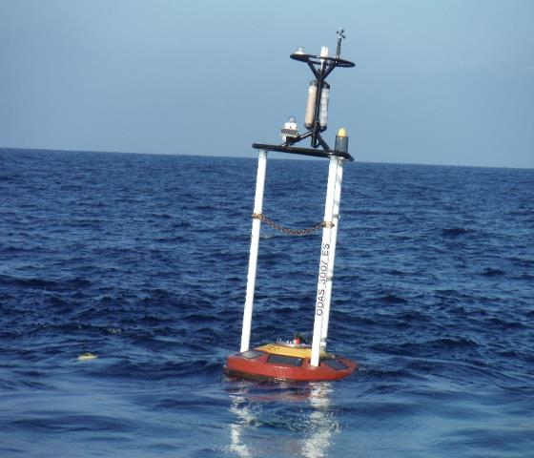
Metocean data types (level of processing)
Level 0
Level 1
Level 2
Level 3
Unprocessed instrument data
Data processed to sensor unit
Derived geophysical variables (same resolution and location as L1)
Georeferenced data (gridded fields)
Level 4
Model output or results from analysis of multiple lower level products, missing data gaps filled
Notes:
Level 0: Level 0 data are unprocessed instrument raw data at the instrument’s space and time resolution. All available supplemental information needed for further postprocessing is included in or appended to or supplied with the data files.
Level 1: Level 1 data are derived from Level 0 data which were processed to values of sensor units, e.g. brightness temperatures, radiances or backscatter ratios. Level 1 data are available at the instrument’s full time/space resolution. All supplemental information needed for further processing is included in or appended to or supplied with the data files. Level 1 data may already be geolocated.
Level 2: Level 2 data are derived from Level 1 data that have been processed to geophysical quantities of interest, e.g. wave height, cloud fraction, aerosol optical depth or radiation at the top of atmosphere. Uncertainty estimates of the retrieved parameters shall be included in or appended to or supplied with the data files.
Level 3: Level 3 data are derived from Level 2 data that have been spatially and/or temporally resampled, e.g. monthly averages on a global 1°x1° lat-lon grid. Uncertainty estimates of the resampled data shall be included in the data files.
Level 4: Further derived products, e.g. climate indices, obtained from analysis of multiple lower-level products. Uncertainty estimates, if feasible to compute, may be included in the data files.

Slide 6
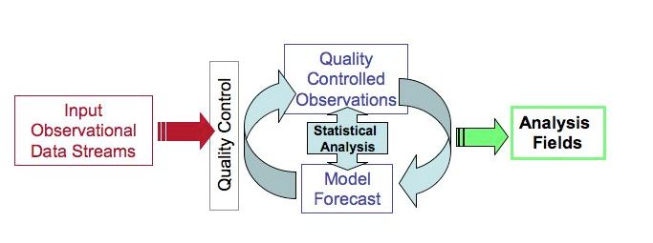
Re/analysis products
An analysis is a snapshot of the state of the ocean at any given time. It is done using a model, data and observations to provide a best fit produced on the fly.
An oceanographic reanalysis consists in modelling the state of the ocean over a long period of time (several years) while correcting it with the best available past observations.
From the Blue Book Copernicus for a Sustainable Ocean
From E. Kalnay, www2.atmos.umd.edu

Slide 7
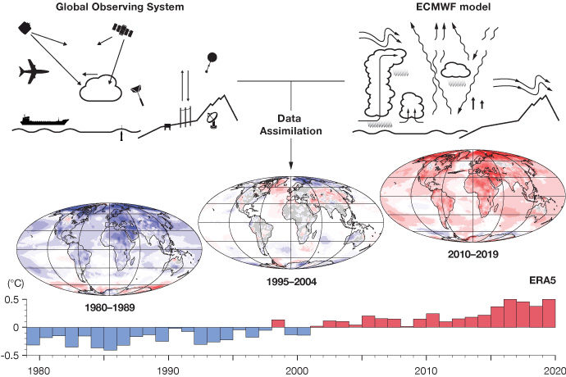
Re/analysis data
Reanalysis data provide the most complete picture currently possible of past weather and climate.
‘Maps without gaps’.
https://www.ecmwf.int/en/about/media-centre/focus/2020/fact-sheet-reanalysis
Notes:
Provide the most complete picture currently possible of past weather and climate. They are a blend of observations with past short-range weather forecasts rerun with modern weather forecasting models. They are globally complete and consistent in time and are sometimes referred to as ‘Maps without gaps’.
Why is reanalysis important?
To understand climate change and current weather extremes, it is important to have observations of the Earth system going back as far as possible in time. However, observations have always been unevenly distributed, and they come with errors. Even in the satellite era, observations alone cannot provide a complete and accurate picture of the state of the Earth system across the globe at a given point in time. Reanalyses fill the gaps in the observational record, and they do so in a way that is consistent in time, thus minimising any spurious signals of change.
How are reanalyses produced?
Reanalysis combines past short-range weather forecasts with observations through data assimilation. The process mimics the production of day-to-day weather forecasts, which use an analysis of the current state of the Earth system as their starting point. The analysis is a physically consistent blend of observations with a short-range forecast based on the previous analysis. Reanalyses are usually produced at lower resolution than current weather forecasts, and they use the same modern data assimilation system and forecasting model throughout the reanalysis period. Prior to the production of a new reanalysis, work is carried out to improve the quality and availability of past observational data, for example by digitising old paper-based records and reprocessing existing satellite records. Careful quality control is carried out as reanalyses are produced, and their reliability is assessed by comparison with reanalyses produced at other institutes.

Slide 8
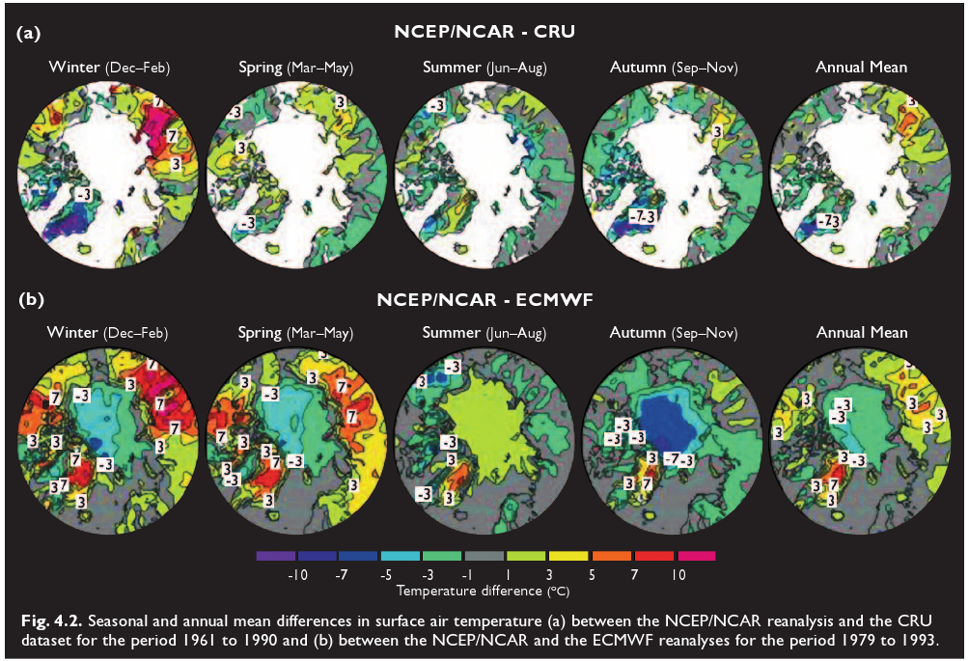
Re/analysis data: uncertainty
ACIA Report 2004
Notes:
Differences among different reanalysis, but also affected for the nature of the ocean/atmospheric field (std, time variability) and theamount of observed data available

Slide 9
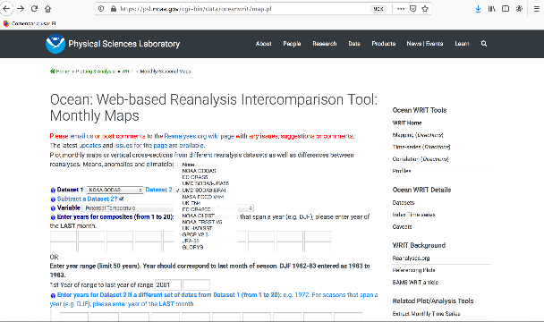
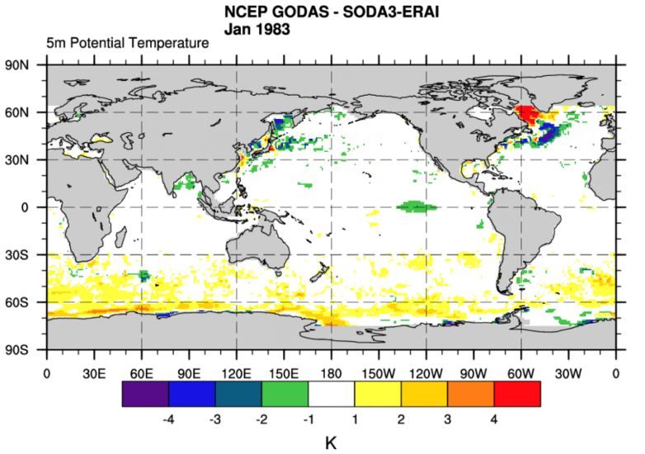
Re/analysis data: uncertainty
Differences between GODAS and SODA3 using NOAA WRIT
Notes:
The accuracy of the data sets, in this case, reanalysis, is really of importance. A renalysis never will give us what was the “true” past state of the system (ocean, atmosphere), but a good approximation of how it was. Different reanalysis are based on different observations, assimilation / analysis techniques, ocean/atmosphere models, time/space resolutions, therefore they can produce different outputs. It is important to read the data set documentation to understand if they fit for a cocrete task/purpose/research.

Slide 10
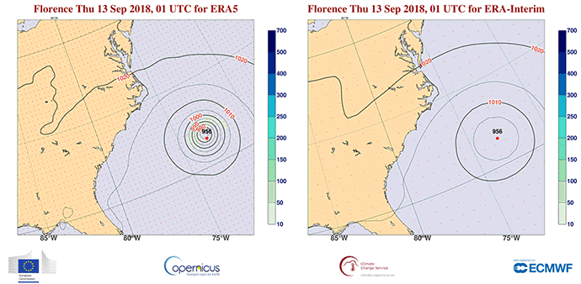
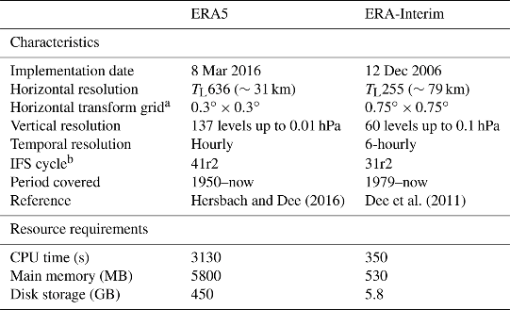
Reanalysis data: improving accuracy
From: https://www.ecmwf.int/en/about/media-centre/news/2018/ecmwfs-era5-reanalysis-soon-extend-back-1979
From Hoffman et al. (2019) https://acp.copernicus.org/articles/19/3097/2019
Notes:
The ERA5 reanalysis provides a detailed picture of the track, intensity (contours, in hPa) and accumulated rainfall (shading, in mm) associated with Hurricane Florence as it struck the east coast of the US in September 2018 (left). Its predecessor, ERA-Interim, provides a less accurate and less detailed picture as it uses an older model version, fewer observations and a lower spatial and temporal resolution (right).

Slide 11
Climatology data
Climate is the statistical ensemble of states occurring in the system Atmosphere-Ocean-Solid Earth in a period of several decades (Monin, 1979).
Climate may be defined as the multivariate, multiple-time probability distribution of status of the ocean-ice-atmosphere system (North et al. 1982).
Climate normals: Period averages computed for a uniform and relatively long period comprising at least three consecutive ten-year periods (WMO No-1203).
Climate includes arithmetic mean, but it can also include values such as the standard deviation, percentile point, number of exceedances of a threshold or extreme values
Notes:
daily and seasonal variabilities, for example std of the monthly multiyear series.
Gridded climatology are made from multiple source observation analysis, but also can be done from reanalysis.

Slide 12
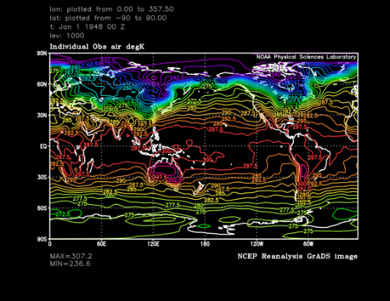
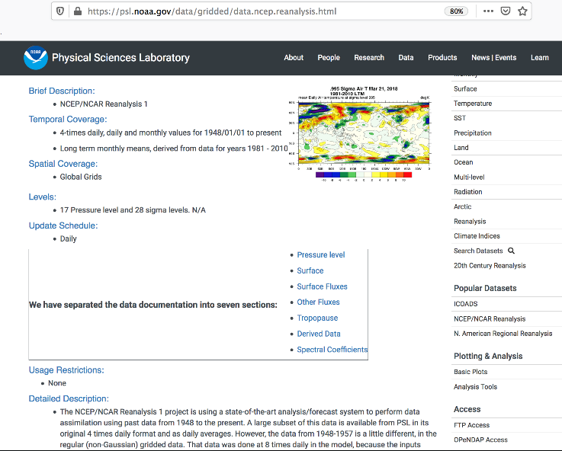
NCEP/NCAR Reanalysis 1
Air temperature at Surface (January 1st 1948)
Resolution 2.5° x 2.5°

Slide 13
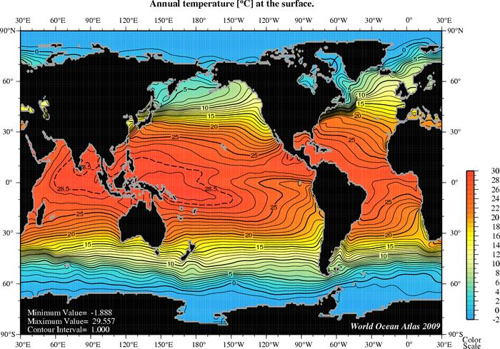
World Ocean Atlas 2009 (WOA09)
www.nodc.noaa.gov/OC5/WOA09/pr_woa09.html
World Ocean Atlas 2009 (WOA09) is a set of objectively analyzed (1° grid) climatological fields of in situ temperature, salinity, dissolved oxygen, Apparent Oxygen Utilization (AOU), percent oxygen saturation, phosphate, silicate, and nitrate at standard depth levels for annual, seasonal, and monthly compositing periods for the World Ocean. It also includes associated statistical fields of observed oceanographic profile data interpolated to standard depth levels on both 1° and 5° grids .

Slide 14
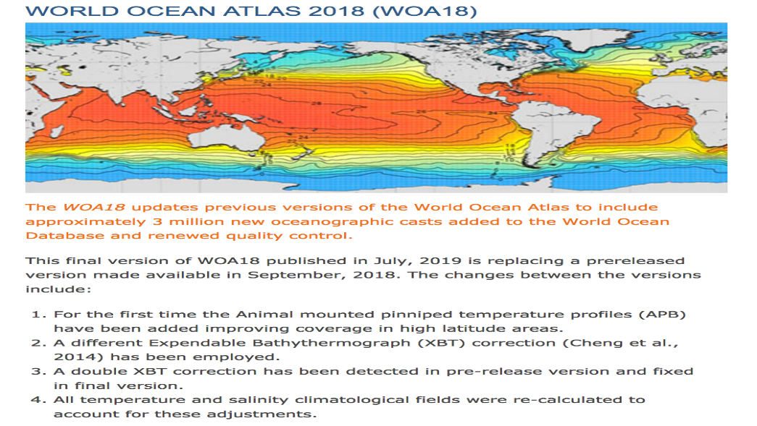
World Ocean Atlas 2018 (WOA18)
https://www.ncei.noaa.gov/access/world-ocean-atlas-2018/

Slide 15
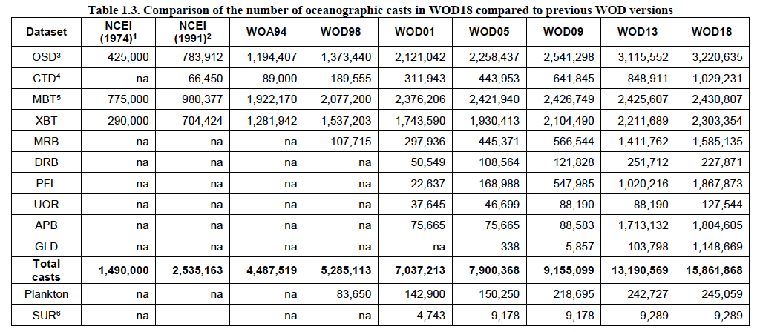
World Ocean Atlas 2018 (WOA18)
https://www.ncei.noaa.gov/access/world-ocean-atlas-2018/
Boyer et al., 2018

Slide 16
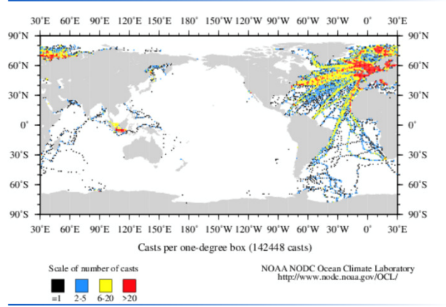
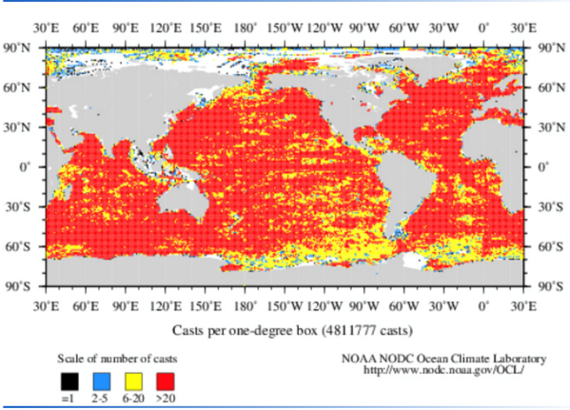
World Ocean Database 2018 (WOD18)
https://www.ncei.noaa.gov/access/world-ocean-database-select/dbsearch.html
1910-1920
2010-2020

Slide 17
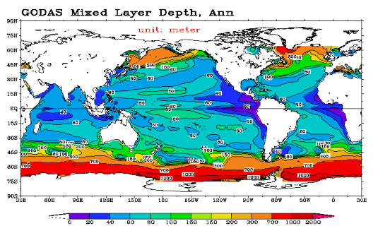
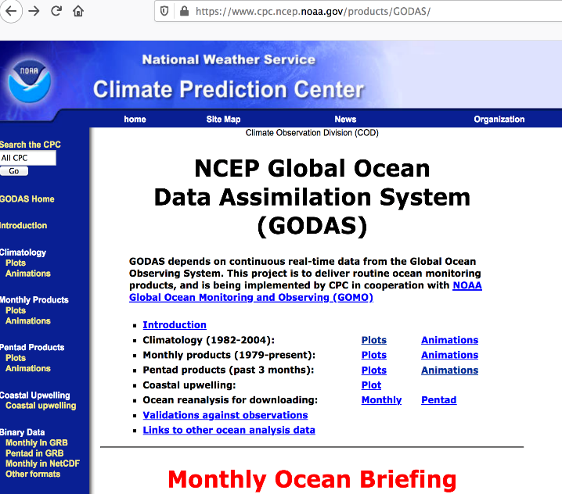
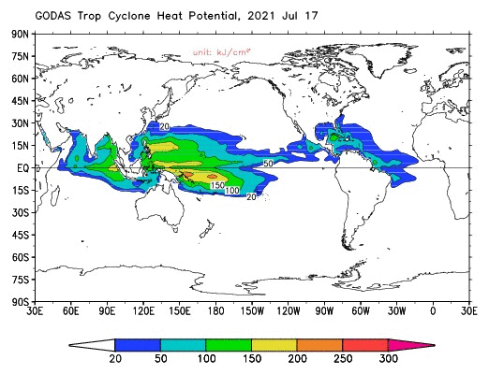
NCEP Global Ocean Data Assimilation System (GODAS)

Slide 18
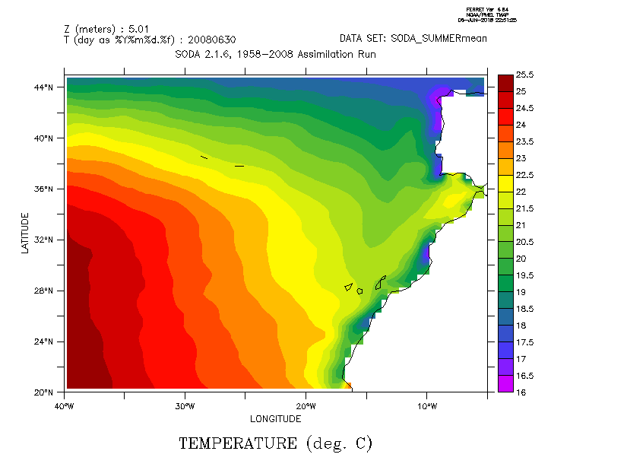
Simple Ocean Data Assimilation (SODA)
Model: GFDL MOM5/SIS1
Resolution: Horizontal 0.25° (28 km at Equator). 50 vertical levels, uper layer at 10 m depth
Period and time resolution: 1871-2008 (monthly), 1980-2017 (5 days)
Assimilated data: WOD09 T&S, ICOADS 2.5 SST
Forcings: 20CRv2 for wind stress and bulk formulae
https://www.soda.umd.edu/

Slide 19
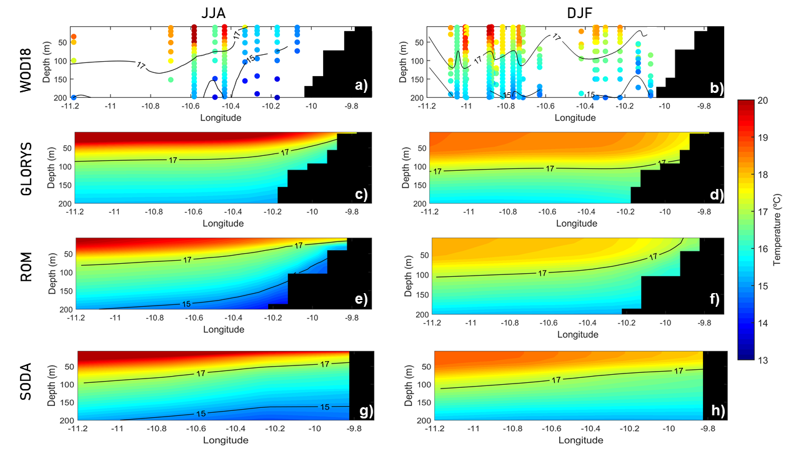
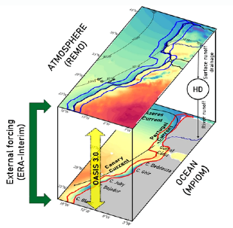
Insitu data, models and reanalysis
Temperature (ºC) transect for JJA (left) and DJF (right) in Cape Ghir (1980–2012) for WOD18 (a, b), GLORYS (c, d), ROM (e, f) and SODA (g, h). Vázquez et al. (2021)

Slide 20
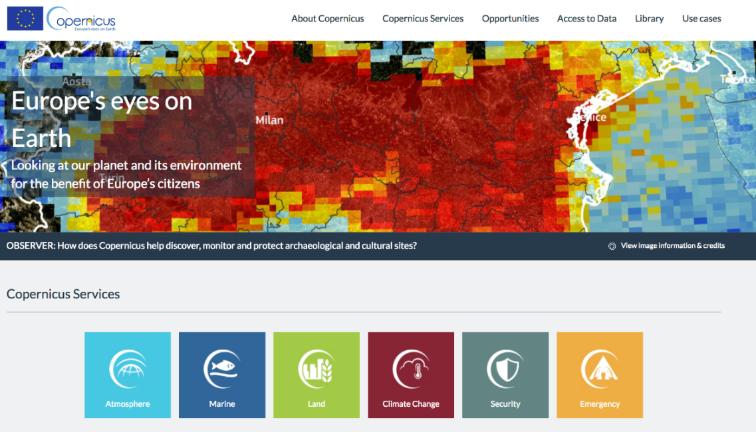

Slide 21

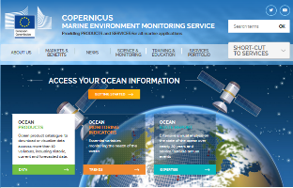
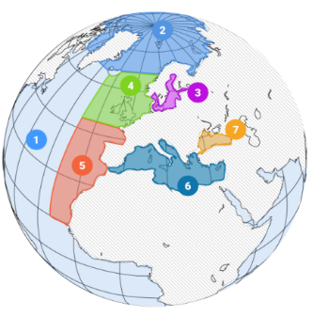
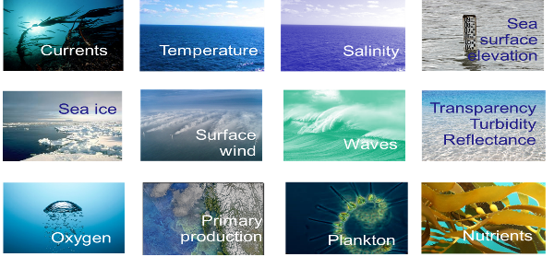
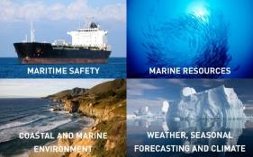
Copernicus Marine Environment Monitoring Service
CMEMS -An operational European service by European experts to offer the best worldwide information on Marine Environment based on observations and models
Domains: Global and 6 regional domains

Slide 22
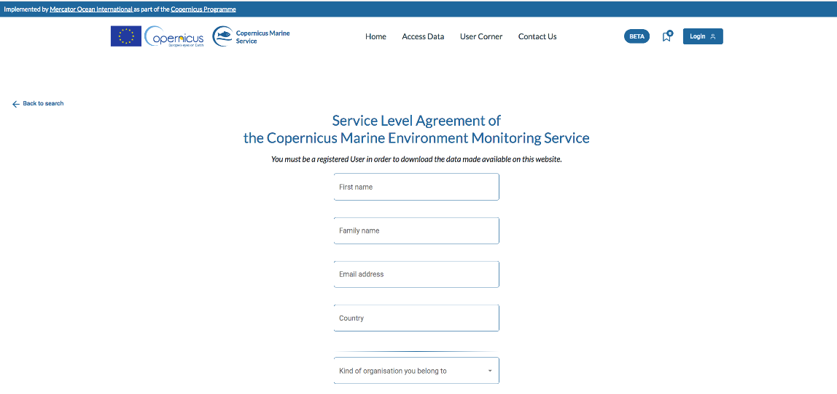
Copernicus Marine Environment Monitoring Service
User registration
https://resources.marine.copernicus.eu/registration-form

Slide 23
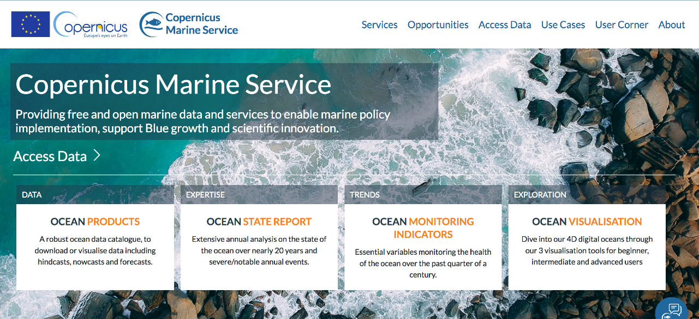
Copernicus Marine Environment Monitoring Service

Slide 24
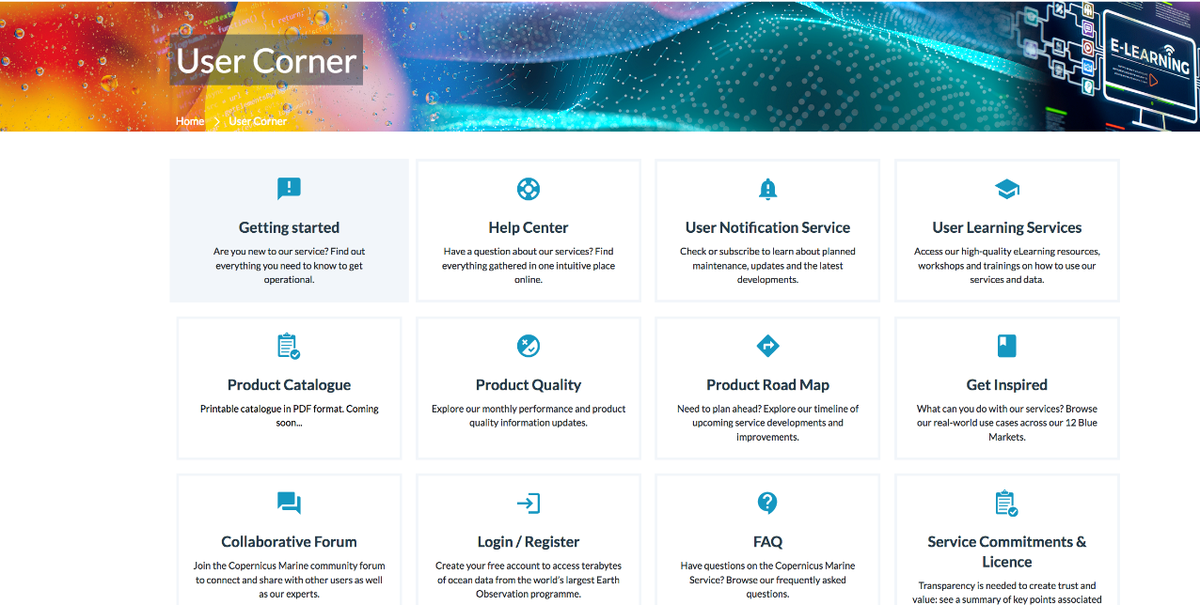
Copernicus Marine Environment Monitoring Service

Slide 25
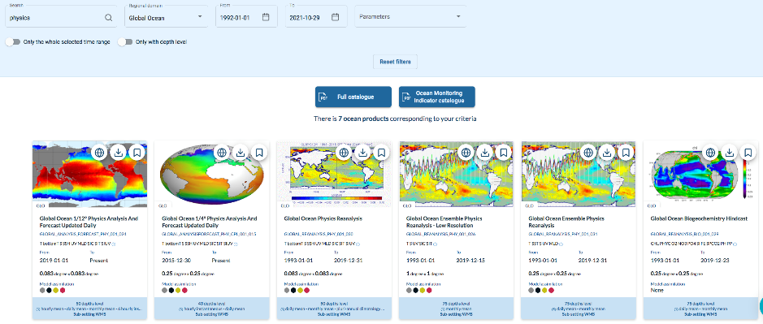
Copernicus Marine Environment Monitoring Service
Searching the
catalogue:
- Keyword
- Domain
- Time period
- Parameters
Product
Datasets
Parameters
Resolution and coverage limited by:
- computing power
- storage capacity

Slide 26
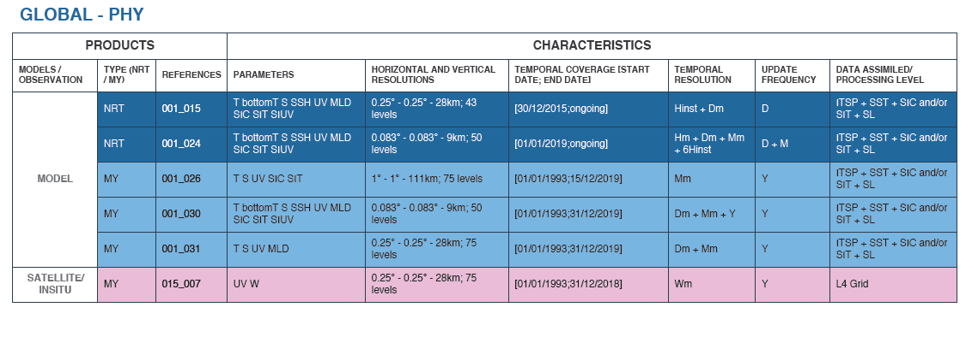
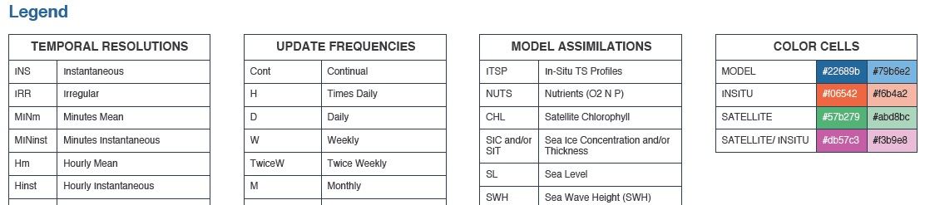
You can download a pdf with the products corresponding to your search criteria, and an informative glossary

Slide 27
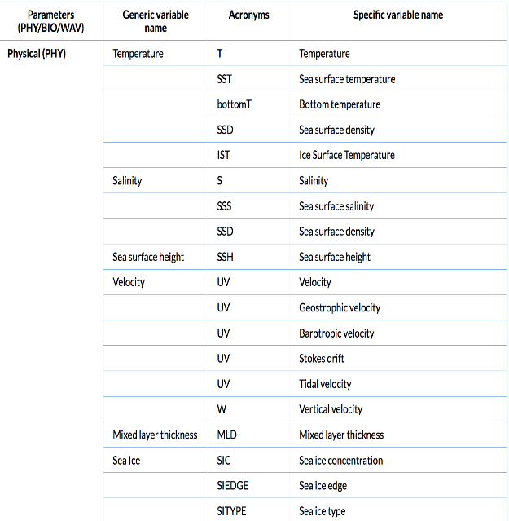
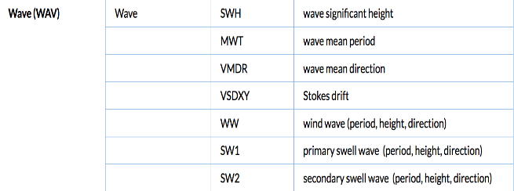
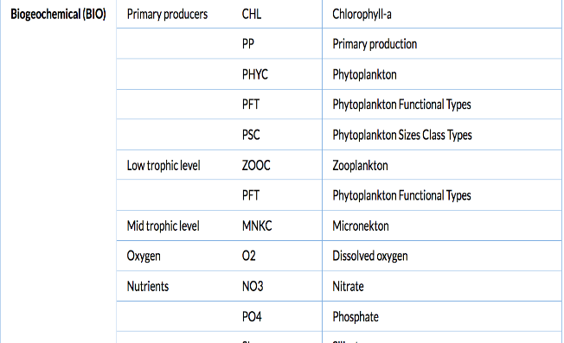
Parameters acronyms (lexicon gets larger…)

Slide 28
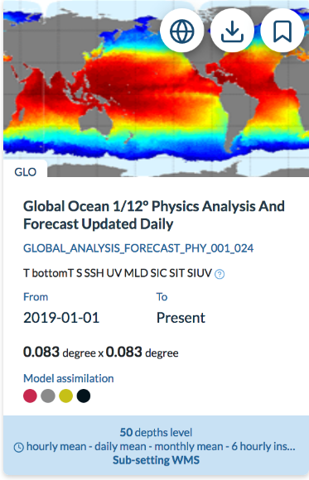
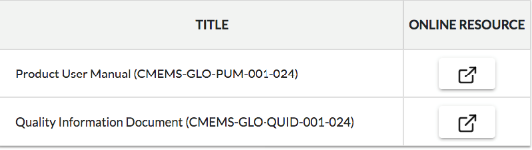
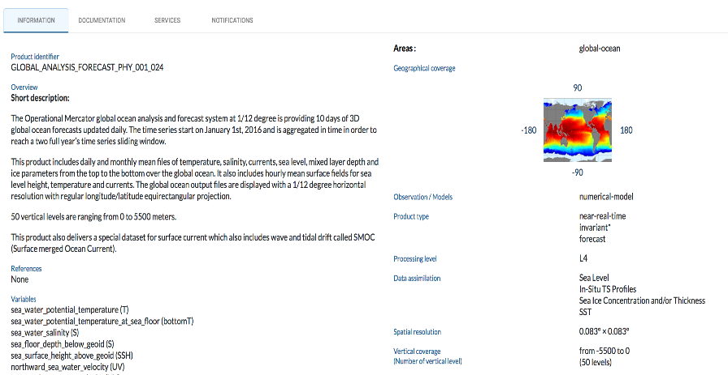
We select one of the products…
DOWNLOAD
VIEW

Slide 29
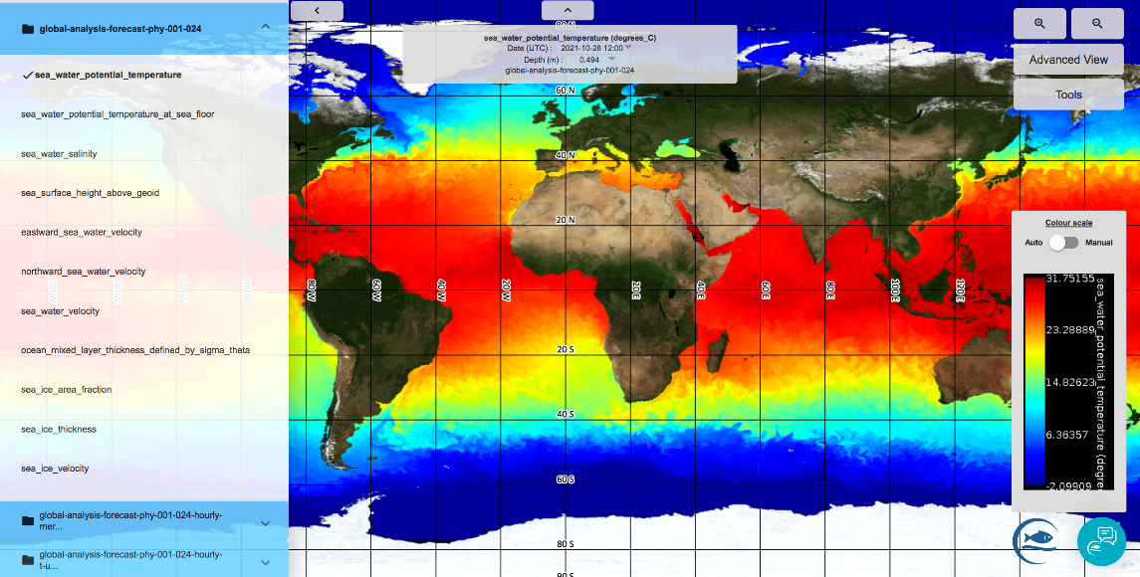
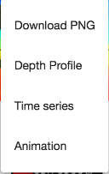
We view one parameter from one of the datasets of the product …
DATASETS
PARAMETERS

Slide 30
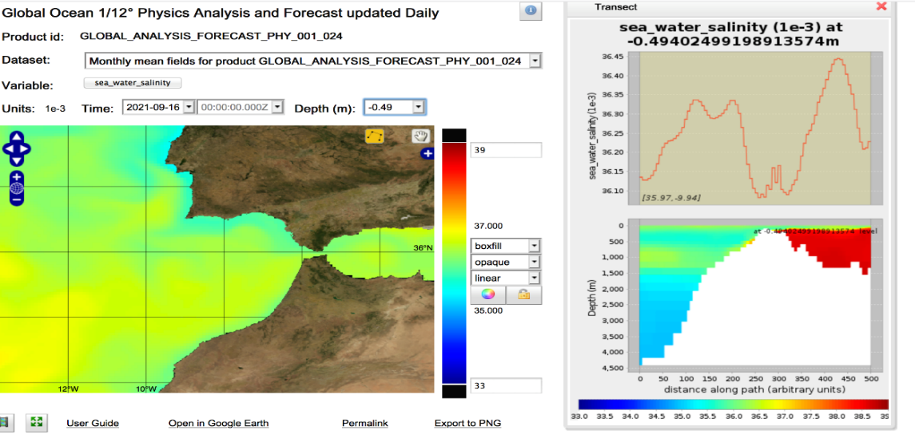
We view one parameter from one of the datasets of the product …

Slide 31
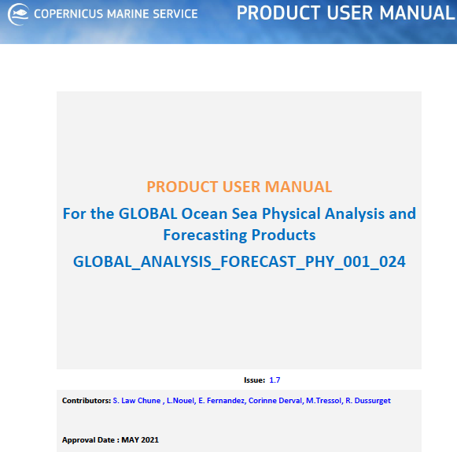
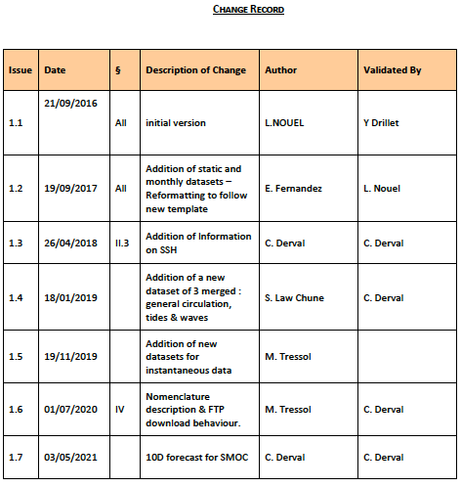
PRODUCT USER MANUAL (PUM)
CONSTANTLY UPDATED: EVOLVING SYSTEM, IMPROVING SERVICES

Slide 32
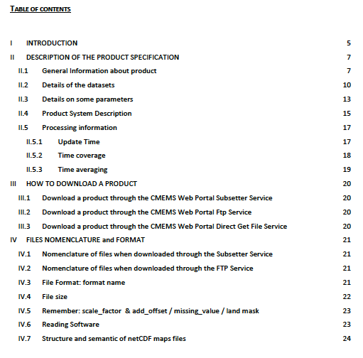
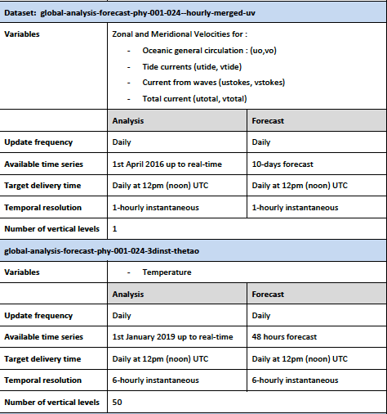
PRODUCT USER MANUAL (PUM)
One product may have several datasets, each of which may have several parameters
Full description and how to use it

Slide 33
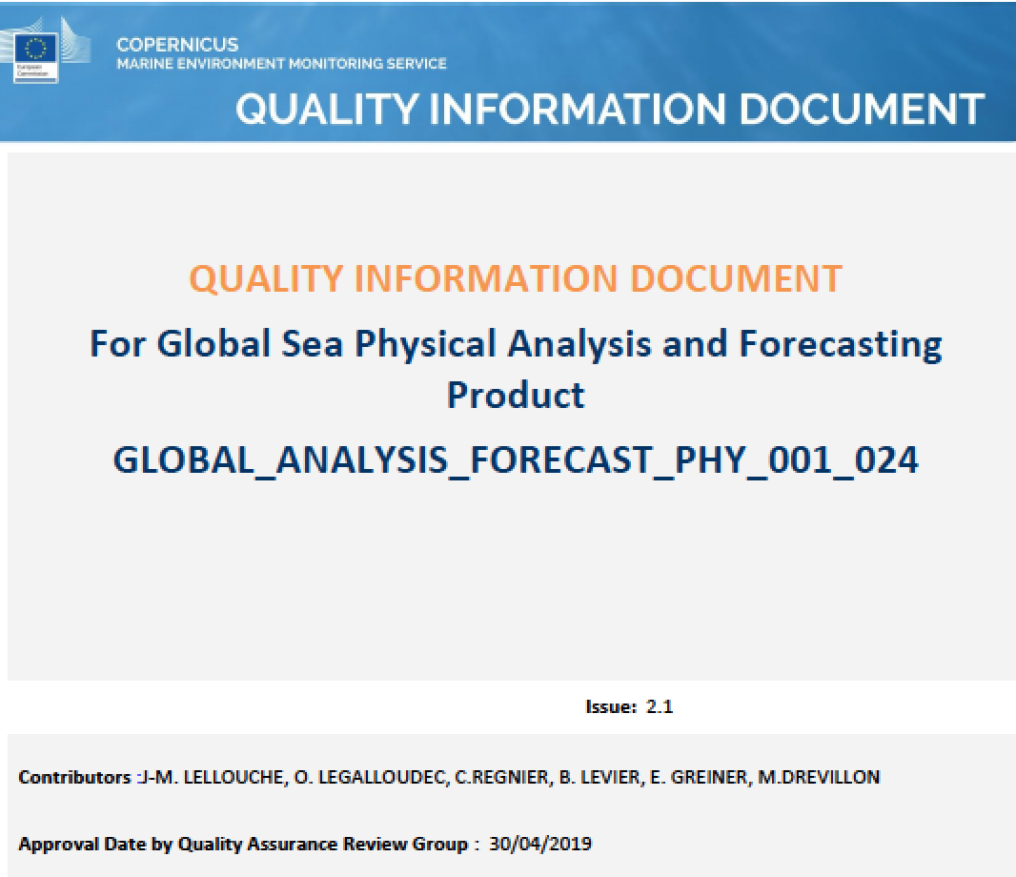
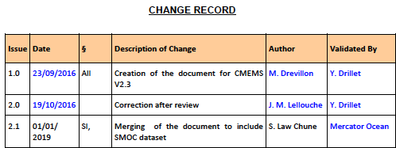
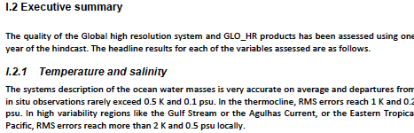
QUALITY INFORMATION DOCUMENT (QUID)
CONSTANTLY UPDATED: ASSESSMENT LEADS TO PRODUCT IMPROVEMENT

Slide 34


QUALITY INFORMATION DOCUMENT (QUID)
Assessment metrics for different variables, using a large set of observations and reference climatologies

Slide 35

CMEMS IN SITU TAC
Data filtering: Domain Platform Parameter Time period
Platform info
Download
Data view
http://www.marineinsitu.eu/dashboard/

Slide 36

CMEMS IN SITU TAC
Multiple platforms
International and regional organizations
NRT (Near Real Time) products
REP (Reprocessed) of delayed mode products
From CMEMS-INS-QUID-013-030-036.pdf

Slide 37

CMEMS IN SITU TAC
Each regional center:
Data acquisition
Automated Quality Control
Product validation
Product distribution
From CMEMS-INS-QUID-013-030-036.pdf
Notes:
● Data Acquisition: Gather data available on international networks or through collaboration with regional partners
● Data Quality control: Apply automatic quality controls that have been agreed at the In Situ TAC level.
These procedures are defined by parameter, elaborated in coherence with international agreements, in particular SeaDataNet, and documented in the CMEMS Catalogue
● Product validation: Assess the consistency of the data over a period of time and an area to detect data that are not coherent with their neighbours but could not be detected by automatic Quality Control (QC)
● Product distribution: Push the data available to CMEMS Distribution Unit (DU). The DU is responsible for data distribution to end users.

Slide 38


QUALITY CONTROL: 2 STEPS
STEP 1:
Automated NRTQC
STEP 2:
REP: Area dependent metrics, including
Visual quality control.
2. Comparison to a reference climatology.
3. Objective analysis and residual analysis.
4. Assessment of drifter data.
From CMEMS-INS-QUID-013-030-036.pdf

Slide 39
MARINE DATA
LEARN
ASK
USE
CONTACT & FOLLOW UP: tomas.fernandez@uca.es

