Slide 1
Jesús Gómez-Enri (jesus.gomez@uca.es) Alfredo Izquierdo (alfredo.izquierdo@uca.es)
University of Cádiz
Exploiting gridded altimetry products in the Mediterranean Sea: From daily to monthly and seasonal time-scales

Slide 2
OUTLINE
Main Objective
Gridded products from altimetry
Study Area
Data Source
Software
Tasks

Slide 3
Main Objective
Physical Oceanography from Space: Sea level oscillations and surface currents at different spatio-temporal scales.
Use of high resolution products derived from multi-mission altimetry.
Download, process and interpret time-series of essential climate variables: sea level and currents.

Slide 4
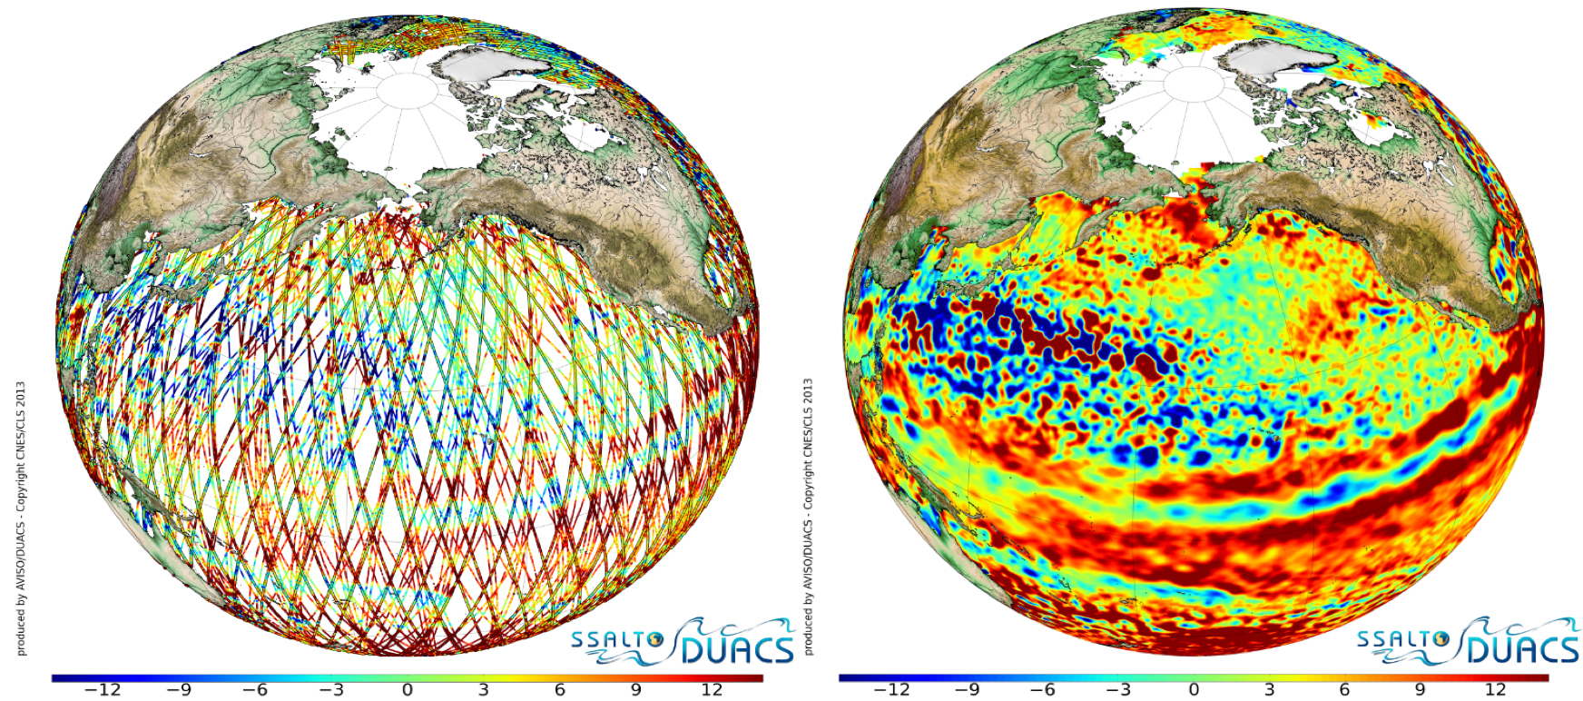
Gridded products from altimetry
Satellite data processing levels for users
Level 2
Level 3
Sea Level Anomaly

Slide 5
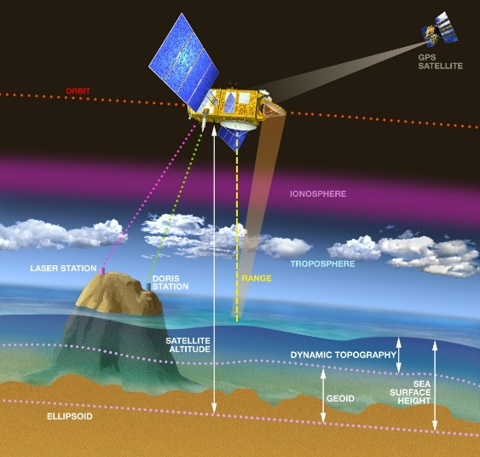
Gridded products from altimetry
https://www.aviso.altimetry.fr/gallery/entry_1_altimetry_principle.html
Absolute Geostrophic Current
Absolute Dynamic Topography

Slide 6
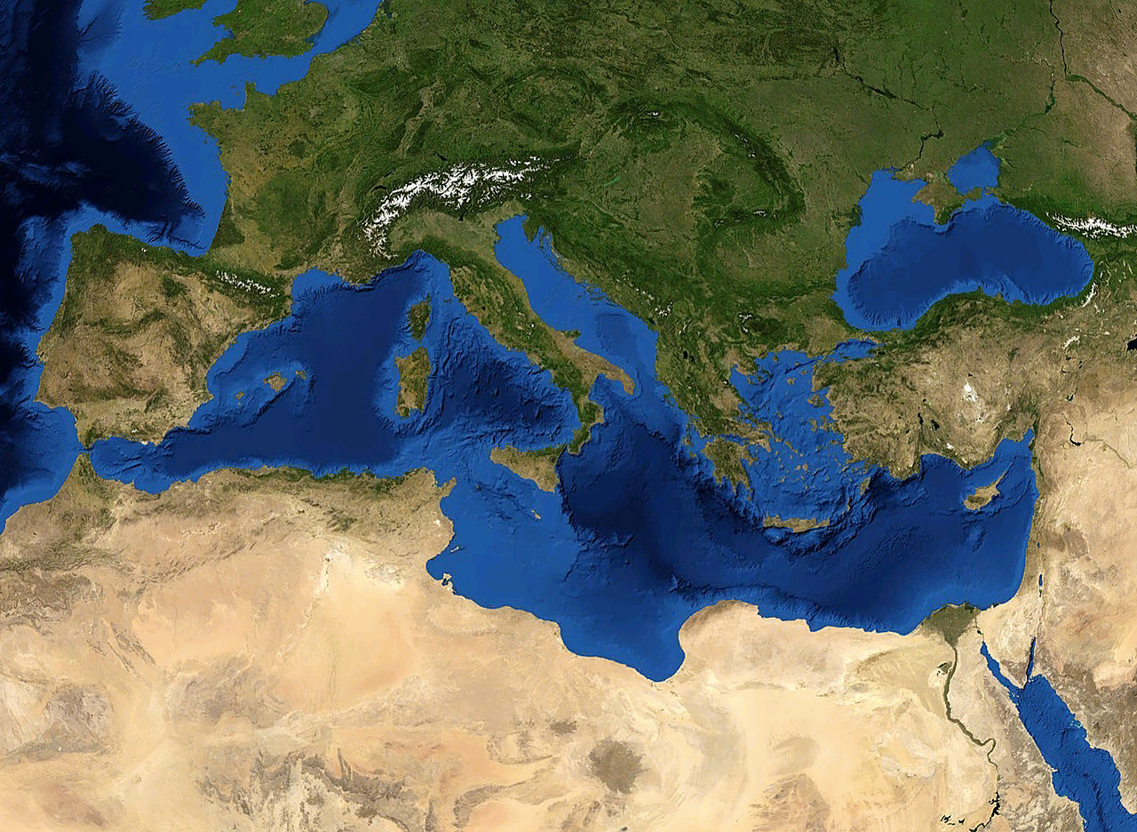
Study Area
Mediterranean Sea
Lat_Max : 48ºN
Lat_Min: 29ºN
Lon_Max: 42º E
Lon_Min: -6º W

Slide 7
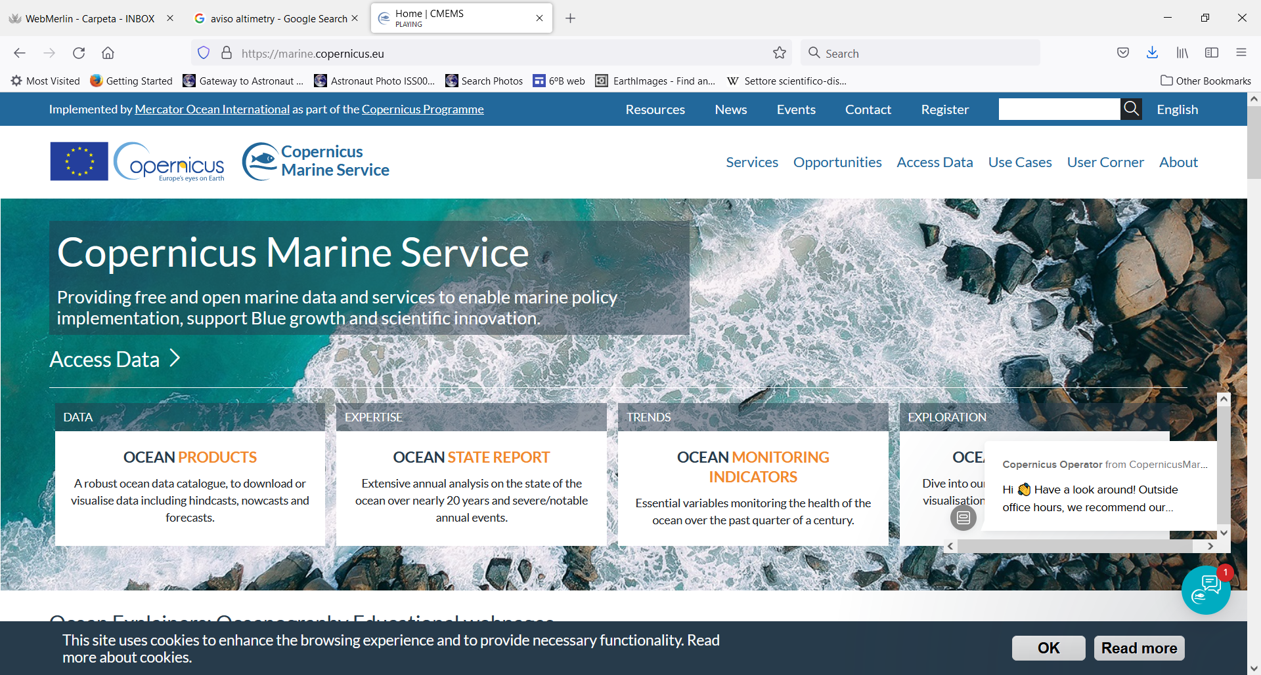
Data Source
https://marine.copernicus.eu/

Slide 8
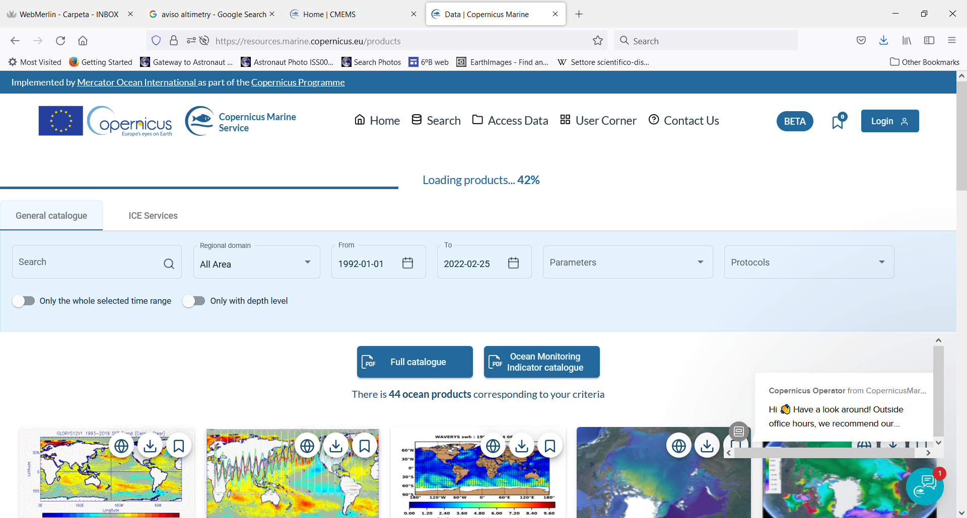
Data Source
European Seas Gridded L4 Sea Surface Heights and derived variables
Spatial resolution: 0.125º x 0.125º
Data frequency: daily and/or monthly.
You need to be registered.
Time period of analysis:
Jan. 1993 to Dec. 2020

Slide 9
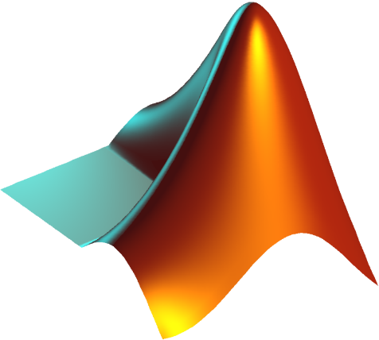
Software
Basic statistical analysis of the data: estimation of monthly and seasonal means, trends.
Basic plotting tools in Matlab. If needed, other tools such as CDO or ncview will be used.
MATLAB
Find and download data from data providers.
Read the NetCDF file format.
Apply basic statistical spatial/temporal analysis to large data sets.
Use basic plotting tools for a better comprehensive view of satellite data.
Derive, plot and interpret oceanographic features in the study area.

Slide 10
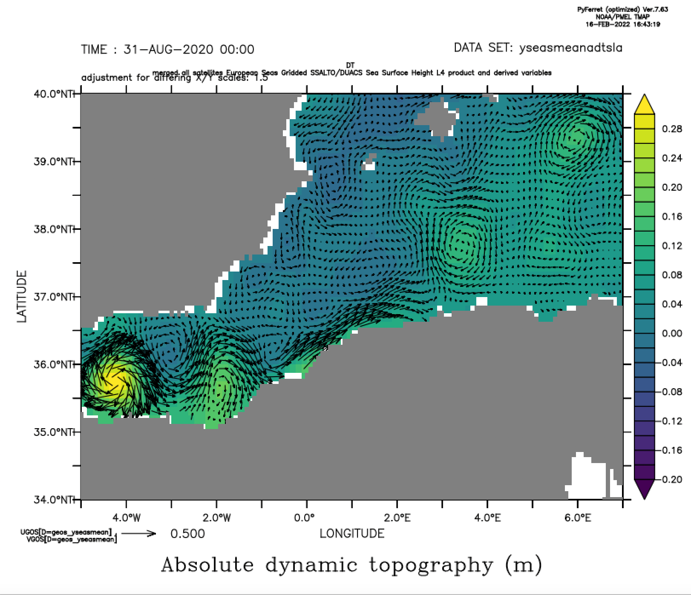
Software
Summer average of the absolute geostrophic current using the whole time period. Alboran Sea.

Slide 11
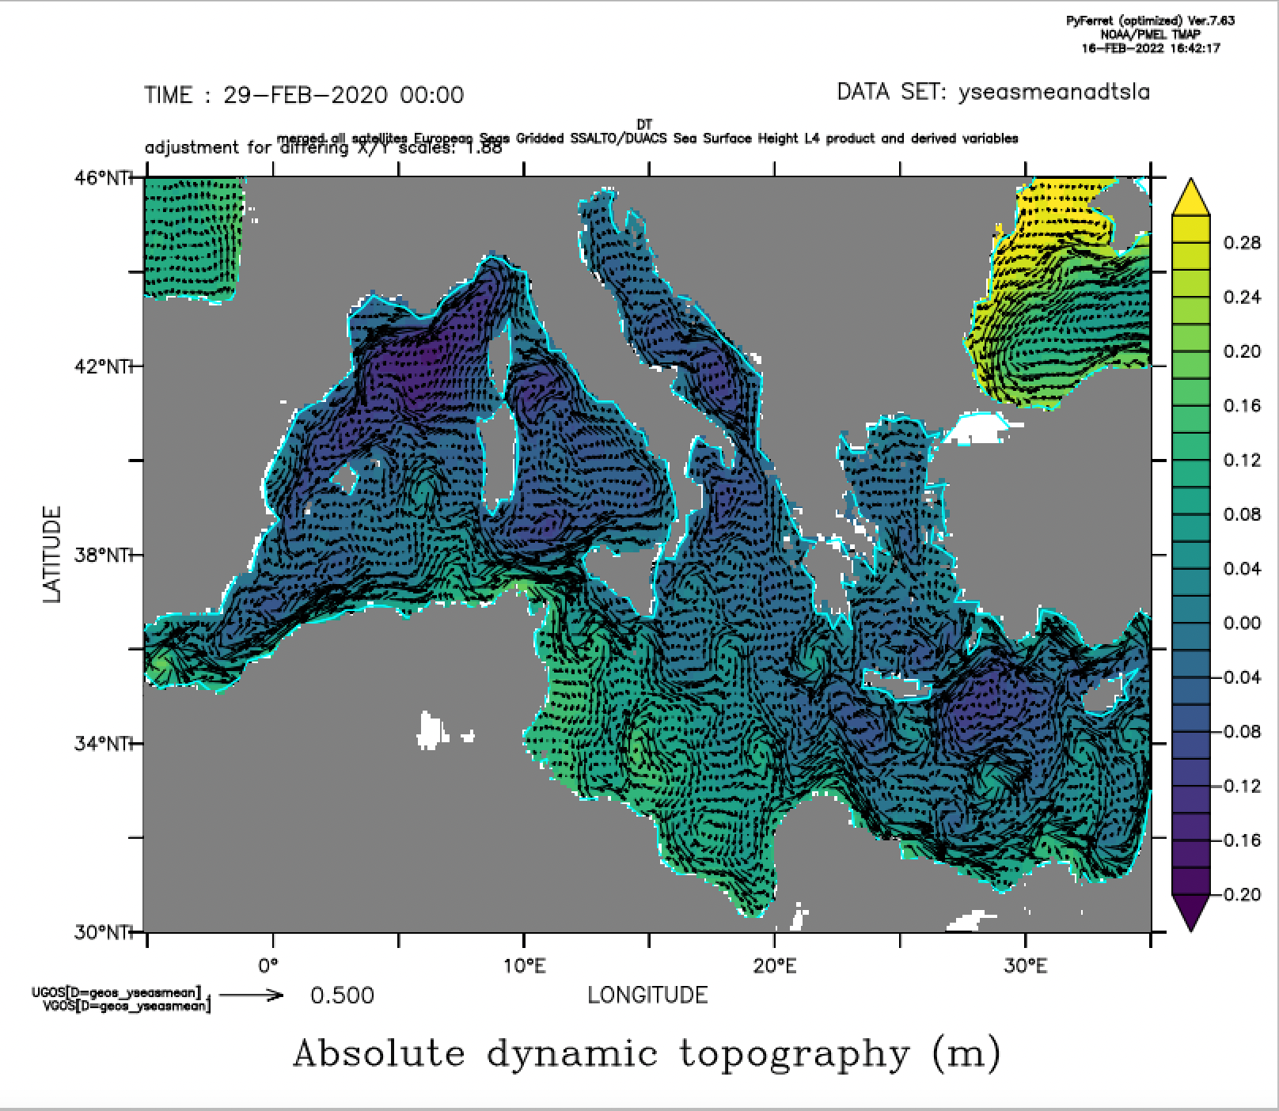
Software
Winter average of the absolute geostrophic current using the whole time period. Western Mediterranean Sea.

Slide 12
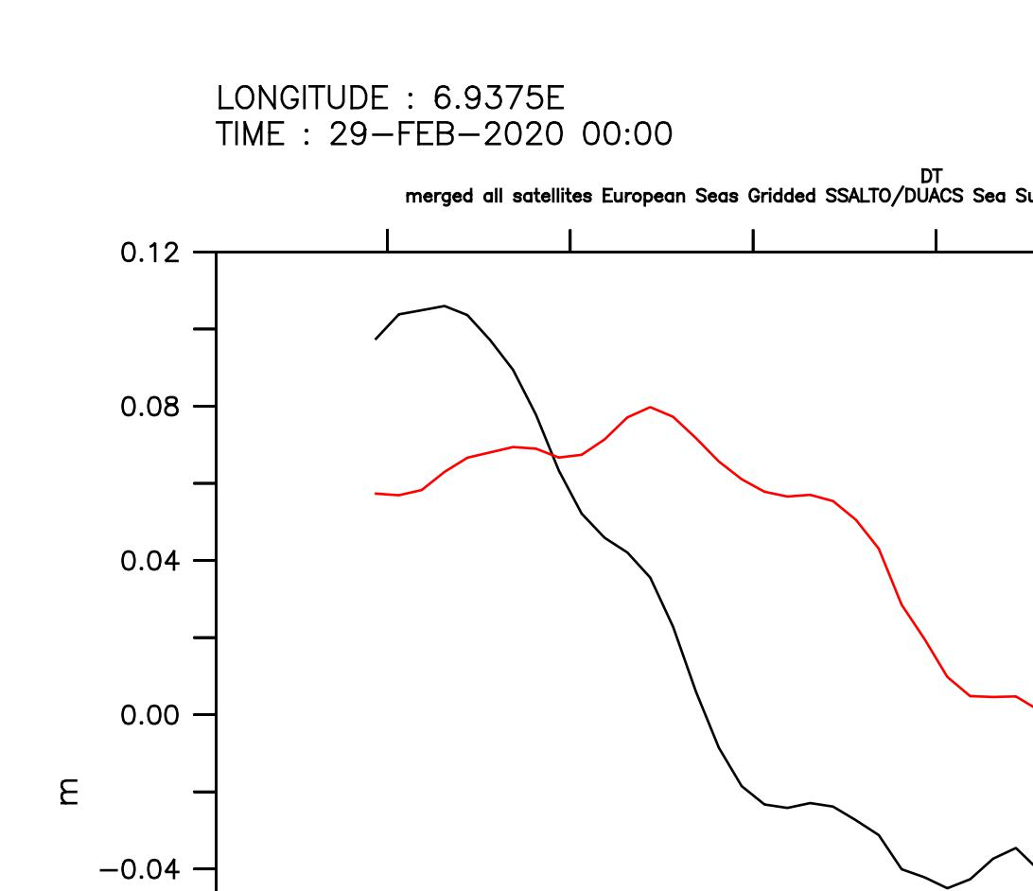
Software
summer
winter

Slide 13
Tasks
Data selection and downloading: Absolute Dynamic Topography and Absolute Surface Geostrophic Current.
Statistical analysis: Computation of monthly means, climatology, etc.
Data plotting and interpretation.

Slide 14
Thanks...
Questions?

