Slide 1
Introduction to FAIR Guiding Principles for scientific data management and stewardship
Jelle Rondelez
Project Manager – Datacenter VLIZ

Slide 2
VLIZ Marine Data Centre (VMDC)
- Operational since 2000
- Presently 22 staff members
Accreditted and certified as International (oceanographic) Data Centre
Teams | Specialization
Geospatial Data & Products | Management of local and international spatial data products
MarineLife+ | Management of the World Register of Marine Species & cooperation in related projects
Open Science | Ensure innovations and implementations towards FAIR and Open Science
Local Services & Projects | Providing data services and data management to all user groups and within projects on the BPNS and Scheldt Estuary
Notes:
Explain role in vliz
Explain datacenter

Slide 3
VLIZ Marine Data Centre (VMDC)
Our Infrastructure
Our Activities
Applications
Data Capture
From VLIZ systems
From external data providers
For project purposes
Scientific
Data
Provider
Download & visualisation tools
Analytical software
Workflow models
(R, Pyton, ..)
Data Products
Web services
Data Processing and Management
Data storage
Quality control
Provide (meta-)metadata
Data systems
Archives
Data
Catalogues
Standards & vocabularies
Thematic databases
ICT infrastructure
Data publication and distribution
Produce products
Maintenance of portals
Flows to external data systems
Scientific
Data
User
Networking
Storage & computing resources
Security, performance monitoring & intervention
Notes:
- Explain datacenter activities and resources

Slide 4
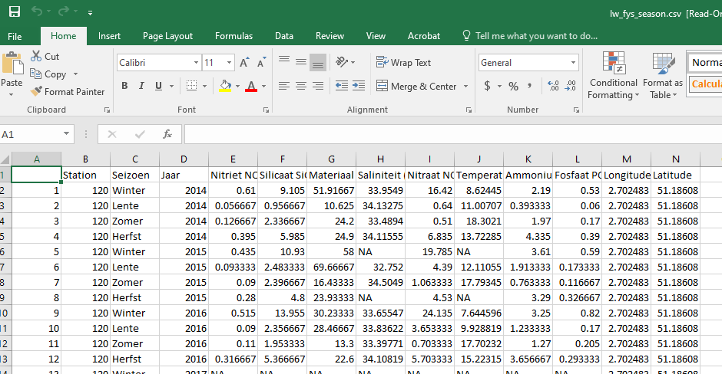
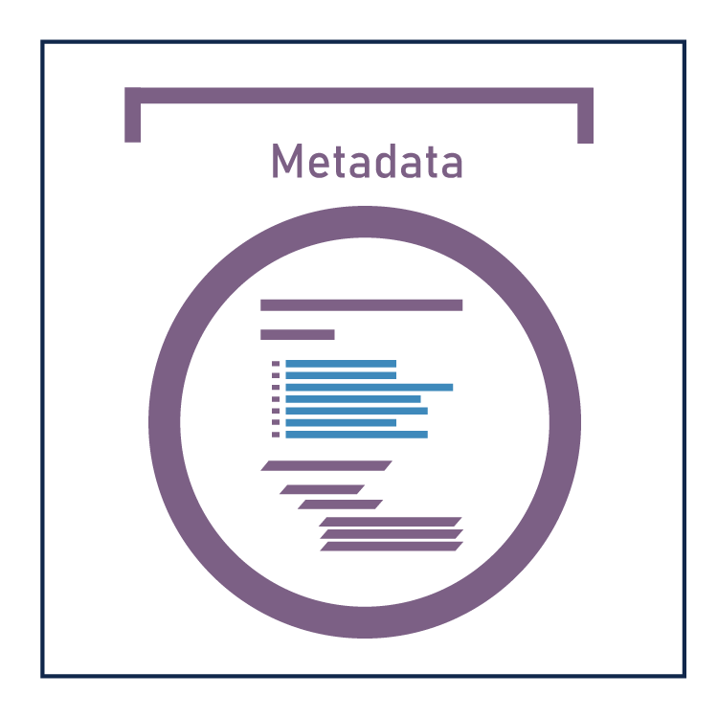
Data from monitoring
Raw data in database
Data cleaning
Clean data
Processing software
Add metadata
Define license
Data product online
Notes:
Explain example of data stream and activities

Slide 5
Data management cycle
Scientific question
6. Data dissemination
1. Data collection
2. Data analysis
5. Data integration
4. Data Archiving and Publication
3. Dataset Description
Notes:
Explain common cycle
Explain cycle evolution with arrows

Slide 6
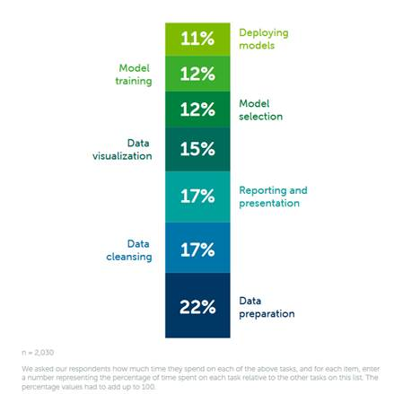
Source: The Anaconda 2021 state of data science report
Notes:
- Highlight time spent on data preparation and data cleansing (versus the ‘fun’ part)

Slide 7
Notes:
- Highlight challenges in relation to the FAIR principles

Slide 8
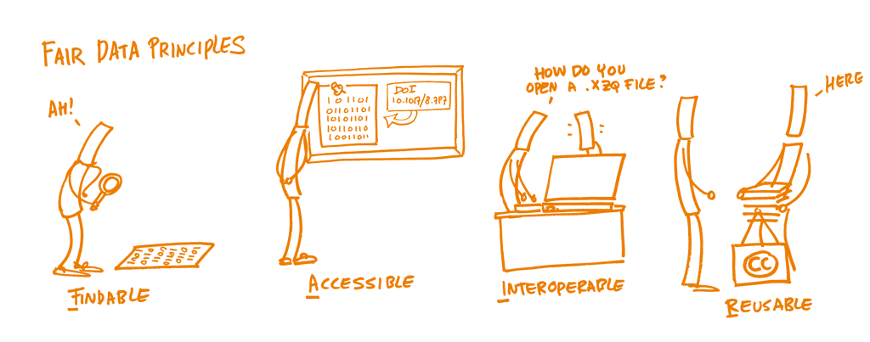
Principles published in 2016:
“The FAIR Guiding Principles for scientific data management and stewardship”
https://www.go-fair.org/fair-principles/
Notes:
Explain fair principles:
“The principles emphasise machine-actionability (i.e., the capacity of computational systems to find, access, interoperate, and reuse data with none or minimal human intervention) because humans increasingly rely on computational support to deal with data as a result of the increase in volume, complexity, and creation speed of data.”

Slide 9
FAIR principles
F1. (Meta)data are assigned a globally unique and persistent identifier
F2. Data are described with rich metadata
F3. Metadata clearly and explicitly include the identifier of the data they describe
F4. (Meta)data are registered or indexed in a searchable resource
Notes:
Findable – the data owner should archive their raw and/or processed data in a community data repository, and create a full metadata record for those data in a publicly-accessible data catalogue (usually this catalogue is part of the repository). The archive and catalogue system must ensure that the (meta)data receive a unique and persistent identifier so they can always be found.

Slide 10
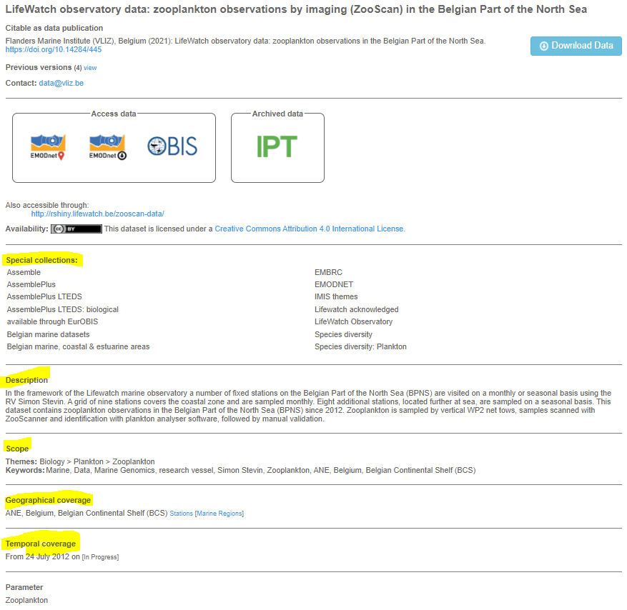
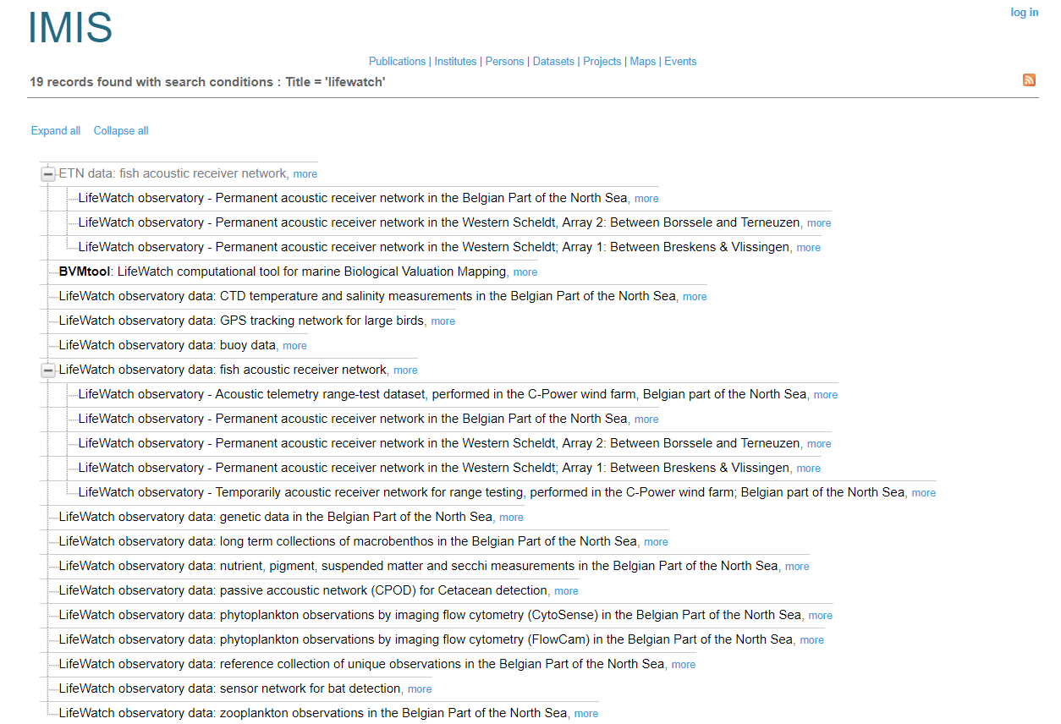
FAIR - Findable
http://www.vliz.be/imis?module=dataset&dasid=4687
Notes:
Highlight example out of imis

Slide 11
FAIR principles
A1. (Meta)data are retrievable by their identifier using a standardised communications protocol
A1.1 The protocol is open, free, and universally implementable
A1.2 The protocol allows for an authentication and authorisation procedure, where necessary
A2. Metadata are accessible, even when the data are no longer available
Notes:
Accessible – the catalogue system should ensure that the metadata are publically accessible and downloadable at a machine2machine level, and should be accessible even when the data are no longer available.

Slide 12
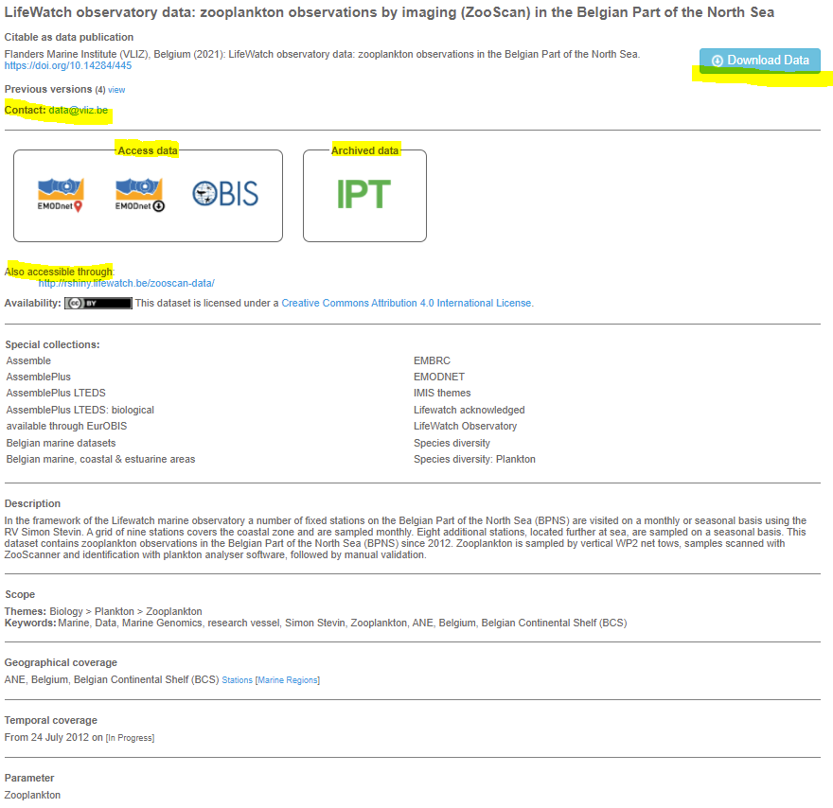
FAIR - Accessible
http://www.vliz.be/imis?module=dataset&dasid=4687
https://doi.org/10.14284/394
Notes:
Highlight example out of IMIS

Slide 13
FAIR principles
I1. (Meta)data use a formal, accessible, shared, and broadly applicable language for knowledge representation.
I2. (Meta)data use vocabularies that follow FAIR principles
I3. (Meta)data include qualified references to other (meta)data
Notes:
Interoperable – the data and metadata should be in a standard format and use standard vocabulary; the responsibility for this is shared between the data owner (to use the standards) and the data archive and catalogue system (to provide the necessary metadata fields and accept the necessary data formats)

Slide 14
FAIR principles
R1. Meta(data) are richly described with a plurality of accurate and relevant attributes
R1.1. (Meta)data are released with a clear and accessible data usage license
R1.2. (Meta)data are associated with detailed provenance
R1.3. (Meta)data meet domain-relevant community standards
Notes:
Reusable – the conditions of reuse should be clearly stated, i.e. the data should have a licence. Provenance metadata must be included in the metadata record, all metadata necessary to be able to reuse the data must be provided. Responsibility for these points is shared between the data archive and catalogue system (to include these metadata fields in their systems) and the data owner (to fill the fields when creating the record).

Slide 15
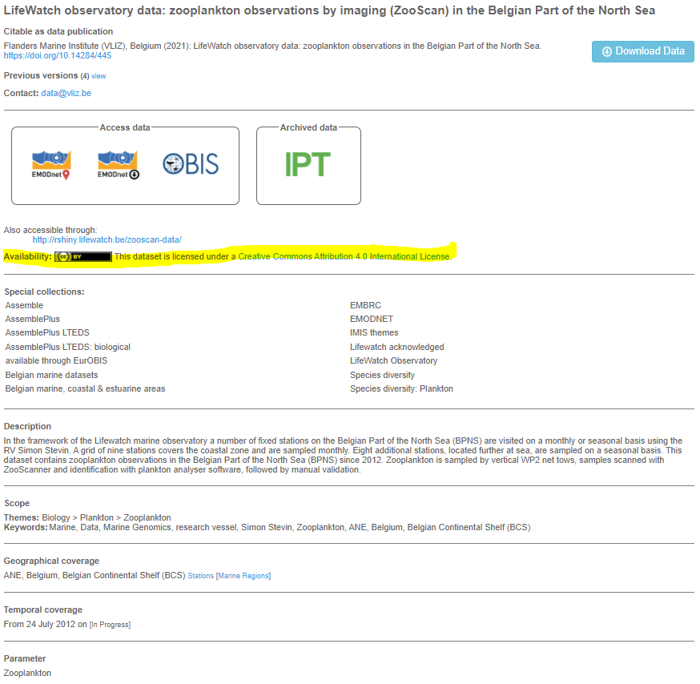
FAIR - Reusable
http://www.vliz.be/imis?module=dataset&dasid=4687
https://doi.org/10.14284/394
Notes:
Highlight example out of IMIS

Slide 16
Open vs FAIR
Open: anyone can access, use and share
Managed Data
FAIR Data
All Research Data
Open Data
Notes:
Explain diagram:
Research data is everything generated
Managed data is what is managed by a data steward/manager
Open data can be freely used, shared
FAIR data doesn’t have to be open data! The two are working towards each other…

Slide 17
How to make it FAIR
data
F
Describe dataset
A
Accessible metadata
I
R
Use open format
Link/describe methodology
Provide means of authentication
Put data in repository
Use standards
Add license
Notes:
Explain certain things to look out for to make data fair again

Slide 18
FAIR benefits
Notes:
Explain benefits, while pointing at the beginning of the presentation

Slide 19
